Slide 1

Monica Koia
Massey University
Enhancing the Māori Health Workforce
Preparing and Supporting Māori to Gain a Tertiary Qualification
Notes:
Mihi
Acknowledge MC
Importance of planning and preparing for tertiary studies

Slide 2

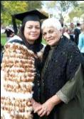
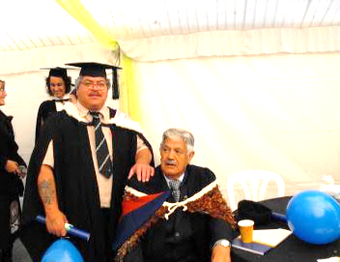
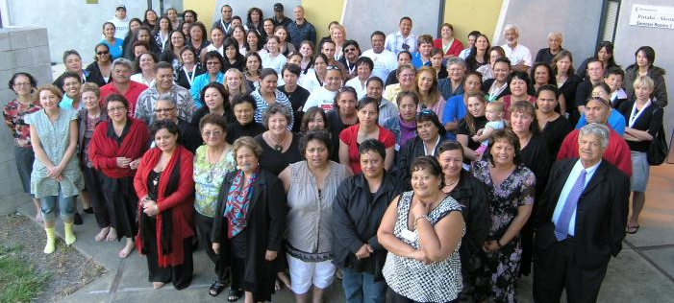
Background
Shortage of Māori employed in health sector
Not many Māori in clinical positions
Very few Māori enrolled in a tertiary health related qualification
1999 Te Rau Puawai Workforce 100 programme established
Photo’s sourced from Te Rau Puawai Ngamoemoea Newsletters and Massey University
Notes:
Few Maori in heath sector, clinical positions and tertiary qualification
Established TRP Maori mental health workforce
Partnership Massey and MOH – support Maori to commence or complete health related qualification
Provides financial, learning and pastoral support
Finance $1000 to $10,000 per year fees, course related cost, travel & research cost
Mix of qualifications (psyc, reha, nursing, maori health, social work, maori)
120 students per year
70% part-time, distance, remainder full time
At least 70% mature students
280 graduates 12 doctorates, 110 masters, 90 degrees, remainder cert/dip under and post
Partnerships dhb, pho, iwi health social services
Governance moh, massey, partnership reps
Staff co-ordinator, 2 f/time tutors, 1 administrator, 4 p/time phone team tutors

Slide 3

What Did I Do
Examined the Te Rau Puawai Programme from 1999 to 2009
  Qualitative study using a kaupapa Māori framework
  Purposeful sample of 6 stakeholders
  Semi structured interviews
  Thematic anlaysis
  Three Major Themes
Tikanga Māori
Multiple Supports
Ensuring Success
Notes:
I wanted to see what made this programme a success So I examined the Te Rau Puawai programme from 1999 to 2009
done a qualitative study ……………….
Preparation and planning under multiple supports, interlinked with tikanga and ensuring success

Slide 4



What do I do?, Which path?,
So many questions
Student?
Whānau?
Qualification?
Fee cost?
Looking after
my whānau?
Papers?
Full or part-time?
Whānau
awareness
Career goals
Internal or distance?
Employer?
Employment?
Leave?
Rosters?
Job Security?
Notes:
I am sure that some of these questions are familiar to us all and its not limited to these queries.
GO THROUGH SO OF THESE
I would like to share a story to illustrate how this programme addressed these questions fulltime study. – Taumata.
Highlight key findings
Part-time study importance of employer, whanau realties, shift work
Importance of planning returning job or return job availability
Qualification relevant to regions need i.e research link to health priorities
What was very prominent in the findings was tikanga Māori and the principles of whanaungatanga and manaakitanga and how much value put on these principles by the staff of TRP. In turn staff have to be competent in tikanga, University processes, and aware of external supports outside of University such as student loans

Slide 5


Te Kawakawa o te Ora
Students
Preparation
Students
Qualifications
Qualifications
Multiple Supports
Financial
Competencies
Leadership
Graduates
Organisational
Infrastructure
Graduates
Educational Service Provider and Key Stakeholders
Tikanga Māori
Kaumātua
Tuakana
Karakia
Teina
Whanau
Whanaungatanga
Aroha
Tautoko
Kanohi -Kitea
Manaakitanga
Notes:
This framework Te Kawakawa o te ora provides a summary not only for the preparation and planning but supporting students and their whanau through their journery.
Roots represent tikanga the foundation and the key to its success
Soil is the partnership i.e funding provider and tertiary provider who provide the nutriates, and opportunity for students to grow and florish.
The trunk is symbolises the support mechanism provided by TRP staff, governance, mentors, funder
Branches are the various supports, leadership, competencies, financial resrouces crucial in student success
Leaves represent the students and thte seeds their qualifications,
As seeds fail new kawakawa plants are estabished representing students expansion into the health sector.
THE IMPORTANCE OF PREPARING AND PLANNING IS
YOU ARE ENROLLED IN THE RIGHT PAPERS, AND QUALIFICATION THAT LEAD TO YOUR LONG TERM CAREER GOALS. OTHERWISE, COULD END UP DOWN THE WRONG PATH, AND HAVE WASTED A LOT OF TIME AND MONEY

Slide 6
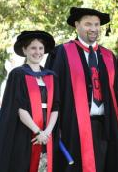



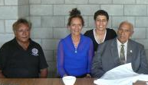
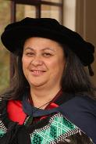
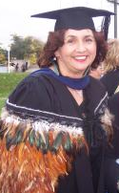

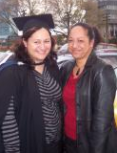
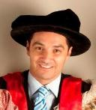
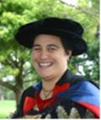

Key Points
Career goals and course planning are vital
Whānau awareness is essential
Employer support is necessary
Competent staff (tikanga, management, university systems)
Te Kawakawa o te Ora framework is transferable and;
Tikanga and the enactment of key principles is what makes this programme unique and successful
Further information can be accessed via http://mro.massey.ac.nz Koia, M. N. (2010). Enhancing Māori mental health workforce: "Te Rau Puawai o te kawakawa o te ora". Master of Management M. Mgt., Massey University, Palmerston North.
Notes:
In summary
Go through key points after tikanga
But requires competent governance, management and staff
No reira

