Slide 1
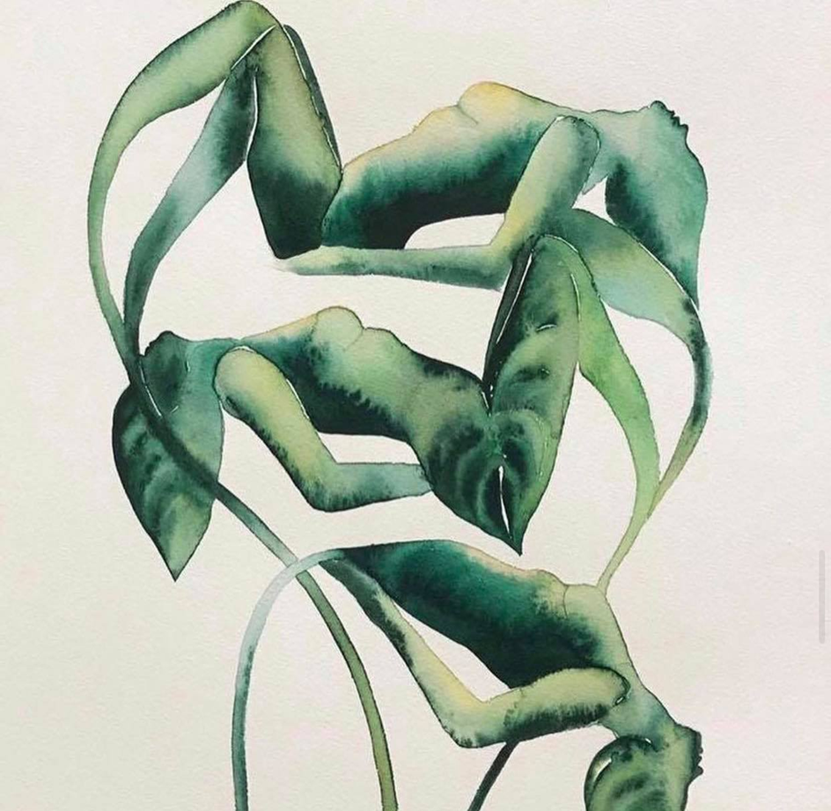
Shifting paradigms – decolonising minds bodies spirits and hearts
with Ksenija Napan,
Associate Professor
Massey University
Aotearoa (New Zealand)

Slide 2
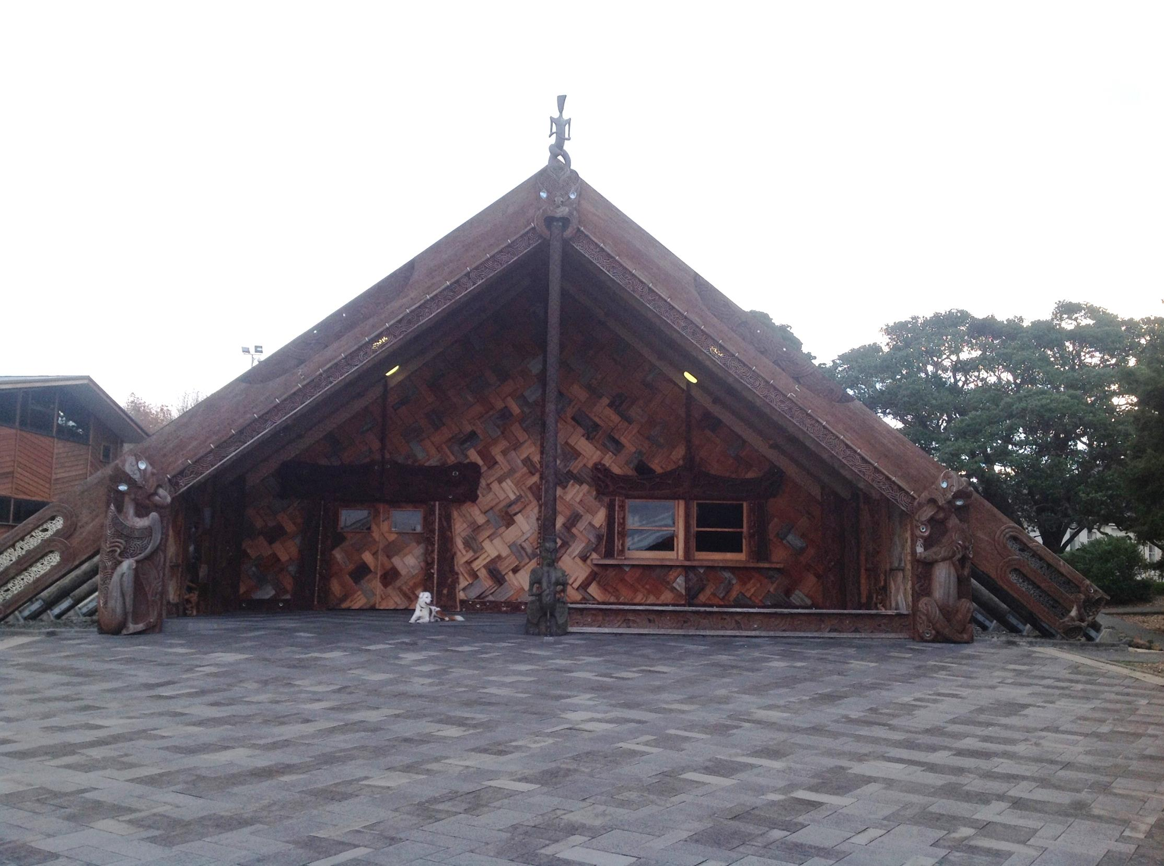
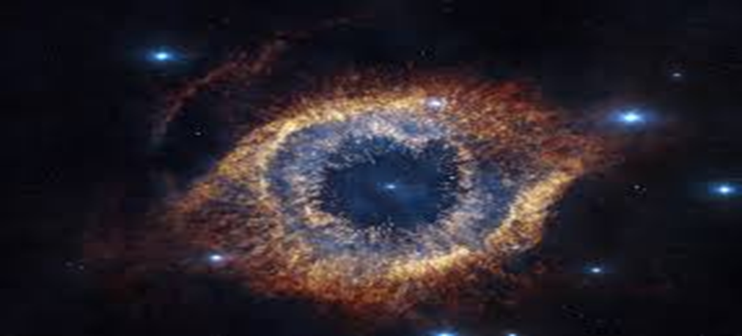

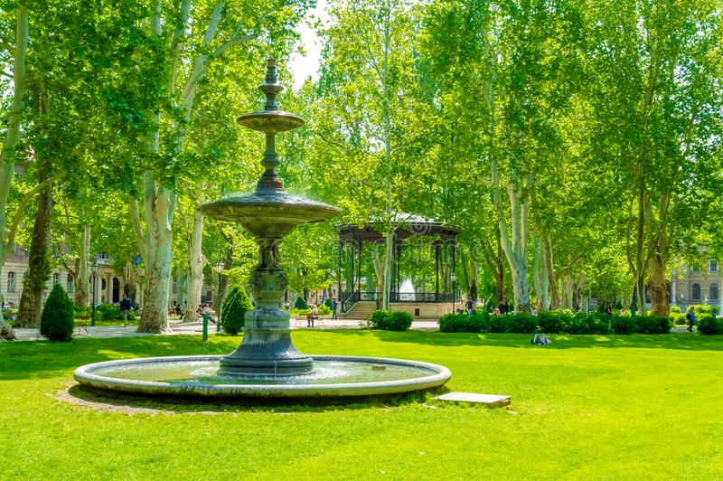
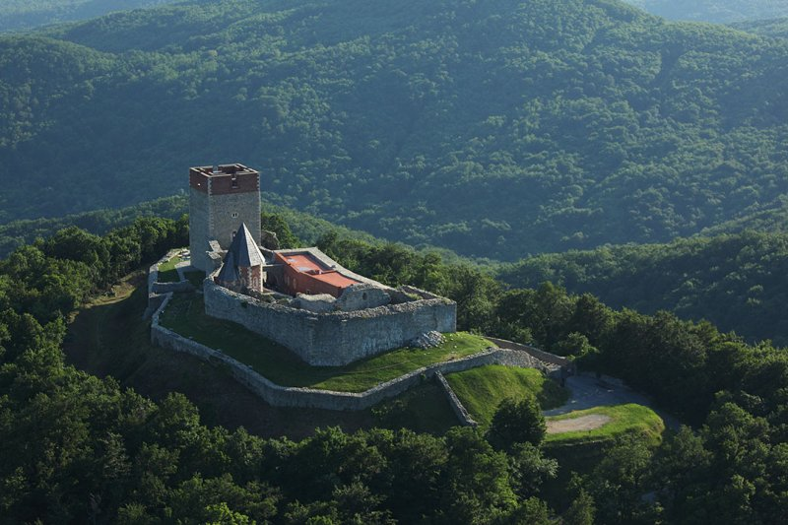
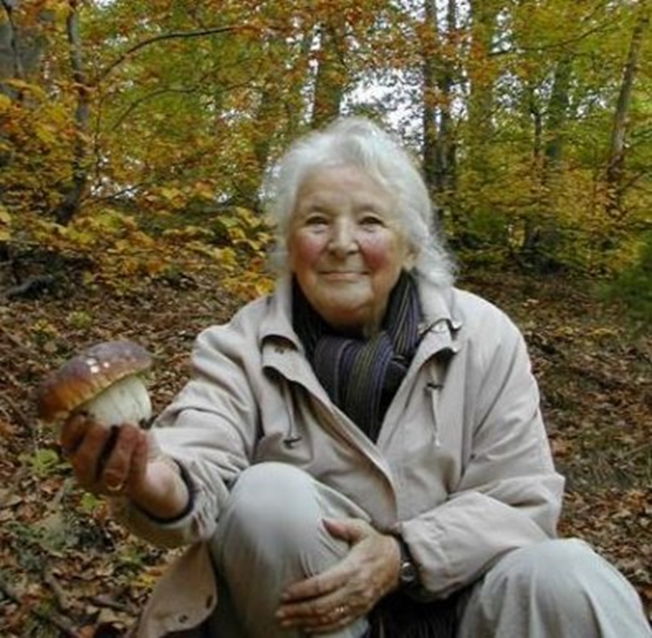
Tēnā kōtou katoa
E rere kau mai te awa nui nei
Mai i te kāhui maunga ki Tangaroa
Ko au te awa
Ko te awa ko au.
The river flows
From the mountains to the sea
I am the river
The river is me.
Ko Medvednica te maunga
Ko Sava te awa
Ko Air New Zealand Boeing 777
te waka
Ko Ngāti Pākehā te iwi
Ko tangata Tararā te hapū
Ko Te Noho Kotahitanaga te marae
Ko Ngākau Māhaki te wharenui
Ko Ksenija Napan tōku ingoa
nō reira, tēnā kōtou, tēnā kōtou tēnā kōtou katoa
Notes:
There is a Maori saying I totally resonate with: 'E rere kau mai te awa nui mai te Kāhui Maunga ki Tangaroa, ko au te awa, ko te awa ko au.' The river flows from the mountain to the sea, I am the river, the river is me.
The river gives to you and you give to the river by keeping it healthy.

Slide 3
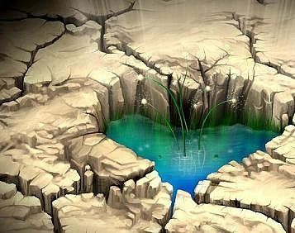
Is a new vision being born from the rubbles of colonized, wounded and exploited world? (or not?)
Can we cocreate a socially just, spiritually respectful and ecologically sustainable world?
Notes:
Stay with this thought for a moment and when ready write down, yes, no or I don’t know.

Slide 4
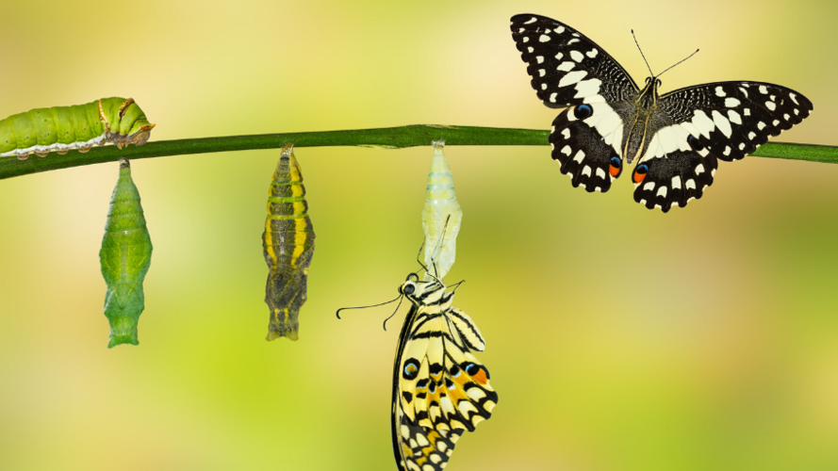
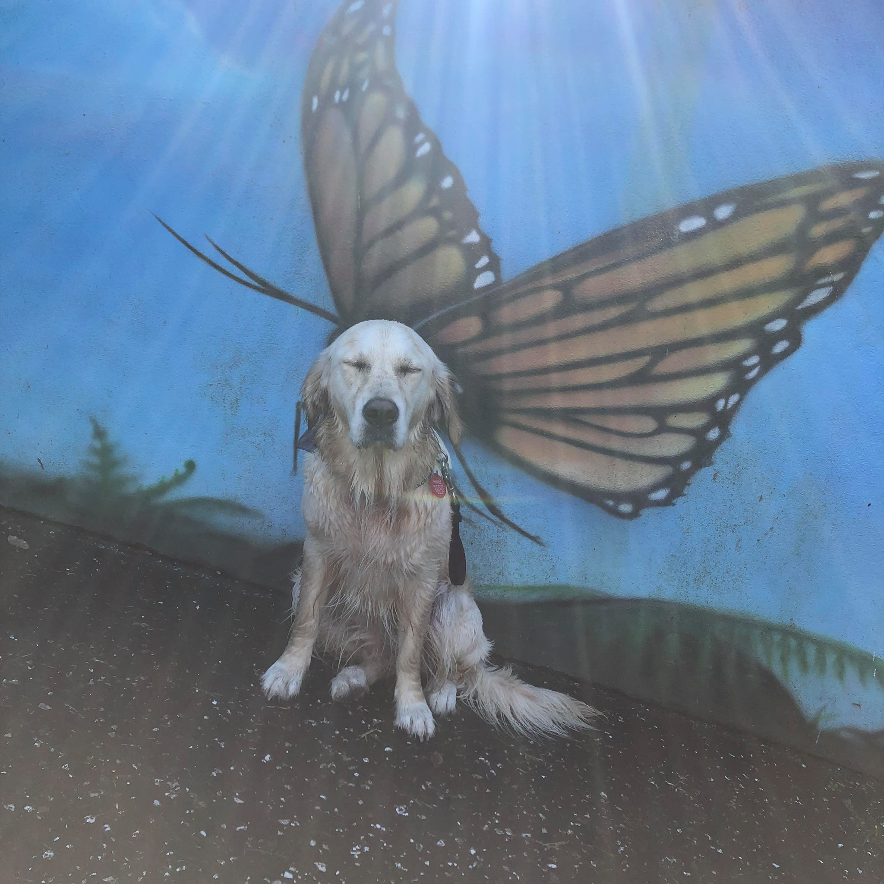
What are the beliefs that we need to change to make it possible?
Notes:
Regardless of your yes, no or I don’t know or any other in-between answer – please take a moment to focus on the second question
The Story of
Imaginal Cells
The term “imaginal” has connotations of imagination, the process of creating new ideas and concepts of things that do not yet exist.
But in biology, the term is applied to imaginal cells – and the startling science behind imaginal cells is where we get our inspiration for the work we do.
We all grew up knowing a bit about the metamorphosis of a caterpillar into a butterfly. The truly amazing part of this process, however, is in the scientific detail of how it actually happens in nature.
After a period of ravenous consumption, a caterpillar finds an appropriate perch and forms a chrysalis – so far so good. The end result, we know, is a butterfly, but the truly astonishing thing is that there is no structural similarity at all between a caterpillar and a butterfly.
Inside the chrysalis the caterpillar, unable to move, actually dissolves into organic goop. Cells, which had been dormant in the caterpillar and which biologists have the poetic genius to call “imaginal cells,” begin a process of creating a new form and structure.
At first these imaginal cells – the seeds of future potential, which contain the blueprint of a flying creature—operate independently as single-cell organisms. They are regarded as threats and are attacked by the caterpillar’s immune system. But they persist, multiply, and connect with each other. The imaginal cells form clusters and clumps, begin resonating at the same frequency and passing information back and forth until they hit a tipping point. They begin acting not as discrete individual cells but as a multi-cell organism – and a butterfly is born.
We believe that courageous leaders are the imaginal cells within their organizations to help them transform to meet the challenges of our times.
Our life’s work is to find new and more effective ways to help courageous leaders imagine a better future and work with others to make their dreams a reality.
https://www.imaginal-labs.com/about

Slide 5

Nonsense no 1: Man is born into sin, essentially corrupt at the core
Every person in the world has a soul and a heart
Most of us want to love and be loved
We connect with that place of love in our own heart and then we project it outwards
Breath in and out and connect to your heart and soul and feel how it emanates from the core of your being. Everything you think, do and feel comes from that core
Let us take a moment now to open to the heart connection we share with all that is
Look around and connect with friendly faces in the room or on the screen.
Suspend your judgement and laugh at your cynicism that may have appeared
Notes:
Photo is is from: https://www.momentoflove.org/
Luckily, it is only a man, we still have more than 50% of population who is not!!!! Joke aside, how does this belief make us feel, act, think?

Slide 6
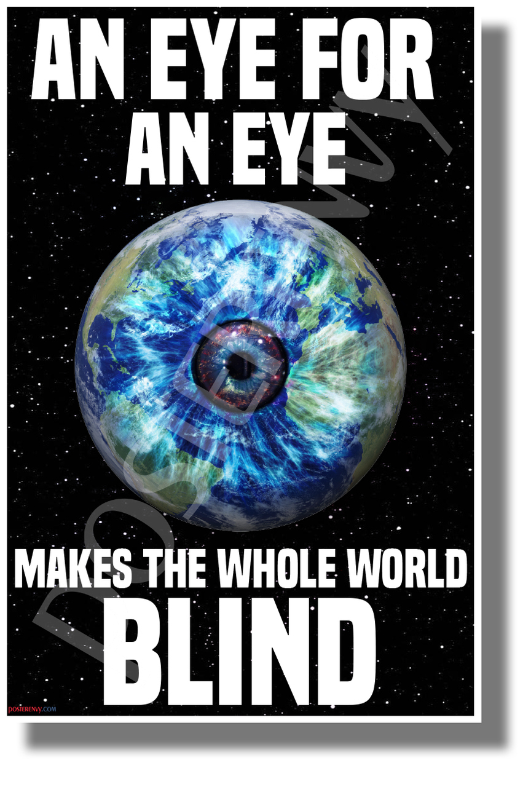
Nonsense 2: Hatred and vengeance are justified for wrongs suffered. An eye for an eye.
Forgiveness is an act of courage and compassion
Eye for an eye makes the whole world blind and blindly polarised
Forgiveness and remorse has a transformative potential
That does not mean tolerating injustice nor putting up with oppression and discrimination!!!!
Notes:
Polarization is good only on sunglasses

Slide 7
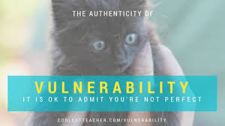
Nonsense 3: Don't show real feelings or you'll get hurt. Create a convincing persona to present to the world.
Welcome authenticity and vulnerability. It's all about being honest and real with each other
Puffed up egos are like soap bubbles
Your authenticity is directly linked with your wellbeing
Sense of coherence
Be you - nobody can do it better
Notes:
https://www.weboflove.org/keystolife#acceptance
Nina Maybe TedX talk:
https://www.ted.com/talks/nina_maybe_radical_vulnerability_choosing_authenticity_as_an_act_of_resistance

Slide 8
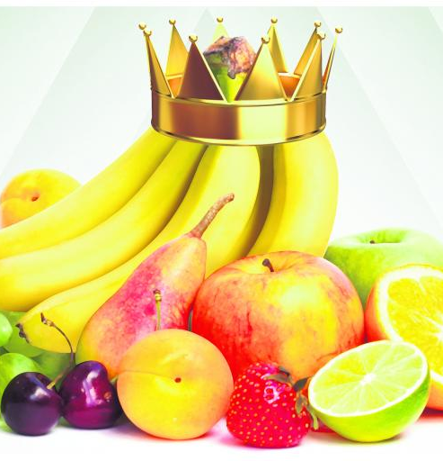
Nonsense 4: Emphasise on imaginary hierarchies and focus on competition so that the best rise to the top
Crown or not, you are still a bunch of bananas!
Emphasis on equity and fairness is lifegiving
Focus on cooperation in order to support the greatest good for all
Reciprocity
Co-creation

Slide 9
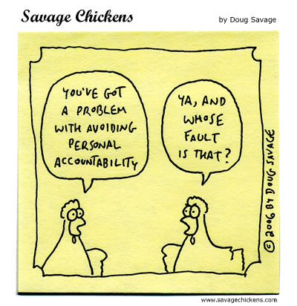
Nonsense 5: Avoid personal responsibility by blaming those above or below in the hierarchy
Take personal responsibility for actions and learn from mistakes

Slide 10
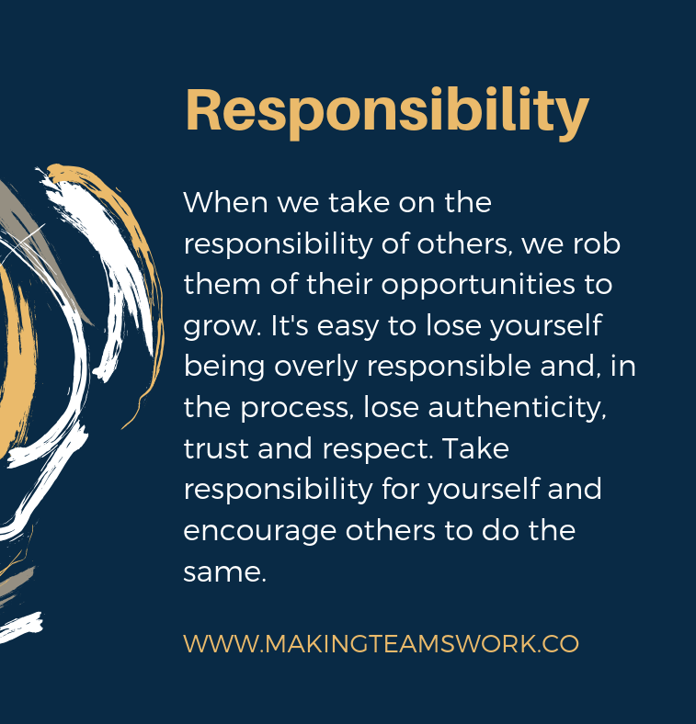
Nonsense 6: People need to be led or controlled by those believed to be better or more capable
Each individual is a powerful creator capable of meeting their needs with the help of others
How can we balance personal responsibility with responsibility for the community effectively?
A sense of belonging … local and global (there is no away…)

Slide 11
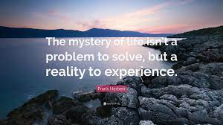
Nonsense 7: The mind and science are supreme (or the imaginary man with a beard rules it all)
The scientific paradigm supersedes the mystery of unknown and unmeasurable and/or religious dogma supersedes scientific work.
Science and spirituality are part of a same whole
Heartless social workers are equally dangerous as mindless ones
The heart and personal relationships are of paramount importance
The deepest essence of life is a mystery to be welcomed and explored with sceptical curiosity
Polarised views prevent a potentially useful discussion and debate as well as new discoveries

Slide 12
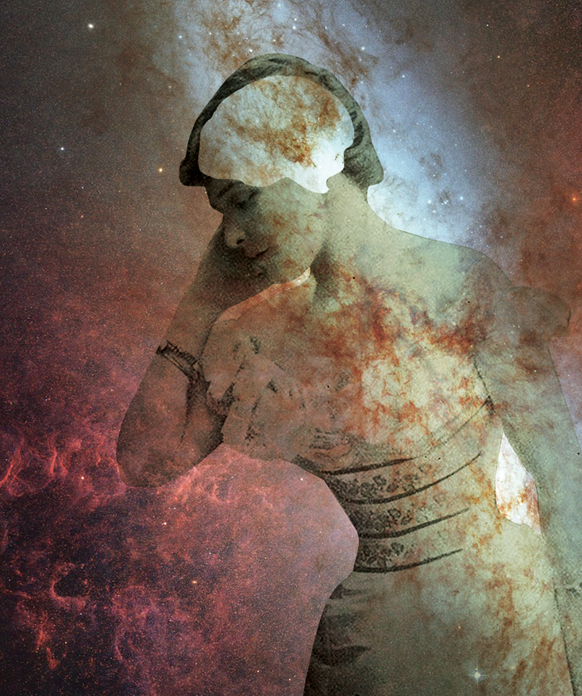
Nonsense 8: Don't question accepted scientific paradigm (or religious dogma) and focus on three-dimensional, five-sensory world
Foster fluid intelligence! It has little to do with IQ or "book" intelligence. It is rather the ability to step outside of our beliefs and consider information which does not fit into our previously accepted view of reality.
Explore the edges of consciousness, especially other dimensions and capabilities not believed to be possible under the old paradigm
The "whole in every part" nature of a hologram provides us with an entirely new way of understanding organization and order. For most of its history, Western science has labored under the bias that the best way to understand a physical phenomenon, whether a frog or an atom, is to dissect it and study its respective parts.
A hologram teaches us that some things in the universe may not lend themselves to this approach. If we try to take apart something constructed holographically, we will not get the pieces of which it is made, we will only get smaller wholes.
Interconnectedness of the universe
https://www.bing.com/videos/search?q=hologram&&view=detail&mid=8E5B8640FD2E23196AB08E5B8640FD2E23196AB0&&FORM=VRDGAR&ru=%2Fvideos%2Fsearch%3Fq%3Dhologram%26FORM%3DHDRSC3
Notes:
https://www.personalgrowthcourses.net/stories/talbot.universe_hologram - pic
https://www.wanttoknow.info/fluidintelligence - definition
https://nautil.us/issue/50/emergence/the-strange-similarity-of-neuron-and-galaxy-networks (image)

Slide 13
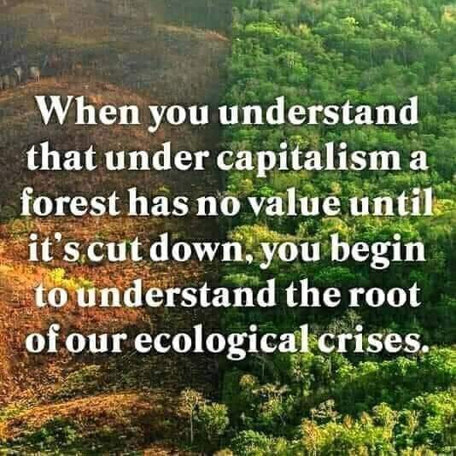
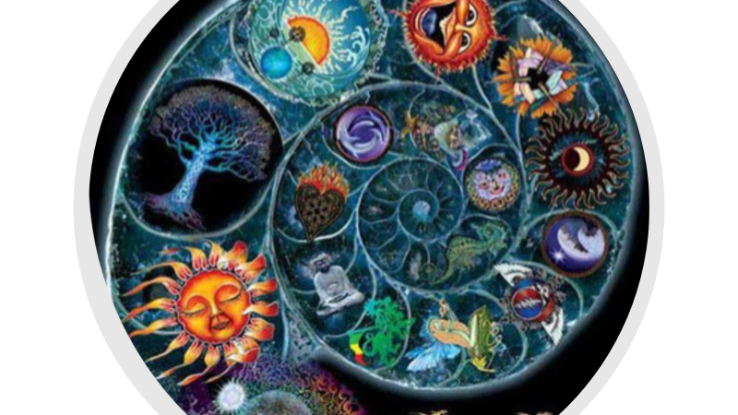
Nonsense 9: Categorizing and dissecting nature allows us to better control it and to profit from it
Recognizing the interrelatedness of all life leads to greater growth and harmony

Slide 14
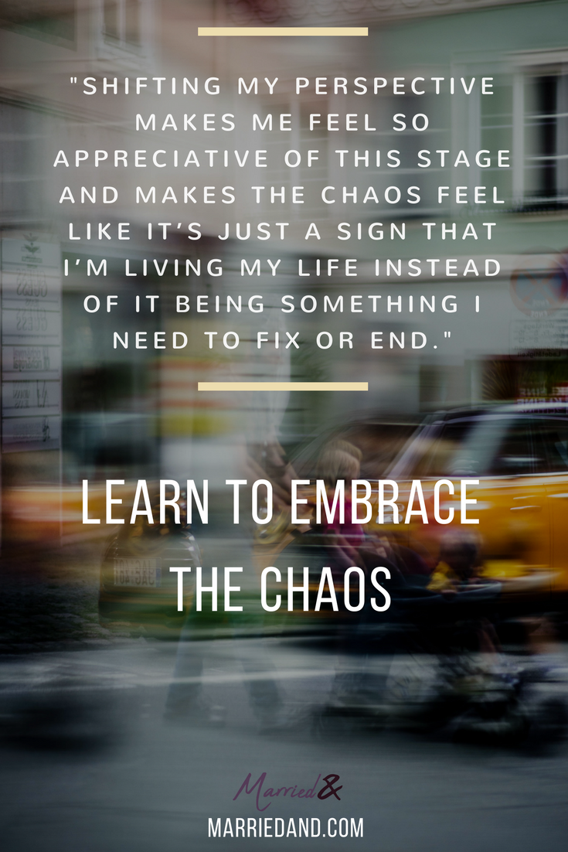
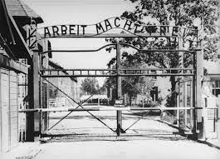

Nonsense 10: Focus on order and discipline - Ordnung und disziplin, Arbeit Macht Frei
Welcome flexibility and the occasional chaos and disorder as means to see new possibilities! HAVE FUN!!!!

Slide 15
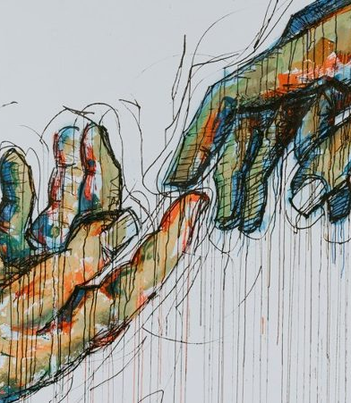
Nonsense 11: Value boundaries, borders, and divisions (yes - for what purpose?)
These give security, safety, and comfort (yes-to whom?)
Healthy boundaries are VERY important
While respecting and honoring differences, look for shared vision and ways to work together
Blurring professional boundaries with ethics and integrity
Build bridges instead of walls!!!!
Transdisciplinarity
Boundaries between humans, animals, plants and machines
Daring and challenging
Frontiers of science
Science and spirituality united
Take risks in order to grow
Short-term pain can bring long-term gain but also a disaster
Context and purpose are essential!

Slide 16

Nonsense 12: You can't trust anyone
Surrender to and trust the process that is part of the force greater than our egoic selves
Fear of death (regardless of being religious or scientific) blocks creativity and free expression of life
Fear of unknown
Fear of difference(mother of all discriminations)
Fear of indifference (creativity killer)
Illusion of human superiority
Trust – benefit of the hindsight/foresight

Slide 17
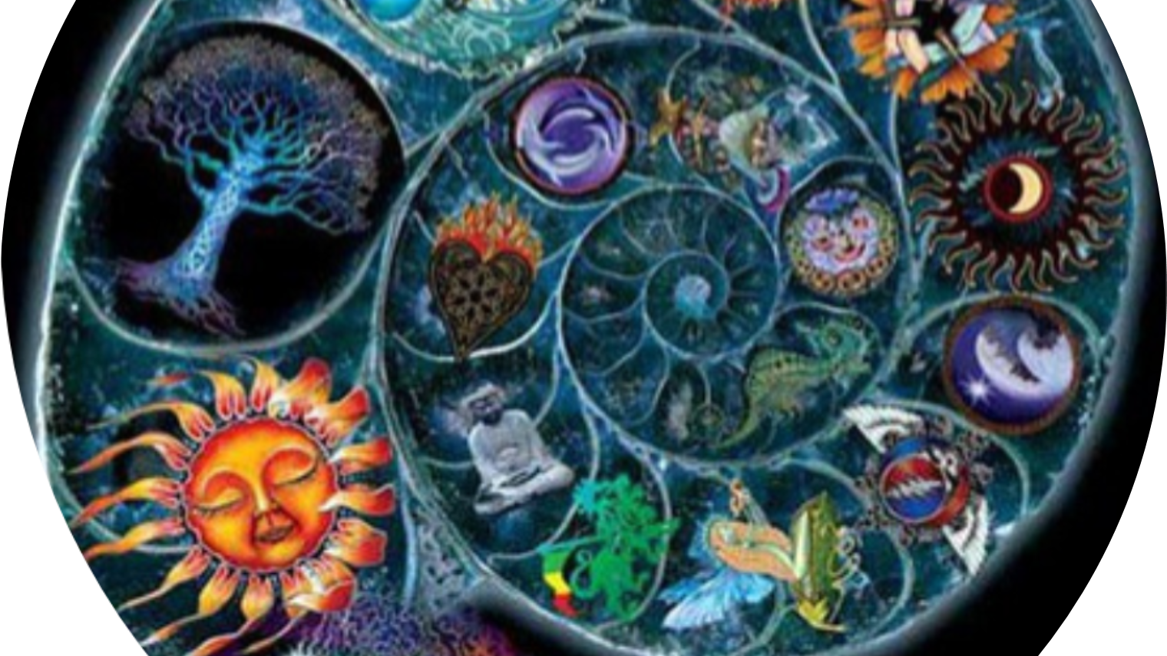
Nonsense 13: Focus on defeating and conquering the enemy, us versus them, wars against “evils”
Committed to transforming and integrating life's challenges. The external reflects the internal. The internal projects on external.
‘And’ instead of ‘but’
Embracing challenges and preventing disasters
Integrating intuition and scientific findings
End the war against the nature and embrace her changes and transformations as we are part of her

Slide 18
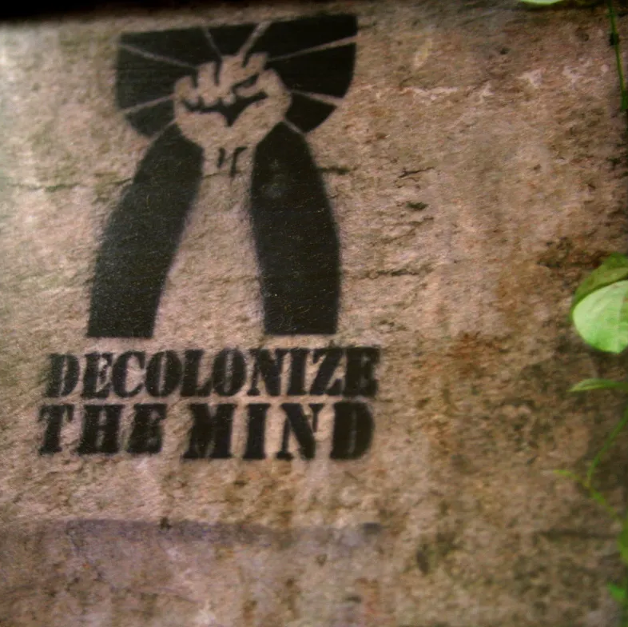
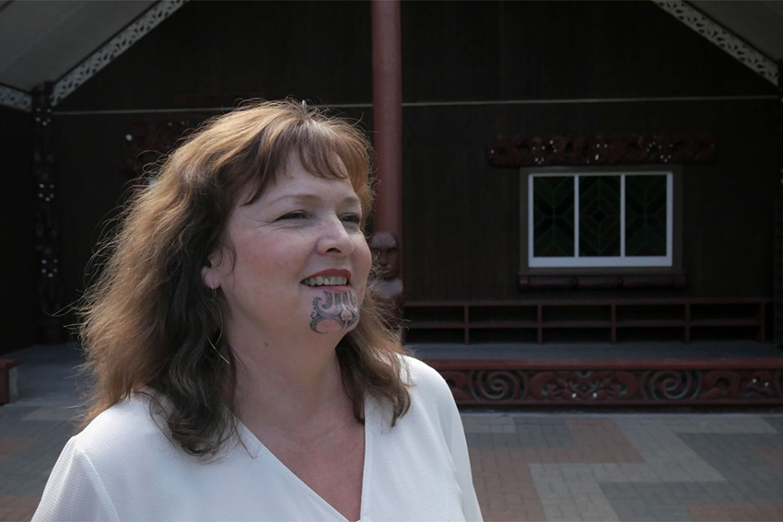
How to decolonize our minds while swimming in the soup of colonization, indoctrination, exploitation and manipulative power?
Notes:
https://news.aut.ac.nz/opinion/how-to-decolonise-a-mind
AUT lecturer Dr Atakohu Middleton.
raised with Pākehā values only. It never occurred to me, as a kid, that there were other ways of seeing, being and doing. At that age, you don’t realise the power of socialisation to embed and reinforce the sanctioned narrative.
For me, the decolonisation process started with the rude realisation that the history of Aotearoa we were told at school presented just one side of the story, demonising Māori as it went. But that spurred me to action. So, based on that experience, which took place in the 1990s when I was in my 20s, here are my top tips on how to decolonise a mind.
1: Read accessible, well-written history from a Māori perspective to make up for what we never got at school. The changing waiaro (attitudes) in our country and the new school history curriculum that comes into force next year will remedy the lop-sided story-telling for the next generation. It’s come too late for adults, so we have to take our own decolonisation in hand.
My top books for this are Ka whawhai tonu mātou Struggle without end by Ranginui Walker (Penguin) and Tangata Whenua: An Illustrated History by Atholl Anderson, Judith Binney and Aroha Harris (Bridget Williams Books). Also useful is the bilingual comic book Te Tiriti o Waitangi by Toby Morris, Ross Calman, Mark Derby and Piripi Walker (Life Education E Tū), which is written in a style accessible to pakeke (adults) and rangatahi (young people).
2: Decolonising your mind means a lot of unlearning as well as learning. Unlearning the idea that the narrative I had been brought up with was the only one (or the only one worth valuing) and learning to balance the world views of my English heritage and my iwitanga. Learning about the construction of identity and realising that while my father identified only with his Pākehā heritage, I was not constrained.
3: Learning to see two ways of being teaches you why some Pākehā really struggle to understand the power of their own socialisation. As journalist, writer and teacher Philip Tremewan wrote in Tu Tangata magazine in 1986, “many Pākehā don’t understand their own conditioning. They’re so monocultural that they don’t realise they have a culture and that the values - are culturally based, not some universal, divinely ordained law.” That, of course, does not excuse racism.
4: Decolonisation means reconsidering entrenched narratives around a whole raft of things, among them gender roles. For example, early visitors to Aotearoa documented the great influence of women in ritual, social and practical affairs. These early observers of Māori life also documented our tāne as tender and forgiving fathers. Missionaries and settlers introduced an ideology of male dominance that undermined the Māori imperative of balance, with the attendant consequences.
5: Decolonising our minds puts us on a path reclaiming our mana and our pride, and the confidence that comes with knowing our own histories make us stronger. As cross-cultural trainer Takawai Murphy says in the book Decolonisation in Aotearoa: Education, research and practice (edited by Jessica Hutchings and Jenny Lee-Morgan, 2016, NZCER Press) decolonisation is about “stripping away the layers of colonial myths that have taught us as a people to dislike ourselves.”
6: Decolonising our minds means sitting with the uncomfortable sensations, memories and emotions that might arise. Anger may well be one of them. I don’t think you can avoid these; I found it useful to unpick my own reactions and came to understand them as part of the decolonisation journey.
It’s also important to avoid beating yourself up for what you didn’t know or didn’t do in the past. Our social systems, policies and laws have, until relatively recently, done a pretty good job of trying to squish us all into a monocultural mould.
7: I am not sure that this business of decolonising one’s mind has an end. There is always something new to learn about our difficult collective history and our identity as individuals and a nation. So go forth and whaowhia te kete mātauranga. Fill your kete with a different type of knowledge.

Slide 19
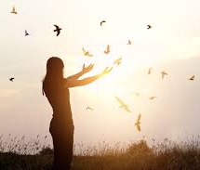
Decolonising means unlearning with your whole being (body-mind-spirit) and community
What history & geography books taught us and what have we learnt by deeper exploration and critical reflection?
Exploring our indigenous and our multiple identities and how were they influenced by culture, power, status, class, gender, appearance, sexuality, ability etc…
Although it is an internal experience it cannot happen in isolation and without an external influence
Diving into questions like – who am I, where do I belong, what are my strengths and challenges, how can I contribute to make our world a better place?
Moana Jackson (2021) calls it the ethic of restoration
As you can see a girl is not liberating birds, she is cherishing and sharing a commonality of a sense of freedom WITH them
Notes:
https:
//phys.org/news/2021-07-shifts-decolonise-ecological-science-field.html

Slide 20
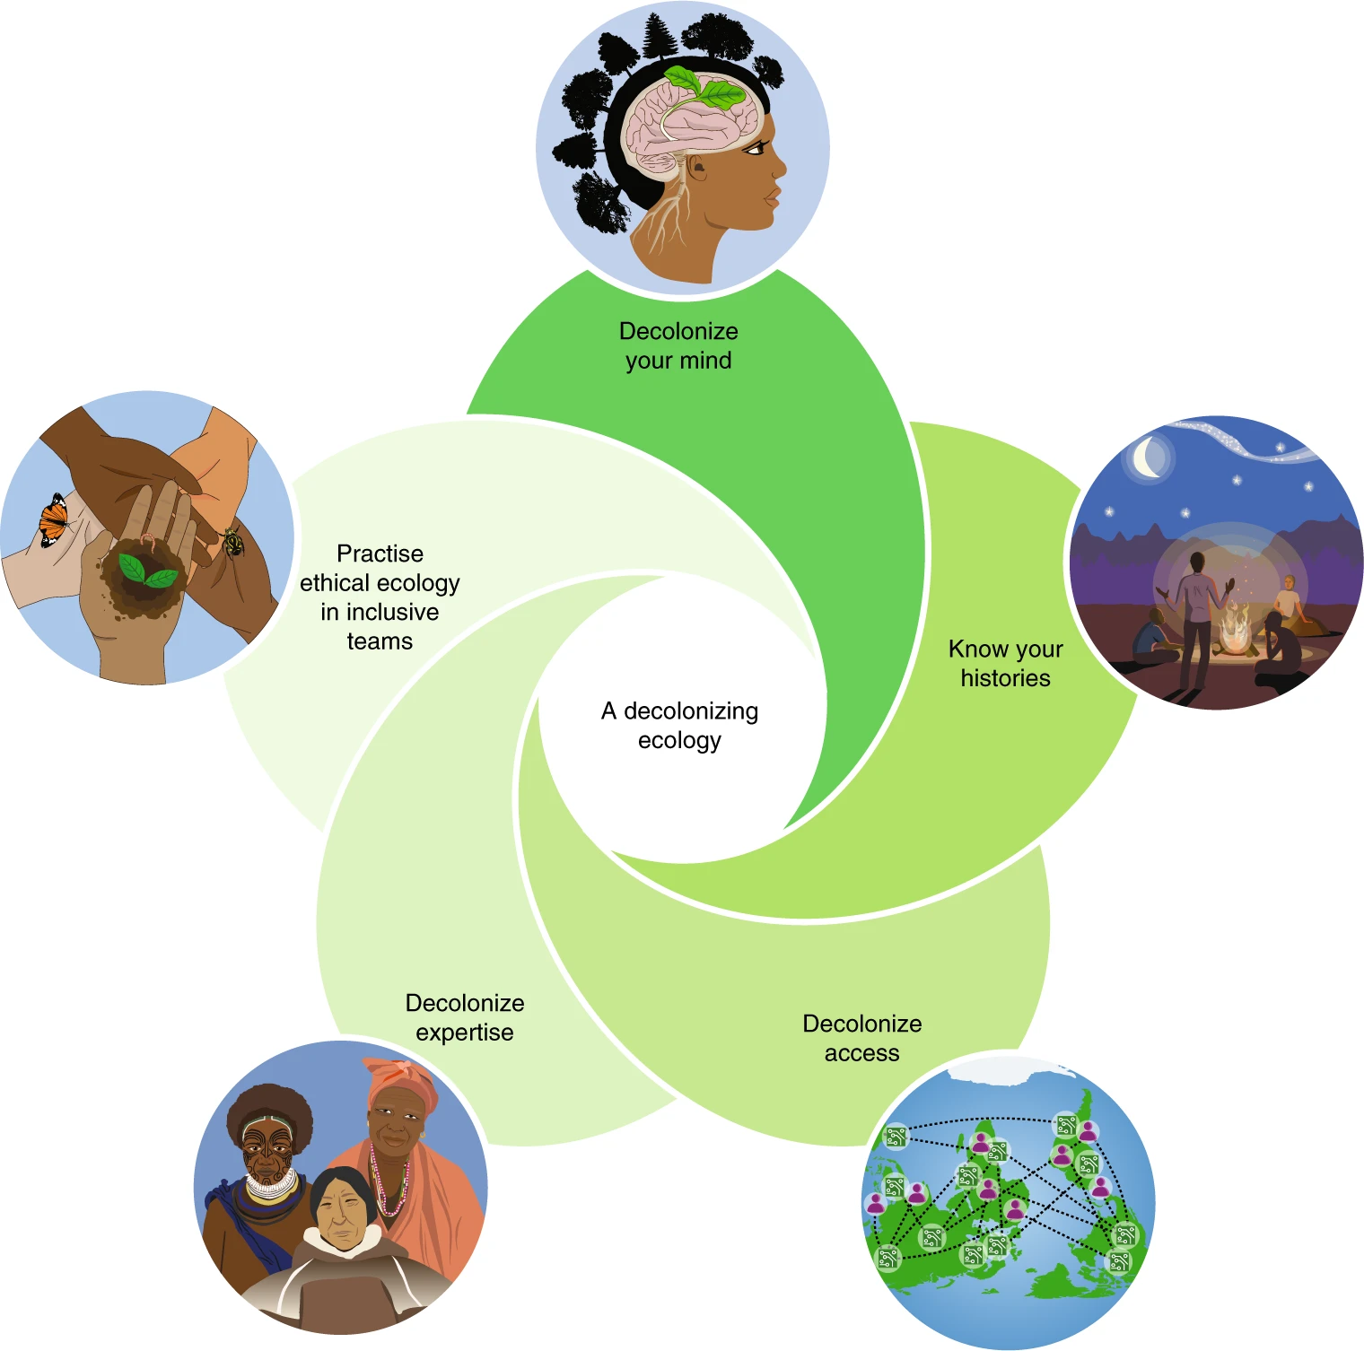
Decolonise everything by ethically restoring life
Trisos, Auerbach & Katti (2021)
Notes:
https://phys.org/news/2021-07-shifts-decolonise-ecological-science-field.html
Cite this article
Trisos, C.H., Auerbach, J. & Katti, M. Decoloniality and anti-oppressive practices for a more ethical ecology. Nat Ecol Evol 5, 1205–1212 (2021). https://doi.org/10.1038/s41559-021-01460-w
Image: https://www.nature.com/articles/s41559-021-01460-w/figures/2 (Keren Cooper)

Slide 21
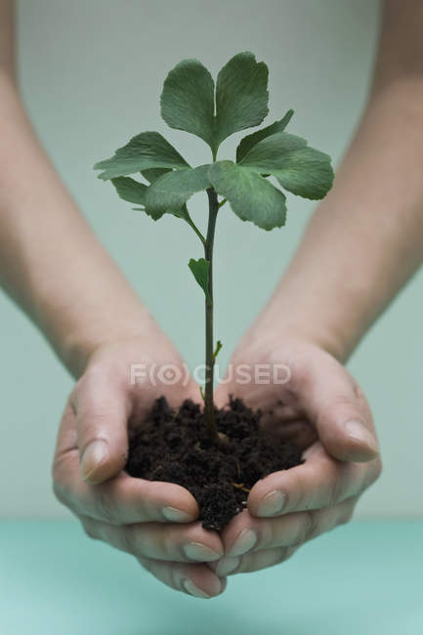
So, how can we change our world?
With our hands only and with a little help from our grandmas if they have not forgotten their indigenous wisdom … if they have, this wisdom is still embedded in your DNA passed on to us for many generations …

Slide 22
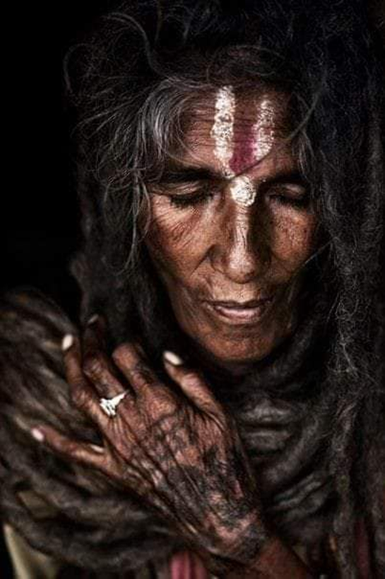
Grandma, how do you deal with pain? by Elena Barnabé
"With your hands, dear. When you do it with your mind, the pain hardens even more.”
“With your hands, Grandma?"
"Yes, yes. Our hands are the antennas of our soul. When you move them by sewing, cooking, painting, touching the earth or sinking it into the earth, they send signals of caring to the deepest part of you and your soul calms down. This way she doesn't have to send pain anymore to show it.“
"Are hands really that important?"
"Yes, my girl. Thinking of babies: they get to know the world thanks to their touches. When you look at the hands of older people, they tell more about their lives than any other part of the body. Everything that is made by hand, so it is said, is made with the heart because it really is like this: hands and heart are connected. Masseuses know this when they touch another person's body with their hands, they create a deep connection. Thinking of lovers: when their hands touch, they love each other in the most sublime way."
"My hands, Grandma . . . how long haven't I used them like that!"
"Move them my girl, start creating with them and everything in you will move. The pain will not pass away. But it will be the best masterpiece. And it won't hurt anymore. Because you managed to embroider your essence."
Notes:
https://eileenadler.com/blog/grandma-how-do-you-deal-with-pain-by-elena-barnabe

Slide 23
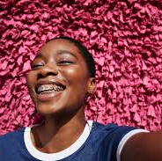

How can we embroider our essence in our social and community working?

Slide 24
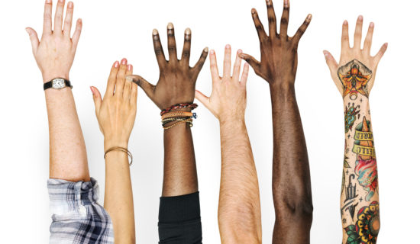
HANDS (a simple embodiment method created to enhance your wellbeing and social working by K.Napan)
Holistic
Affirmative
Natural
Development
System
Can be used for assessment, empowerment, relaxation, connection, exploration, mediation, meditation, work with couples, community development, embodiment, acknowledgement ….

Slide 25
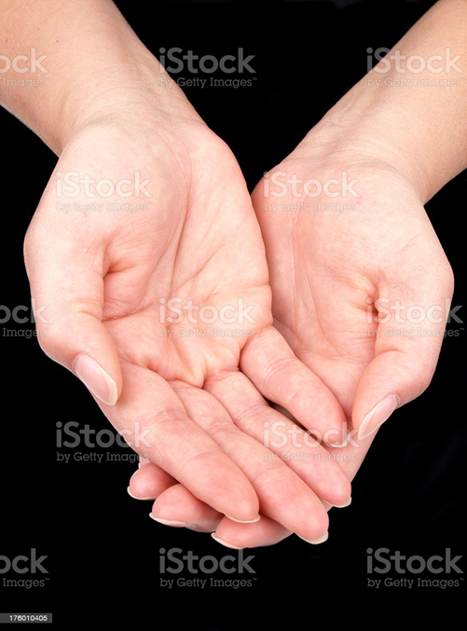
I would like to invite you to gently hold your left hand in your right hand.
Cradle your hand, pay attention to the lines that tell stories of your life.
Be kind to your hand … like it belongs to a best friend or to a loved companion.
Appreciate your left hand, thank it for being there for you either in a leading or supporting role in your life.

Slide 26
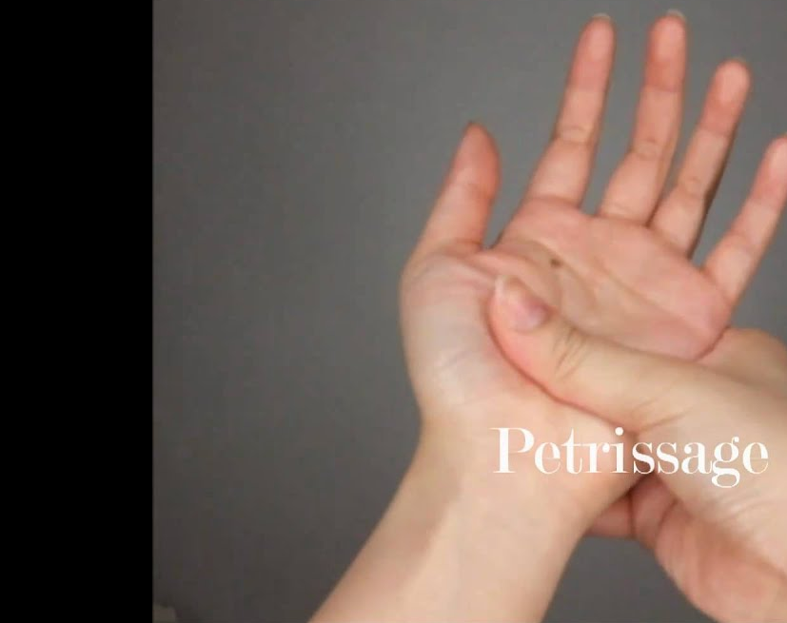
Start by gently massaging your thumb.
It represents your ancestors, the long lineage that enabled you to be a person you are today. These ancestors can be your blood relatives but also significant elders that shaped your ideas, beliefs, ways of being….
They can be real or fictional; teachers or writers, philosophers or influencers
Your thumb represents physical survival, but also, it is an opposing thumb – it enabled you to oppose to ancestral stories that are no longer valid.
It represents a strong drive for survival and necessity of maintaining physical health.
Briefly reflect on long line of beings who contributed to you being a person you are today. Acknowledge them.
If you hold your thumb for 5 mins it can help with anxiety, headaches and migraines.

Slide 27
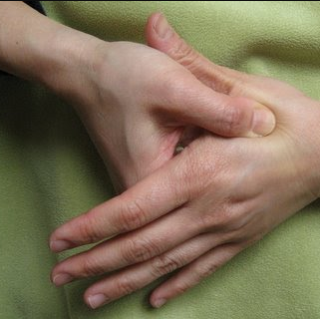
As you are moving from your thumb towards your index finger, there is a spot that will feel tender. Gently massage it for a minute.
This is a point of choice – a point where we accept lifegiving messages from our ancestors and elders and reject prejudices, dogmas, impositions, injunctions, all “should” and “musts” that have been imposed on us over years.

Slide 28
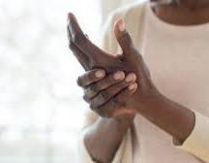
Now please move to your index finger (or fore finger). This finger represents the need for freedom – the freedom from and the freedom to.
Freedom to point out when something is not right or freedom to shake it when you disagree or say ‘no’. It represents the freedom to be you (as nobody can do it better). Holding this finger can help reduce muscle pains and feelings of fear, embarrassment and disappointment.

Slide 29
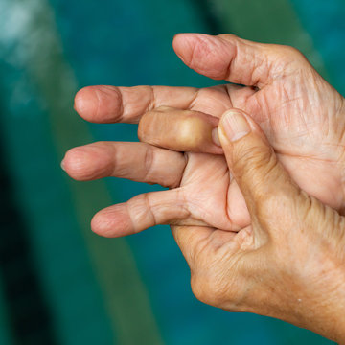
Now, move to your middle finger.
It represents your need for power, potency, competence, strength and influence.
When you are competent in doing something, you often love it. When you love something, you will put a lot of energy in mastering it.
If you are angry or annoyed, you can press this finger and slightly decrease your blood pressure which will increase the sense of being calm.

Slide 30
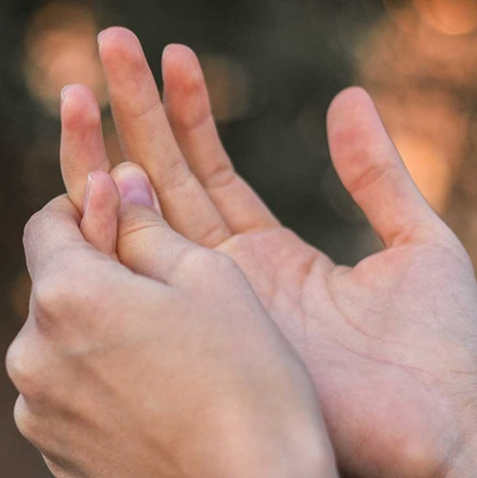
Explore your ring finger.
It represents the basic need for love and belonging; love for activities, nature, people, places.
Reflect on people, activities, companions, colleagues, places and spaces that you love. Hold them in your mind eye being aware that your love you feel for others is about your soul expanding and appreciating difference and uniqueness of every single expression of life on the planet.
Clutching this finger can help with emotions of sadness, longing for someone and massaging it can expand your creativity in expressing love.

Slide 31
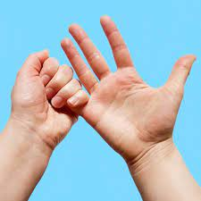
Play with your little finger.
It is about fun and expression of joy.
Fun and learning are closely related. Lightheartedness and playfulness add joy to every endeavour.
If you massage it for 5 minutes it helps boosting self esteem, relieves stress and increases creativity.

Slide 32
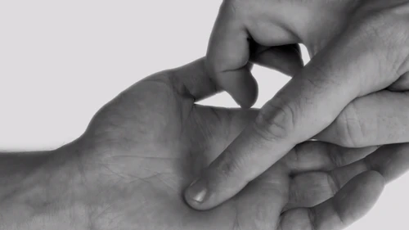
Gently spiral with your right index finger in the middle of your palm. Right in the centre there is a sensitive spot. This spot represents your soul. It radiates and informs everything else. Let it inspire your transformational work in the world.

Slide 33
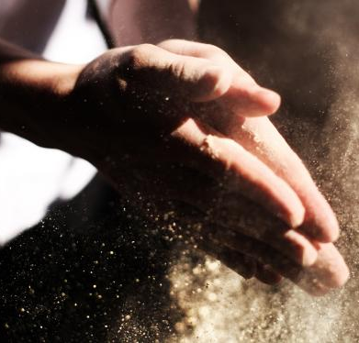
For a closure rub your hands together and thank them for being there for you. Listen to the soothing sound they make.

Slide 34
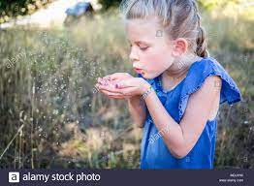
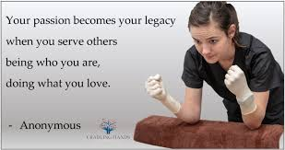
I wish your grandma’s best wishes for you and the world we are all part of get manifested through your hands

Slide 35
References
Trisos, C.H., Auerbach, J. & Katti, M. Decoloniality and anti-oppressive practices for a more ethical ecology. Nat Ecol Evol 5, 1205–1212 (2021). https://doi.org/10.1038/s41559-021-01460-w
Moana Jackson (2021) https://e-tangata.co.nz/comment-and-analysis/moana-jackson-decolonisation-and-the-stories-in-the-land/

