Slide 1
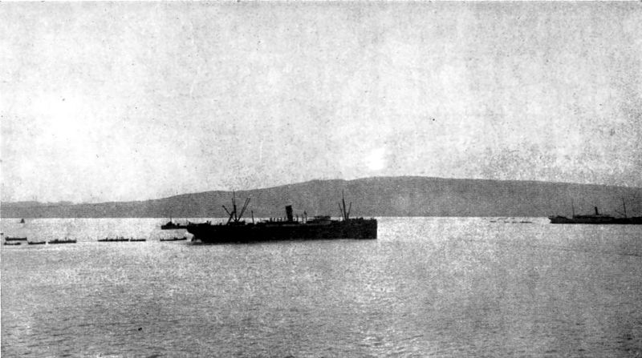
Bully Beef, Biscuits and Scurvy:
The Gallipoli Rations

Slide 2
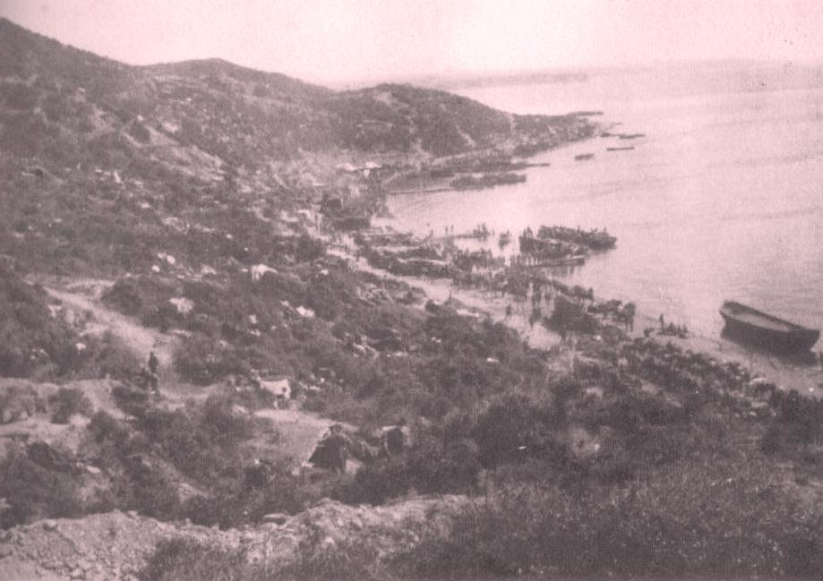
August 1915
Condition of NZ Soldiers
The Gallipoli Rations
Bully Beef and Biscuits
Nutritional Analysis
Complicating Factors
Scurvy at Gallipoli
Conclusions

Slide 3
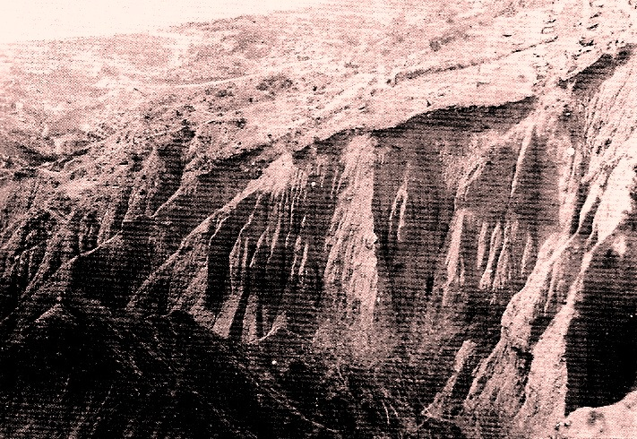
The August Offensive

Slide 4
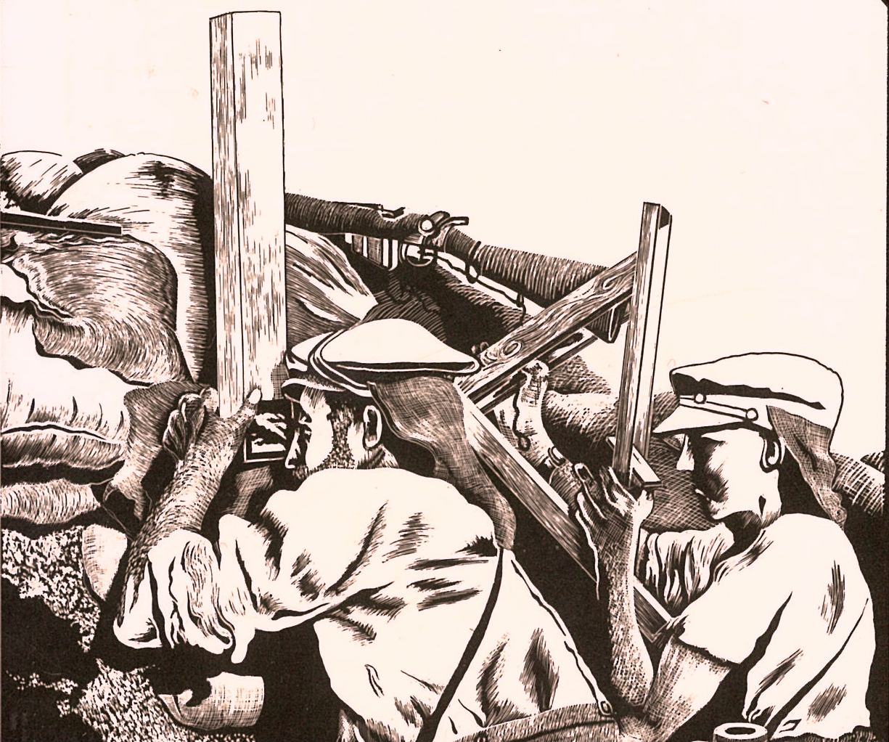
A highly ambitious plan and placed great demands upon the tired troops and weakened staffs of the Anzac Divisions.
Chris Pugsley

Slide 5
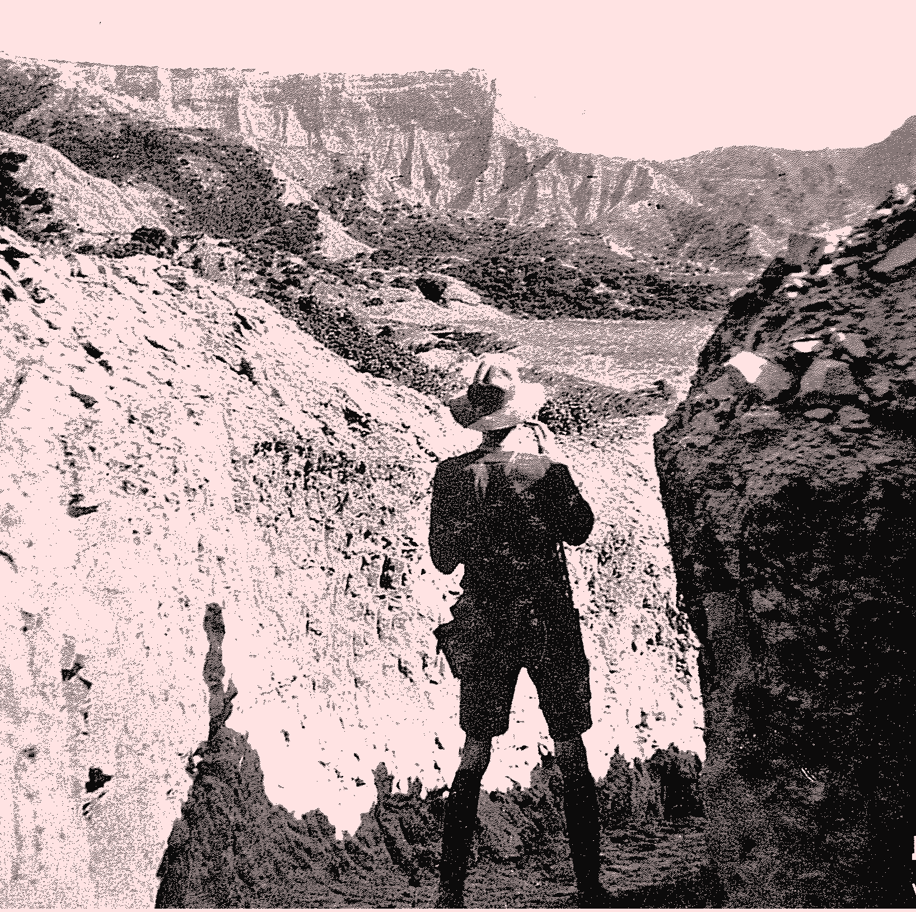
To secure the summit would have required an infantry force of several fresh divisions to simultaneously capture the higher peak of Hill 971 to the north while sweeping down the Sari Bair ridgeline to link up with the ‘old Anzac’ sector.
Ashley Ekins

Slide 6
The tactical complexity of the geography, the distances to be covered under the timetable, the logistical problems and the operations intentions would have presented problems even for fresh, experienced troops
John Tonkin-Covell

Slide 7
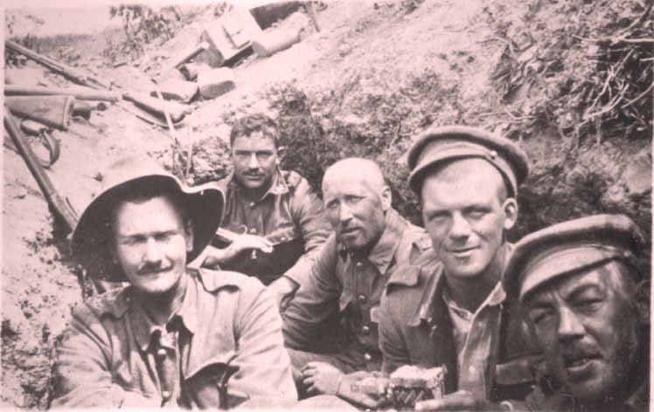
Condition of the Troops

Slide 8
… the men were but shadows of their former selves. Nearly all were suffering from diarrhoea or dysentery, not a few were on the verge of collapse, and most of them were greatly weakened. And yet these sick and weary men were going out to attempt one of the most difficult feats ever planned in the history of the war.
Ormond Burton

Slide 9
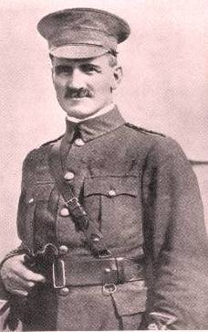
We are pleased to be moving but the men are run down and the reinforcement men are in a big majority so I am not too sanguine about what we can do. General Birdwood, it is reported, said the NZ Inf Bde had had so much hard work and been so knocked about that it should not go in the present move but our Brigadier wouldn’t listen to that and insisted that we be given one of the toughest pieces of the job.
William Malone, diary 4 August 1915

Slide 10
They had great spirit but they were worn out before they marched off to take the heights. Many – maybe 75 per cent, Temperley thought – had dysentery.
Les Carlyon

Slide 11
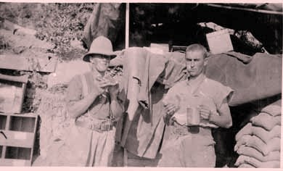
The Anzac Rations

Slide 12
Bully beef (Corned Beef)
Army biscuits
Black tea
Jam (on occasions)

Slide 13
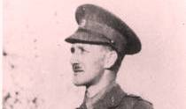
Food was always plentiful (except just after the Great Blizzard in November when stocks ran very low). Tinned meat, jam and hard biscuits and a mug of tea provided 99 per cent of the meals.
Fred Waite

Slide 14
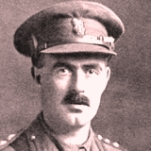
It is a curious fact, though, that after the best part of a year on bully beef and biscuits, the sight of decently prepared food is distasteful to one and none of us looks forward to meals very much.
Charles Mackie Begg, CB, CMG, Croix de Guerre, MiD(3)
DoD 2 February 1919

Slide 15
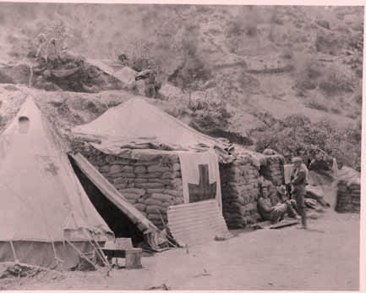
Been sick for three days – never ate a bite, felt savage & wanted to be left alone, just too much meat & tea & no potatoes or green vegetables.
William McAra, 6 November 1915

Slide 16
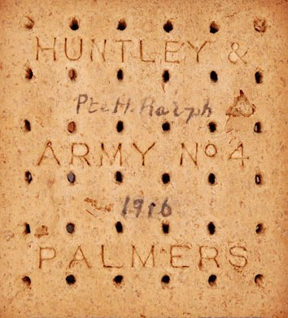
Bully Beef and Biscuits

Slide 17
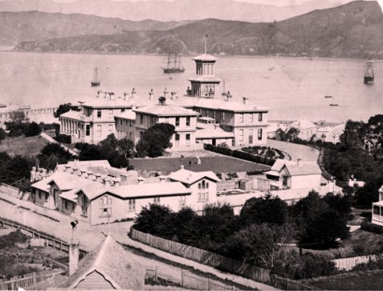
Mr PEARCE (Patea) asked the Minister of Defence who was supplying meat to our men at the front. Farmers from his district who had gone to the front had written back complaining that they were being supplied with American tinned meat, which was very salt, and in a hot climate where they were short of water it is very objectionable. The men were aware that meat in this country had been commandeered for them, but none of it was reaching them.
28 September 1915

Slide 18
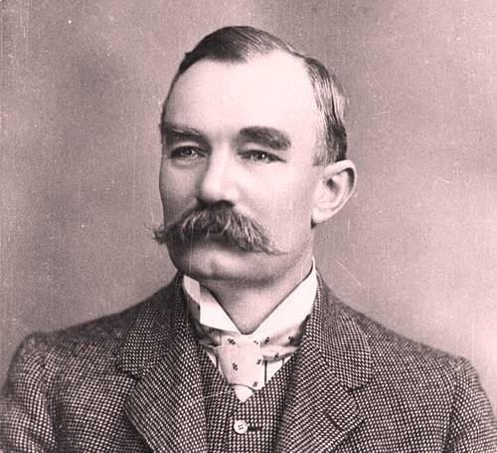
The Hon. Mr. ALLEN (Minister of Defence) was afraid he could not give a very satisfactory answer to the question, as he did not know enough about it. The Imperial Government was providing all the supplies at the front from the Imperial Ordnance Stores.
28 September 1915

Slide 19
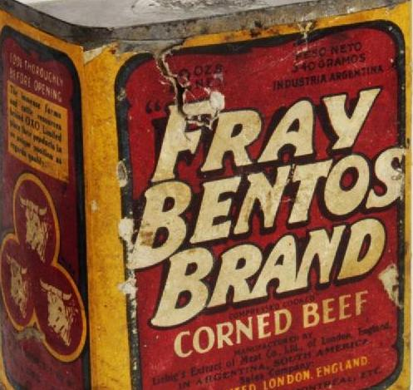
There was nothing actively injurious to health in the meat; but it was of poor quality, and ,from being salt and stringy, it caused some intestinal irritation and so conduced to diarrhoea.
Report of the Dardanelles Commission, Carbery

Slide 21
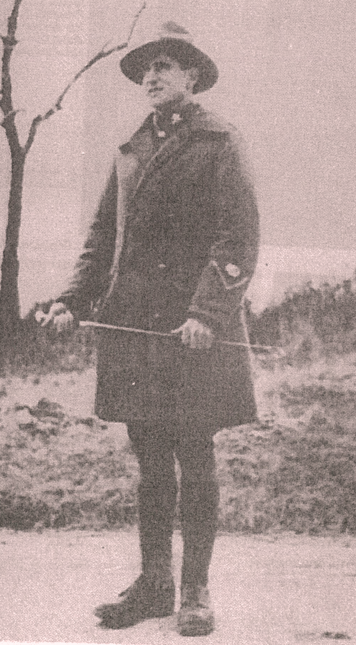
Little French girl: “Mama gives beaucoup thanks for the bully biff and returns the plates”
Smith: “That is fair comment on our hard tack.”

Slide 22
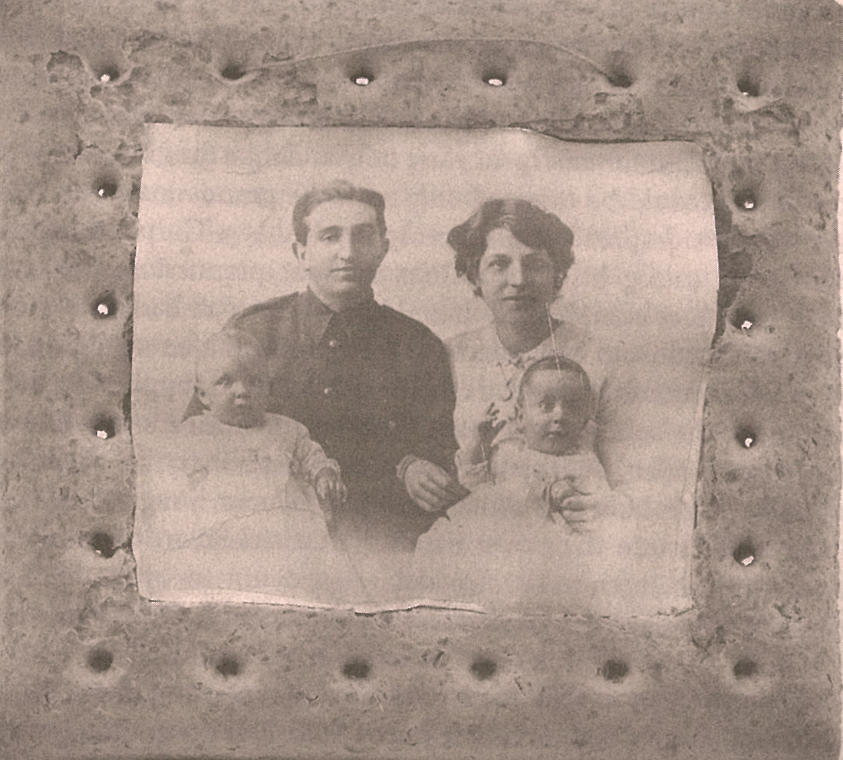

Slide 23
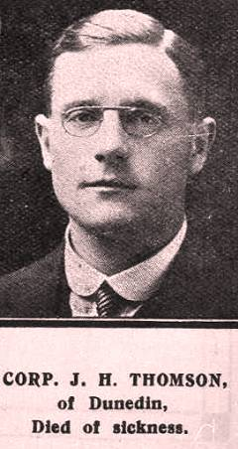
Our rations are 7 biscuits a day, a very little each of jam, tea & sugar & a very fat chunk of bacon. There is any amount of bully beef but only because it is poor & barely eatable. I have to struggle to get satisfied; it takes a lot of gnawing to fill up on biscuits & our 7 are as many as a man with ordinary jaws can manage.
Pte John Henry Thomson,
Diary,2 May 1915 DoD 5 April 1918

Slide 24
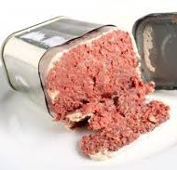
Nutritional Analysis

Slide 25
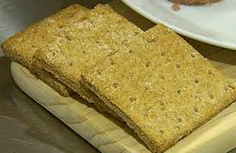
Vitamins, A,C,E
Potassium
Selenium
Dietary fibre

Slide 26
Recommended for disease prevention

Slide 27

Four (Adverse) Factors Affecting Food Consumption

Slide 28
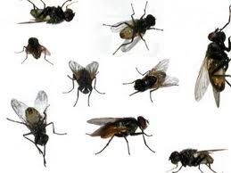
Flies

Slide 29

The smell of the bodies was becoming intolerable and the flies swarmed in millions. It was pitiful to see the wounded covered with them from head to foot but too weak even to attempt to chase them off.
Leonard Hart, Letter,
1 January 1916

Slide 30
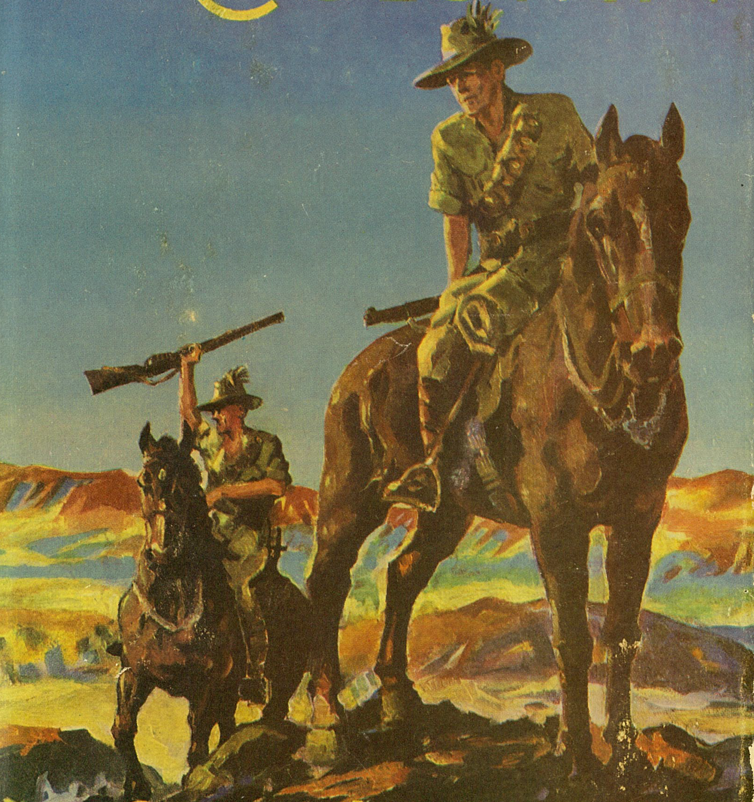
We have just had “dinner”. My new mate was sick and couldn’t eat. I tried to, and would have but for the flies. I had biscuits and a tin of jam. But immediately I opened the tin the flies rushed the jam. They buzzed like swarming bees. They swarmed that jam, all fighting amongst themselves. I wrapped my overcoat over the tin and gouged out the flies, then spread the biscuit, held my hand over it, and drew the biscuit out of the coat. But a lot of the flies flew into my mouth and beat about inside. Finally I threw the tin over the parapet. I nearly howled with rage. I feel so sulky I could chew everything to pieces. Of all the bastards of places this is the greatest bastard in the world.
Ion L. Idress, The Desert Column

Slide 31

Tobacco

Slide 32
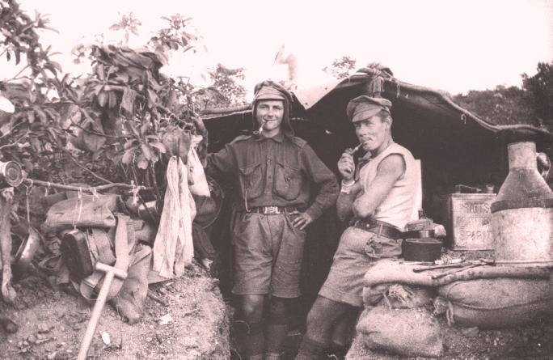
Male smokers, tobacco reduces Vitamin C concentrations by as much as 40%

Slide 33
Recommended for disease prevention

Slide 34
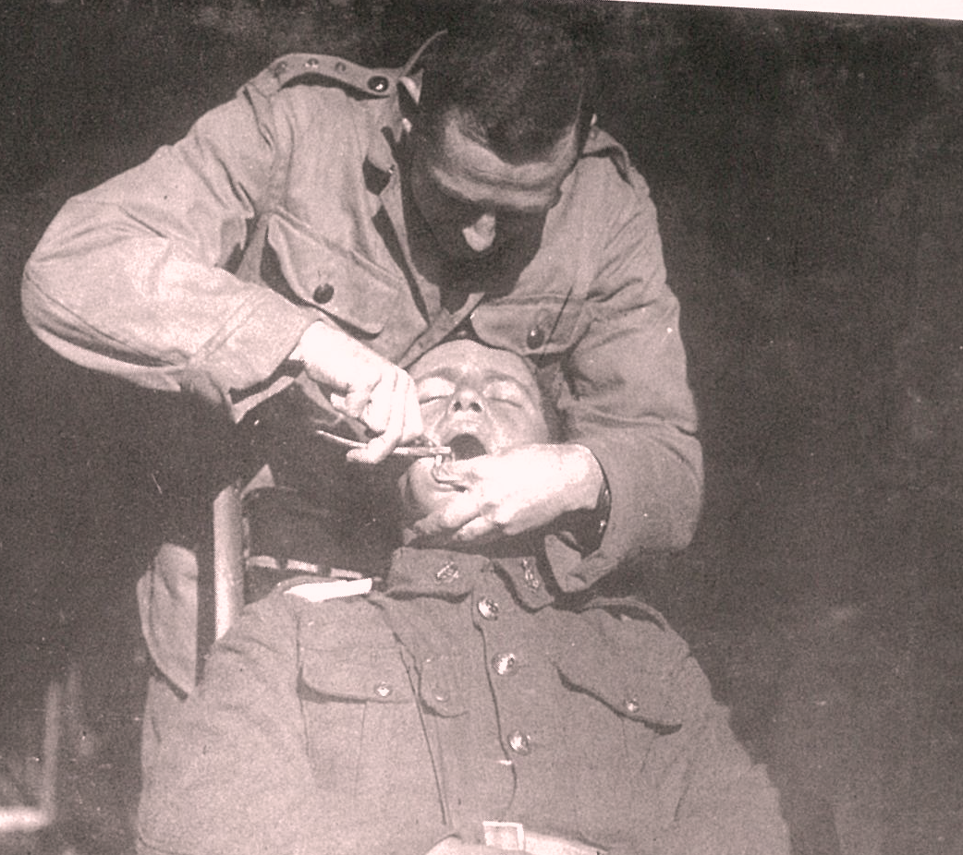
Dental Health

Slide 35
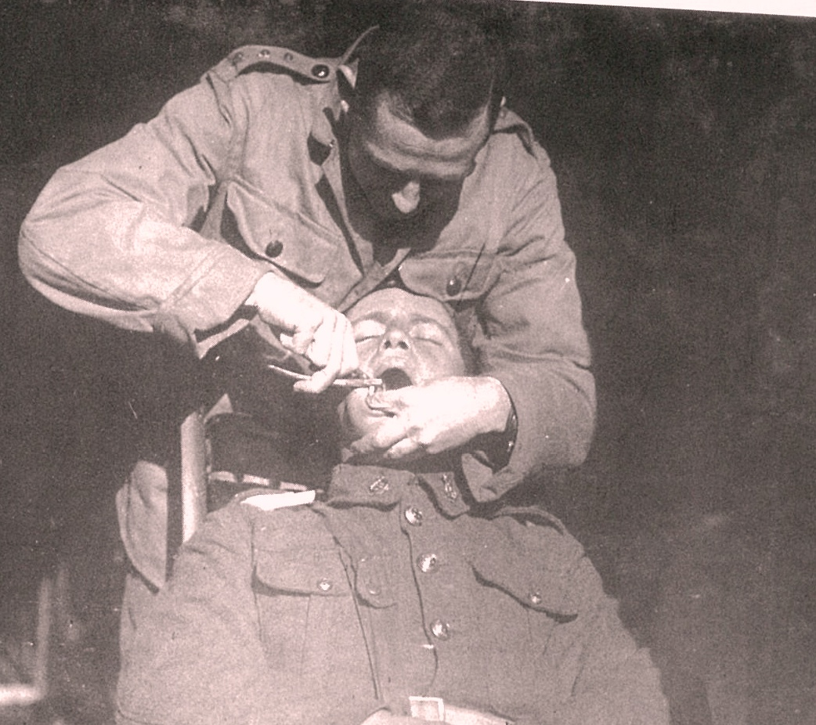
1851 extractions
2940 fillings
200 root canal fillings

Slide 36
Even men with good teeth found it a challenge, and for men with bad teeth it could verge on the torturous.
Rachel Duffett

Slide 37
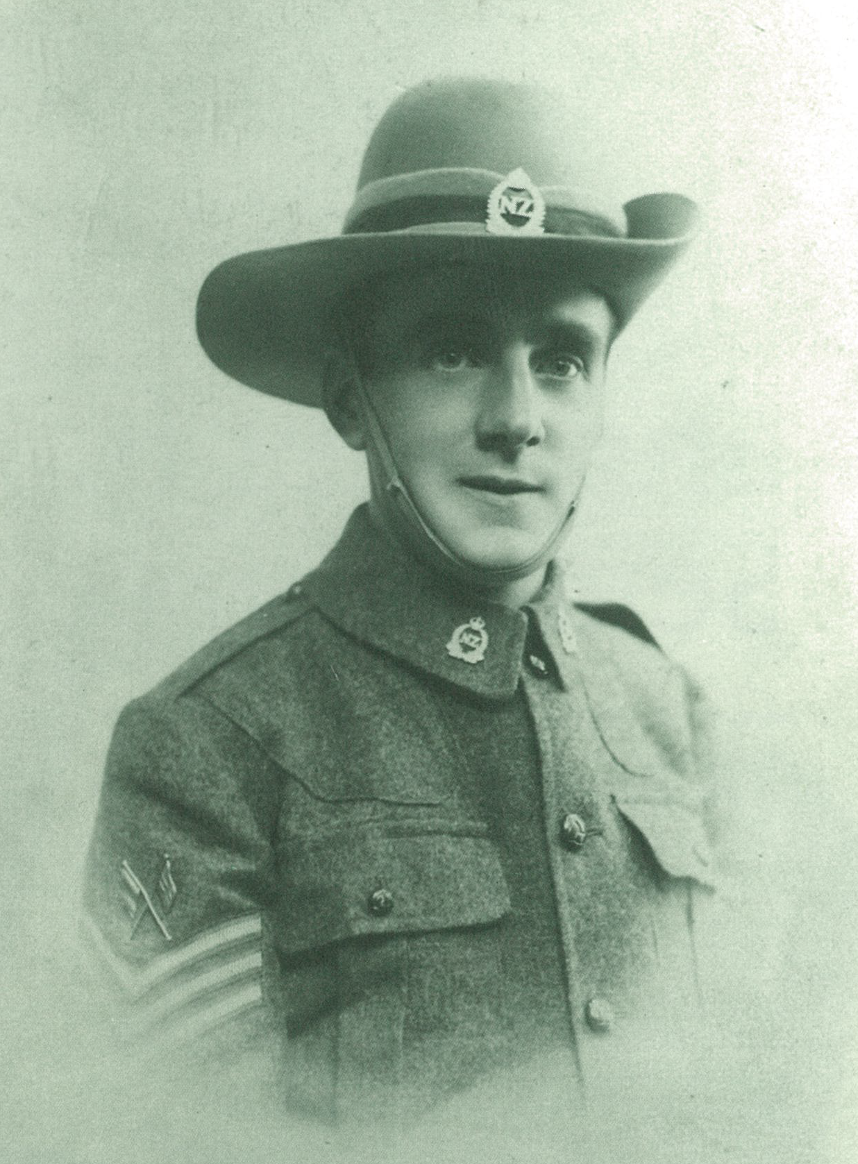
I broke my bottom set of teeth on board the transport through eating hard biscuits, and have lost my top set since, so now I have to pound the biscuits into powder with two stones from the beach before I can eat them. I have just finished grinding up a bagful, and had a meal of bully and powdered biscuits soaked in water.
Walter (Bill) Leadley, diary entry, 27 April 1915

Slide 38
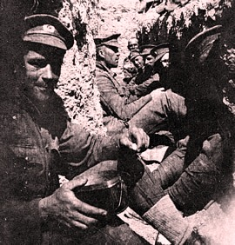
Water

Slide 39
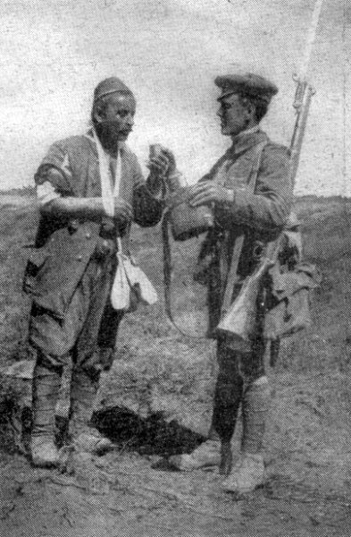
Fred Waite noted: ‘those in the trenches were always desperately short’.

Slide 40
I find myself thinking of the cold stream around Dunedin with maddening persistence and wondering why I didn’t drink more when I had the chance. I find the best thing to do is to drink as little as possible during the day and save as much water as possible for a drink after sundown. One is then able to sleep instead of lying awake with a dry tongue counting the hours till the morning issue.
Pte John H. Thomson, diary, 13 June 1915

Slide 41
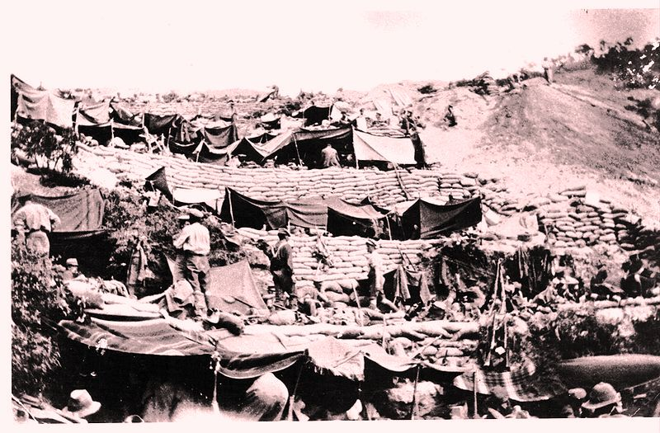
Scurvy at Gallipoli

Slide 42
Lieut.-Col. Dudgeon, R.A.M.C. [a Sanitary Commissioner] inspected part of the lines of the New Zealand and Australian Division occupied by the Australian Light Horse. His advice was to push on with the fly proofing of latrines and to enforce the chlorination of all drinking water. He noted a marked prevalence of gingivitis or pyorrhoea incident to a great extent in the older residents, considered by some to be an evidence of scurvy which certainly existed amongst the Indian supply and transport drivers at Anzac.

Slide 43
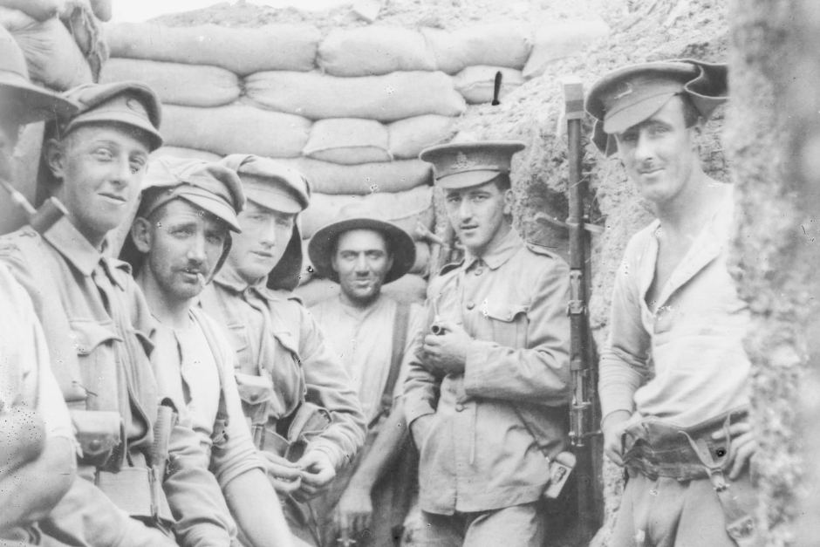
Stage 1 –
(1-3 Months Vitamin C Deficiency)
Symptoms
    compromised central nervous system
    malaise/lethargy & nervous fatigue
    irritability
    mental depression
    uncontrollable mood swings
    shortness of breath
    loss of appetite
    rapid breathing
    diarrhoea

Slide 44
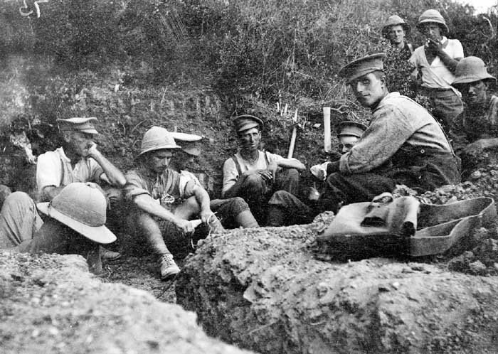
Stage 2 –
6 Months Deficiency
Symptoms
  swollen tissue – especially gums
  bleeding gums
  loose teeth
  sore mouth
  skin complaints (boils & spots)
  dry mouth & eyes
  impaired wound healing

Slide 45
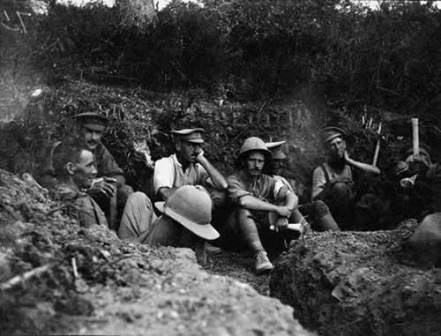
Stage 3 –
Full Blown Scurvy
Symptoms
  loss of teeth
  suppurating wounds
  protruding /bleeding eyes
  jaundice
  fever
  oedema (swelling)
  convulsions
  neuropathy
  death

Slide 46
In a diet where fruit other than jam was virtually unheard of and vegetables other than potatoes, and even those lacking in the latter years of the war, were rare, it is likely that many men were suffering from this intermediate, sub-medical stage of the disease.
Rachel Duffett

Slide 47
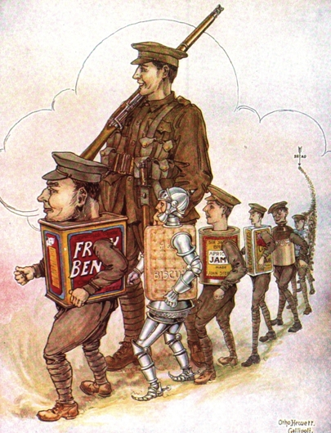
Conclusions

Slide 48
Armies travel on their stomachs: generals … decide what to put in them.
Mintz, Tasting Food, Tasting Freedom,

Slide 49
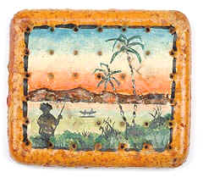


Questions?

