Slide 1

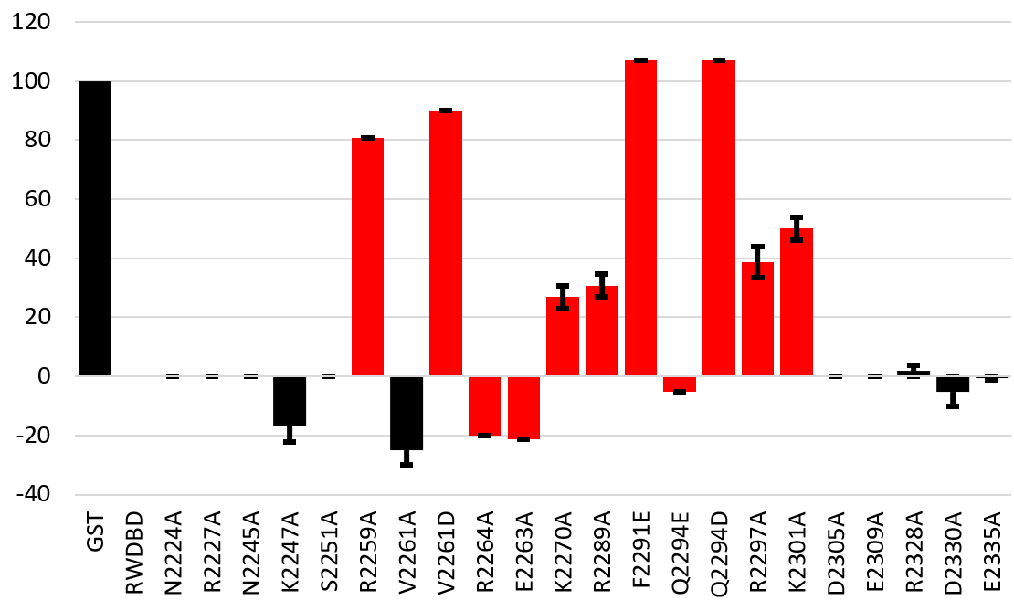
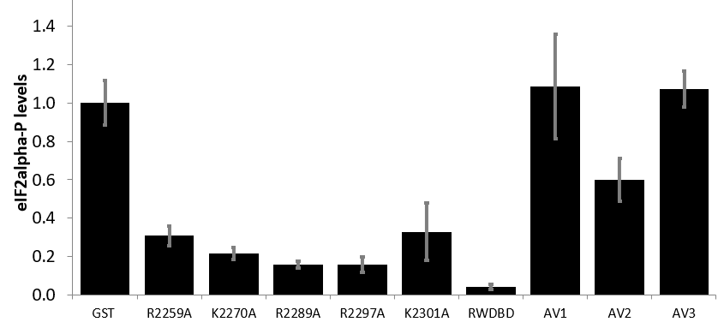
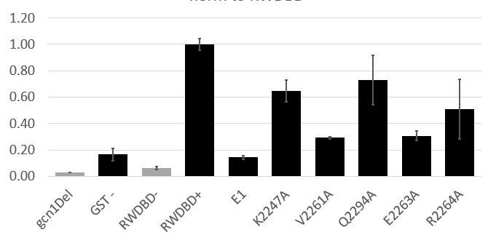
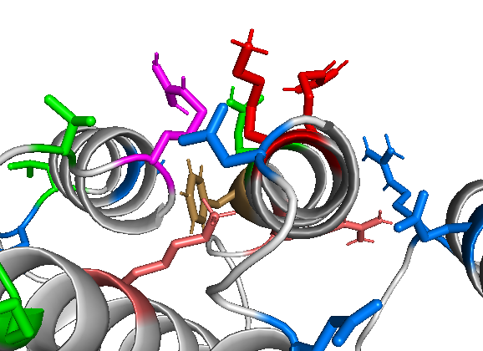

A genetic approach to identify amino acids in Gcn1 required for Gcn2 activation
Susanne Gottfried¹, Anja H Schiemann² and Evelyn Sattlegger^{1,2,3}
¹ School of Natural Sciences, Massey University, Auckland, New Zealand;
² School of Natural Sciences, Massey University, Palmerston North, New Zealand;
³ Maurice Wilkins Centre for Molecular BioDiscovery, Massey University, Palmerston North, New Zealand
Background
Gcn2 binding
General Amino Acid Control (GAAC) stress signalling pathway allows cells to sense and overcome starvation.
Gcn1 and Gcn2 are major players in GAAC.
Gcn1 –Gcn2 complex formation is facilitated by the N-terminal RWD domain in Gcn2 and the RWD-binding domain (RWDBD) in Gcn1.
Arg2559 in RWDBD is important for this interaction.
Gcn2 phosphorylates eIF2α (eukaryotic translation initiation factor).
This leads to reduced global protein synthesis and increased translation of the transcription factor Gcn4 in yeast and allows cells to overcome starvation.
Which other amino acids in RWDBD are important for Gcn1-Gcn2 interaction?
Ribosome binding
R2259
Gcn1
eEF3-like
RWDBD
1330
1641
2207
2602
2672
Figure 1: Schematic diagram of yeast Gcn1
Shown are the ribosome binding and Gcn2 binding sites. Amino acid Arg2259 is required for Gcn2 binding in vitro and in vivo. Overexpression of RWDBD (RWD binding domain) alone inhibits Gcn2 activation through disrupting endogenous Gcn1-Gcn2 interaction
GCN1
RWDBD
B
GCN1
RWDBD
1
Growth similar to WT strain
overexpressing GST alone
A
GCN2
eIF2α
0.8
Growth similar to WT strain
overexpressing RWDBD
GST-RWDBD
GCN2
eIF2α
X
eIF2α
0.6
Gal4
GST
P
Gal4
GST-RWDBD
Relative growth on 3AT medium
eIF2α
0.4
Gcn2 can be activated
Gcn2 can not be activated
0.2
Figure 2: Experimental system
A. GST is overexpressed from a galactose inducible promoter in yeast. Gcn1 and Gcn2 can interact. Gcn2 phosphorylates eIF2α, therefore cells can grow under amino acid starvation conditions. B. Overexpressed GST-RWDBD binds to endogenous Gcn2 and prevents Gcn1-Gcn2 interaction, eIF2α can not be phosphorylated and cells can’t grow under amino acid starvation conditions (induced by 3-Amino-1,2,4-triazole, 3AT).
0
0.2
GST
Q2294D
E2309A
E2335A
D2305A
R2328A
RWDBD
V2261D
K2301A
D2330A
N2224A
Q2294A
R2227A
K2247A
F2291E
N2245A
S2251A
R2264A
R2259A
K2270A
V2261A
E2263A
R2289A
R2297A
AV1: R2559W, K2270A, R2289A, R2297A, K2301A
AV2: R2259W, R2289A, R2297A, K2301A
AV3: R2259A, K2270A, R2297A, K2301A
Growth significantly different to that of strains overexpressing GST-RWDBD (t-test, P <0.05)
A
Figure 3: Growth of each strain expressing GST-RWDBD containing the indicated amino acid substitutions under amino acid starvation conditions (Galactose + 3AT) was quantified and compared to growth on Galactose only. Averages were determined from at least 4 independent experiments.
1.2
relative eIF2α-P levels
4 B
1
E1: K2247A, V2261A, E2263A, R2264A, Q2294A
0.8
calculated wrong
0.6
relative eIF2α-P levels
0.4
Figure 4 A and B: Relative level of eIF2α-phosphorylation in strains grown under amino acid starvation conditions (3AT). Relative level of eIF2α-phosphorylation was determined by Western blotting. The eIF2α-P signal was divided by the Pgk1 (loading control) signal.
0.2
RWDBD
RWDBD
E1
K2247A
V2261A
Q2294A
E2263A
R2264A
starve
unstarved starved
R2259
Q2294
K2301
R2297
Conclusions:
Amino acids R2259, K2270, R2289, R2297, and K2301 are required for full Gcn2 activation
Amino acids R2227, K2247, R2264, and R2328 are not relevant for Gcn2 activation
Acknowledgements
F2291
F2291
Doctoral Scholarship
K2270
R2289
Figure 5: Location of amino acids in Gcn1, side view of potential Gcn2 interaction sites.
Bryce and Ann (née Percival) Carmine

