Slide 1

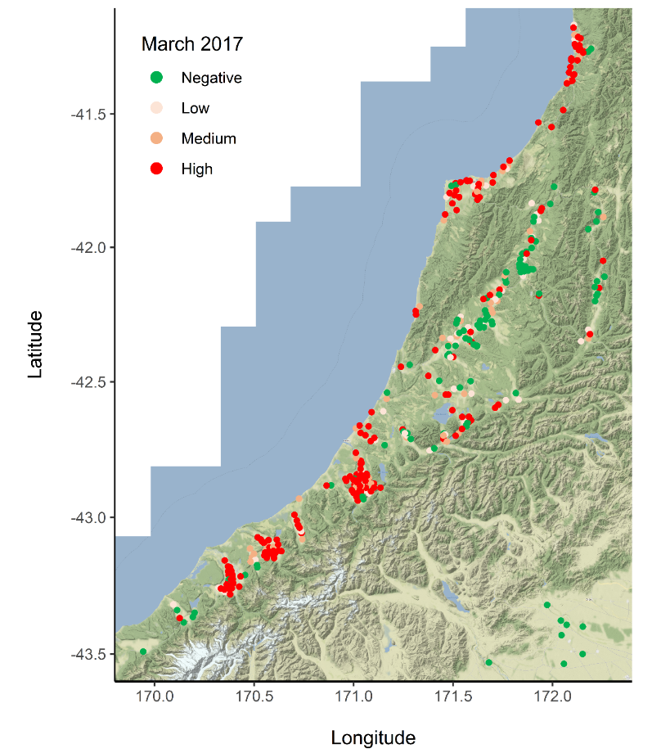
Prevalence of liver fluke on the West Coast of the South Island of New Zealand sampled in the autumn and spring of consecutive lactations
A Dowling¹, L Howe², K Lawrence², W Pomroy², I Scott²
PGG Wrightson Ltd, 1 Robin Mann Place, Christchurch¹ . Massey University, Tennent Drive, Palmerston North.²
Aim: to determine the prevalence of liver fluke Fasciola hepatica in herds from the West Coast of the South Island of New Zealand supplying milk to Westland Milk Coop (WMC) using bulk milk elisa (BME) in March 2017 (autumn) near the end of lactation and again in October 2017 (spring) early in the subsequent lactation.
Background: The West Coast of the South Island lies between latitude -41 to -43 North and latitude 169 to 172 East bounded to the west by coast and east by mountain with 1600-4000mm annual rainfall and mean month temperature ranging from 5 to 18 celsius. Spring calving dairy cows are pasture fed with a non-lactating period of about two months over the winter, with heifers being introduced to the herd and other cows removed. Liver fluke infection is considered to be common and anthelmintic treatment targeting liver fluke may be used in the non-lactating period.
Method: Bulk milk samples from WMC suppliers collected in March and Spring were analysed using the IDEXX Fasciolosis Verification kit Bulk Milk ELISA (BME) kit. This test categorises herds into four levels in liver fluke infection based on SP percentage (SP%) of the sample calculated against a positive control (Table 1). Production is limited when 25% or more of the herd are infected (Vercruysse & Claerebout, 2001).
Table 1: IDEXX Fasciolosis Verification kit correlation table
Results: In the autumn 57% of herds had production limiting infection, compared to 50% in the spring (Table 2).
Table 2: Percentage of herds tests in each diagnostic category sampled in March and October
 | Negative | Low | Medium | High
March (n=430) | 31% | 11% | 14% | 43%
October (n=403) | 33% | 17% | 24% | 26%
To determine the repeatability of the BME test 99 herds were sampled on two occasions in the autumn with an interval of one to two weeks. The Cohens kappa analysis of the diagnostic category of each herd was 0.7 (95% CI 0.58 – 0.82) which indicates a “substantial” agreement between the two test points. There were 388 farms sampled both in the autumn and spring and the Cohens kappa analysis of the diagnostic category of each herd was 0.57 (95% CI 0.51- 0.63) which indicates a “moderate” agreement between the two sample points. There was an overall SP% reduction of 23% from 115 to 88 from March to October, although this did not always change the IDEXX BME categorization for individual farms. Mapping of the farm data showed that coastal farms tended to have a high infection rate whereas inland farms in the Grey River Valley and Maruia River valley tended to have lower levels of fluke infection (Figure 1). Further work will compare these actual results with climate modelling data.
Bulk Milk ELISA results
SP% | Prevalence of Infection | Infection description
≤30 | Negative | no or very weak
30.1-80 | <20% | low
80.1-150 | 20-50% | medium
≥150 | >50% | strong (high)
Conclusion: The prevalence of fluke infection is high in dairy farms on the West Coast of New Zealand, with possibly 50% of farms losing some milk production as a consequence. The lower SP% in Spring may be due to factors including introduction of parasite free heifers, culling of infected cows, natural attrition of current fluke burden, reduced metacercariae ingestion and anthelmintic treatment.
Reference:
Vercruysse J, Claerebout E. Treatment vs non-treatment of helminth infections in cattle: defining the threshold. Veterinary Parasitology 98, 195-214.
Figure 1: Google map of farms categorized by liver fluke category as negative, low, medium or high and the change in category from March to October
Copyright © 2021 Andrew Dowling, andrew.f.dowling@outlook.com
Notes:
Please export the PowerPoint document as a PDF (File – Save as – PDF) and upload the PDF into the system. Please use the font in the document or a similar one and do not use a font size smaller than 16.

