Slide 1



Education (Pastoral Care of Tertiary and International Learners) Code of Practice 2021: What does it mean for work-integrated learning?
Dr. Jenny Fleming
Assoc. Prof. Kathryn Hay
Notes:
Jenny

Slide 2
The Education (Pastoral Care of Tertiary and International Learners) Code of Practice 2021
(referred to here ‘the Code’)
Sets out the outcomes and requirements that tertiary education providers must meet for the wellbeing and safety of learners.
Came into effect 1st January 2022
Applies to any activities provided by, or organised by or on behalf of, a provider for enrolled domestic or international tertiary learners, whether in New Zealand or offshore.
Notes:
Kath
Under the Education and Training Act 2020, the purpose of the Code is to require tertiary education providers to:
• take all reasonable steps to maintain the wellbeing and safety of domestic tertiary students and to also protect international students
• ensure as far as possible that domestic and international students have a positive experience that supports their educational achievement.
Further, the Code plays a part in providing for a system of support to students that honours Te Tiriti o Waitangi and works well for Māori learners and their whānau as tangata whenua. The code contributes directly to the outcomes for Māori set out in the Tertiary Education Strategy.
The Code came into effect this year and is relevant to all staff working with learners in tertiary education.

Slide 3
Key features of the code
A whole-of-provider approach
Strengthened standards for wellbeing and safety practices
Foster learning environments that are safe and support positive experiences of diverse learner groups
Training and support for staff (including accommodation staff)
Better protections for learners for making complaints and resolving disputes
Better consistency within and across providers (and in student accommodation) for responding to emergency situations
Notes:
Kath
On the slide we have listed the key features of the Code.
The requirement to take a whole-of-provider approach to learner wellbeing and safety is particularly important as it means that a wide range of staff need to be aware of the Code and consider how it relates to their learning areas.
All of these features are relevant to WIL and raise questions as to what we are currently doing to support learner wellbeing and safety and how we can improve our current practice. It also gives us an opportunity to think about the relationships we have with other staff in our institution, for example, those working in the health, safety and wellbeing space and whether we could be cooperating more, especially as new systems and processes may be developed to evidence the implementation of the Code.

Slide 4
Wellbeing of learners
“… having a positive frame of mind, resilience, satisfaction with self, relationships, and experiences and progressing towards learning outcomes sought”
Wellbeing of learners is central to positive tertiary learning outcomes.
  Learners being healthy and feeling secure
  Learners achieving academic goals
  Benefits learners families, communities and wider society
For tertiary providers:
  Better achievement outcomes
  Improved retention
  Improved learner satisfaction
  Reputational impacts
Notes:
Kath
Wellbeing is defined in the code as: “… having a positive frame of mind, resilience, satisfaction with self, relationships, and experiences and progressing towards learning outcomes sought”. It is focused on enhancing academic achievement as well as personal wellbeing.
Several benefits for supporting and enhancing learner wellbeing have been identified in the Code, as listed on the slide. The benefits are for both the learners themselves and the tertiary providers. I think many of us can recognise in the bullet points under tertiary providers, areas that our senior leaders are often wanting to enhance- the Code perhaps offers a further lever for work in these areas.

Slide 5


Wellbeing concepts
“ … a heterogenous combination of an individual’s physical, mental, emotional and social health “ (Grant-Smith et al., 2017, p.8
Notes:
Kath
While the Code has specified their own definition of wellbeing, other concepts or models of wellbeing are also available and can assist us with considering how wellbeing may be supported for different cohorts of learners that we may be engaging with. For example, Sir Mason Durie’s well-known wellbeing model, Te Whare Tapa Whā, supports a holistic view of wellbeing whereby people need to experience health in the four pou or areas of taha wairua, taha tinana, taha hinengaro and taha whanau. If one of these areas is not well then the person is not able to reach their full potential. Te Whare Tapa Wha has relevance not only for our Maori learners but all students we are interacting with.
Developed by Samoan-born academic Fuimaono Karl Pulotu-Endemann, the Fonofale model of health is a system of wellbeing that acknowledges and embraces Pacific perspectives. It is a model built around the idea of the Samoan fale, or house, and aspects of the structure, roof, foundation and context are components of a person’s wellbeing. The walls are similar to those of Te Whare Tapa Wha although family or aiga is the foundation. Culture provides a protective roof and time, context and environment are influencing factors that may impact on the fale.
Given that we are often working alongside Māori and Pacific learners we believe it is important that these wellbeing models are also considered and implemented in our mahi to enable us to support the wellbeing and safety of our students.
Over to you Jenny.

Slide 6
The structure of the code
8 Parts
22 Outcomes
Relevant to WIL
Part 3:
Organisational structures to support a whole-of-provider approach to learner wellbeing and safety
Part 4:
Wellbeing and safety practices for all tertiary providers
Part 6:
International Learners
Notes:
Jenny
The Code requires providers to build and maintain strong relationships with diverse learners and other stakeholders. Through this relationship, issues that are important to learners and their communities are identified and appropriate strategic goals, plans and practices can be developed.
Has 8 parts and 22 Outcomes.
Some of these outcomes are foundational and apply to all providers, including those with international students/ and students accommodation.
Relevant to WIL are part 3 and part 4, and part 6 (if involved with international learners or students undertaking placements overseas_.
However, not all outcomes apply to all providers as separate outcomes for school and tertiary providers, domestic, international or living in student accommodation.

Slide 7
Tertiary Provider actions for Part 3
A “Code Administrator” responsible for supporting and administering the code
Universities have undertaken a gap analysis to identify key priority areas within the code to focus on improvement
We, as WIL leaders/ practitioners, also need to take some responsibility for how it impacts WIL
Links need to be made with the tertiary team involved with administering the whole of provider approach
Notes:
Jenny

Slide 8
Part 4
Wellbeing and safety practices for all tertiary providers
Outcomes relevant for WIL
Outcome 3:
Safe inclusive, supportive and accessible physical and digital learning environments
Clause 18 a) Providers must have practices for providing healthy and safe learning environments.
Outcome 4:
Learners are safe and well
Notes:
Jenny
Part 4 is the focus for our discussions today. Within Part 4 are two outcomes that are relevant to WIL students and practices. These are outcome 3, along with clause 18, and Outcome 4.
Outcome 3 has a key focus on the learning environment, while outcome 4 is more focused on the student/ learner.
Important that WIL programmes are inclusive, and accessible to students with disabilities, and that Hosts are adequately prepared to support students with diverse learning needs.
WIL more frequently involves onsite work placements, but now remote work and virtual options are becoming more common. So, it is not only the physical environment that is important, but the digital learning environments are equally important for WIL leaders to consider as to how to ensure student wellbeing and safety

Slide 9
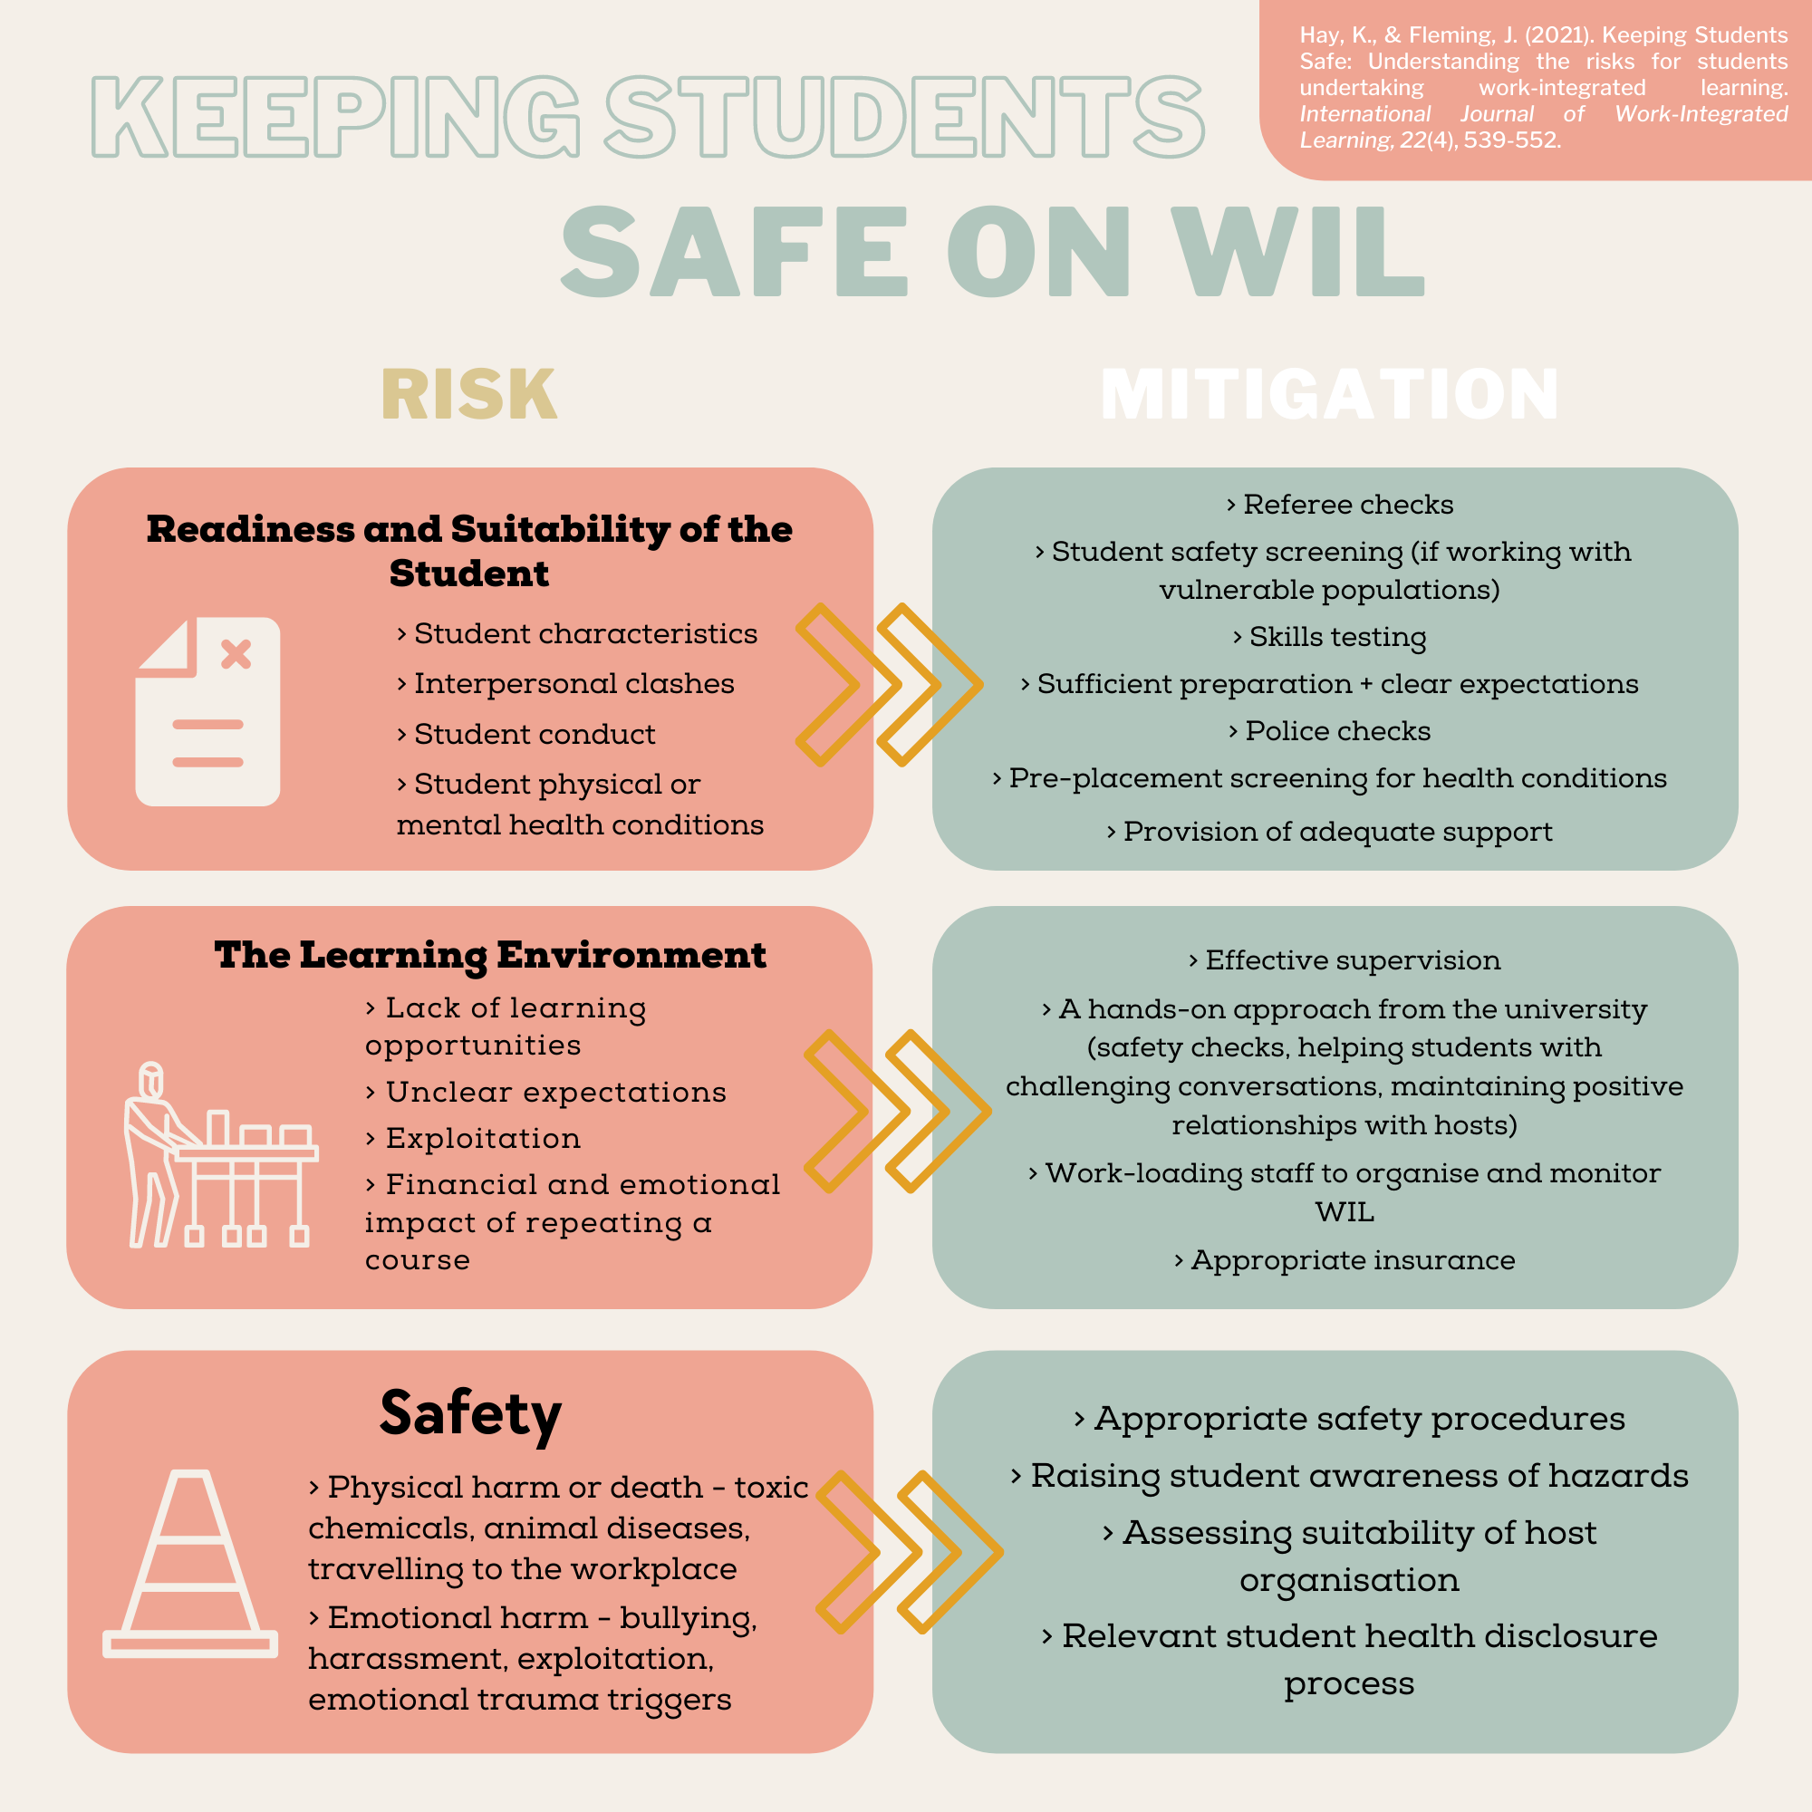
Keeping students safe on WIL
Notes:
Jenny
Research that we undertook related to risk in WIL, resulted in a series of infographics that we have used to summarise the key risks to students and how we can mitigate these. While these won’t be easy to see, these infographics will be available through WILNZ website in the near future.
So how do we keep our students safe?
Need to mitigate risks:
We identified three key areas of risk
Readiness and suitability of the students
Need to ensure students suitability for their placement, this may include skills, characteristics, pre placement screening.
The learning environment
Need to provides opportunities to learn, with clear expectations, with minimal financial impact. Effective supervision by host and supervision or monitoring by university.
Safety
Need to be free from physical harm, or emotional harm, from bullying, harassment or exploitation.
H& S procedures documents and communicated to students
Students are aware of how to report concerns, or incidents related to safety, harassment etc.

Slide 10
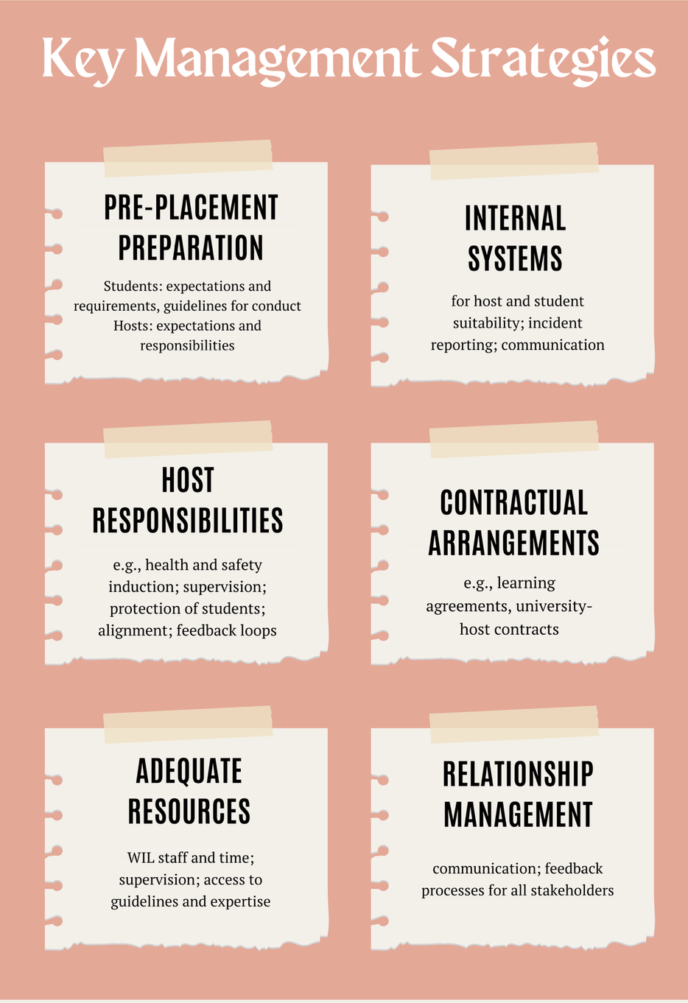
Managing WIL to meet outcomes 3 & 4
Notes:
Jenny
In order to meet outcomes 3 and 4; , here are a few key strategies that are suggested to help manage WIL. Again these infographics will be available as a resource.
Pre- placement preparation.
Ensure clarity of roles and responsibilities for student safety and wellbeing
Host supervisors UNDERSTAND their responsibilities.
Host supervisors are provided support from tertiary provider to ensure they are aware of requirements under the code
Internal Systems
For due diligence of host suitability, incident reporting, communication systems
Contractual arrangements/ agreements
Ensure clear information is provided within these documents that includes reference to ensuring
Adequate resources
WIL staff need time to provide support for students, and also Host supervisor.
Relationship management
Communication, and feedback processes for all stakeholders

Slide 11
Implications for good practice
Lots of good practice already exists but…. evidencing this practice is important
Providers need to have good systems to capture this WIL specific evidence
Robust risk management practices
Ongoing ‘quality evaluation’ of WIL programmes needed
Notes:
Kath
A requirement of the code is that there needs to be ‘evidence’ of good practice. Not only is it important that the learning environment of students’ WIL placements are safe , but we need to have documentation and evidence of the processes that we have undertaken to do this. Sometimes the evidencing of good practice can be challenging, for example, how do we know for sure that a host organisation is a safe environment for students if we are unable to visit before a placement? Is it OK to just rely on a health and safety form we ask them or the student to complete? How can we be sure that a student won’t be injured, exploited, harassed or bullied? We can’t, but we can have processes that minimise or mitigate potential risk and also provide students and organisations with opportunities to alert us to these, especially if harm occurs.
In some programmes or providers there may already be excellent quality assurance systems for WIL set up however for others this may be something that needs to be further explored or implemented. A quality evaluation framework has recently been endorsed by the DVCAs in Universities NZ and provides guidelines for quality evaluation. Frameworks such as this offer a way to have a systematic and consistent process across disciplines.
Perhaps quality evaluation of learner wellbeing and safety is an area for future discussion and collaboration in WILNZ as well as within our own tertiary contexts.

Slide 12
Summary
Wellbeing is important for influencing academic outcomes, career outcomes and outcomes that benefit the community and wider society (Boon et al., 2017).
“… successful learning requires learners to be and feel well physically, socially and emotionally “ (Field, 2009 in Zepke, 2013, p.9).
Ongoing project: To explore the wellbeing of WIL students from New Zealand universities and the strategies that can support them pre-, during- and post-WIL.
Notes:
Kath
To summarise, the new Code offers as opportunity for us to more closely consider how we are supporting learner safety and wellbeing. We know that wellbeing is critical for students and this has impacts on their families, friends and communities. Jenny and I believe that the Code offers us an opportunity to raise the profile of WIL with others in our institutions who are involved in implementing the Code. Also, it gives us some leverage in that our institutions must be implementing the Code and evidencing how we are doing this. Because of this it may mean we have new opportunities to implement better systems and have increased resourcing to enable us to best support learner wellbeing and safety.
As Jenny mentioned earlier, our previous research on risk in WIL in NZ universities has now been completed. Our new project, which is an extension of our focus on the duty of care NZ universities have to WIL students, will explore the wellbeing of WIL students in NZ universities and strategies that can support them pre, during and post WIL. We will be conducting interviews with 15- 20 students from different disciplines and then distributing a survey to a wider range and number of students in the universities.
We look forward to sharing our findings from this research with you in the future.

Slide 13
Questions and Discussion Forum
How do you evidence your practice related to learner wellbeing and safety?
Could the code be used as a driver/ lever to improve current WIL practice in your context? If so, in what ways?
Notes:
Kath
Thank you for listening to our presentation. WE have a few minutes now to move into online and face to face groups and consider the 2 questions on the slide. For those of you online you may wish to jot down the questions so you can refer to them in the zoom group.
For those online delegates, you need to leave the live stream link and open the Zoom link for the day 2 discussion ( which was sent to you in welcome email ).
Day 2 (approx. 9.20 am) Link: MailScanner has detected a possible fraud attempt from "apc01.safelinks.protection.outlook.com" claiming to be https://aut.zoom.us/j/98302167040?pwd=N2dxOSt1MkJWNmlPdXNnYzRPRjREQT09
We will move straight into the break after the discussion. If you would like to chat further to me and Jenny about our research please feel welcome to contact us.
If we have time, we can take a few questions, ether in the chat for those online, or from the floor. The we will break into some discussion groups to look at the following questions.

Slide 14
References
Boon, H., Kimhi, S., Sapountzaki, K., Parmak, M., Groh, A., & Ryan, S. (2017). Preliminary findings from an international study of subjective wellbeing in tertiary students. International Journal of Innovation, Creativity and Change, 3(3), 26-42.
Field, J. (2009). Well-being and happiness. Inquiry into the future for lifelong learning. Thematic paper 4. Leicester, UK: National Institute of Adult Continuing Education.
Zepke, N. (2013). Student engagement: A complex business supporting the first year experience in tertiary education. The International Journal of the First Year in Higher Education, 4(2). 1-14. doi: 10.5204/intjfyhe.v4i2.183

