Slide 1


Validation of a Moral Sensitivity Questionnaire (MSQ) for care and support workers
Marija Jelesic Janic
Andrew Barney
MASSEY
BUSINESS
SCHOOL
Te Kura Whai Pakihi

Slide 2
Issues
What would YOU do?
Why this research was undertaken
Ethics in the service industry
Why the Moral Sensitivity Question was chosen
Validation method employed
Results
Conclusions and future research

Slide 3
What would YOU do?
You are a manager of a large care facility
A resident is often given gifts by family
These gifts have been disappearing from his room
You suspect a particular worker may be taking them
You question the worker. He admits it.
You then question his colleagues.
They deny any knowledge of his behaviour
....and yet, some of the resident’s items have been seen in their possession.
What do you do?

Slide 4

Why this research was undertaken
Specifically
  My Massey University MBS Research Report
  My concerns as District Manager at Emerge Aotearoa

Slide 5
Why this research was undertaken
What were my concerns?
  Unlike registered health professionals there is no agreed code of ethics underpinning the activities of support services industry employees in New Zealand. Carers are excluded from the Health Practitioners Competence Assurance Act (2003)
  Worse, surveys suggest at least 25% of support workers have not completed minimum basic training requirements (Ravenswood et al. 2021). Care and support workers may have a poorer understanding of both ethical issues and techniques to handle them than registered health professionals.
  In practice this situation requires active management of staff ethical decision-making and behaviour in the industry via initiatives such as recruitment screening and staff training.

Slide 6
Managing Ethics in the Service Sector
With a lack of a professional code of conduct, managerial interventions are of greater importance.
However the sector lacks any evidenced-based tools to do so.
There are presently no validated ethical instruments available for use by New Zealand support services managers in recruitment screening, and training interventions designed for staff.
This research was designed to begin the process of finding and validating a suitable instrument for use in this sector.

Slide 7
Ethics and “moral sensitivity”
‘Moral sensitivity’ was first proposed by Rest (1986) who asserted that moral sensitivity is the first and the most important precursor for ethical decision making.
Lutzen and Nordin (1993) defined moral sensitivity as
“a personal attribute which helps the individual identify moral conflicts, understand vulnerable situations and provide insight into potential consequences of decisions made on behalf of others”

Slide 8
The Moral Sensitivity Questionnaire
The Moral Sensitivity Questionnaire (MSQ) operationalises Lutzen et al. (1995) moral sensitivity construct.
Of particular value to this study, the MSQ was specifically designed to assess the moral sensitivity of health workers, primarily nurses and physicians working in mental health settings.

Slide 9
The Moral Sensitivity Questionnaire
The MSQ employs Likert-scale item construction, examining 30 assumptions about patients’ care.
Original Validation.
  Items were reviewed by six experts for their content validity.
  The revised scale was trialled on 79 psychiatric nurses generating a Cronbach’s alpha of 0.73 for the total scale.
  Further scale revisions were trialled on a sample of 145 psychiatric nurses and 150 medical surgical nurses.
  Subsequent revisions led to an increase in Cronbach's alpha to 0.78 (Lutzen & Nordin, 1993).

Slide 10
Four Subsequent Validation Studies
Han (2010) tested the MSQ on a sample of Korean nurses.
The results suggested an adequate reliability for the scale but queried the construct validity of the instrument.
Dalla-Nora et al. (2019) validated the MSQ with Brazilian nurses and found that the MSQ was “appropriate”.
Yilmaz et al. (2015) tested the validity and reliability of the MSQ with Turkish student nurses
Borhani et al. (2017) studied the link between moral sensitivity and moral distress with Iranian nurses.

Slide 11
Current Method
The current study is an initial examination of the content validity of the MSQ for use with New Zealand support workers.
Content Validity Index (CVI) method was employed. (CVI) is the most common quantitative method used to determine content validity (Rodrigues et al., 2017).
CVI involves asking a panel of local industry experts to independently rate MSQ items for their validity. Levels of panel agreement can then be calculated for both items (I-CVI) and full scales (S-CVI). Low scoring items can then be eliminated or modified following discussion with panelists.
CVI method is a good first step in determining the degree of adaption that may be necessary in order for the MSQ to be used safely and effectively within the New Zealand support sector.

Slide 12
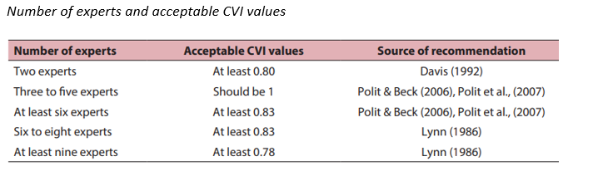
CVI Guidelines
From “ABC of Content Validation and Content Validity Index Calculation,” by Muhamad Saiful Bahri Yusoff, 2019, Education of Medicine Journal, 11(2), p. 51.

Slide 13
Method
Items in the existing MSQ were first reviewed for relevance to the support industry. Several were re-phrased to improve relevance.
An expert group of 7 experienced local care and support managers was recruited using convenience sampling. All were female, most working in mental health services.
Participants were asked to rate the modified MSQ items and scales for their validity using a specific form created on Microsoft Forms. A four-point rating approach was used in line with recommendations from Davis (1992) and Lynn (1986).

Slide 14
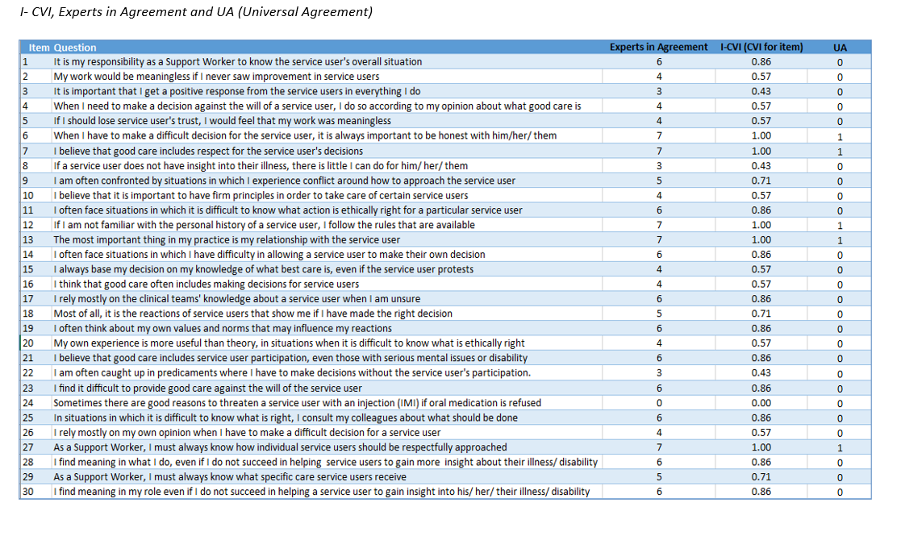
Results

Slide 15
Results
An acceptable total CVI value according to Polit and Beck (2006) and Lynn (1986) for 7 experts is at least 0.83. Other researchers have indicated the acceptable range to be any S-CVI higher than 0.80 (Davis, 1992; Grant & Davis, 1997).
Such advice suggests that the responses from the current expert panel for the MSQ for care and support workers (0.72) is below the minimum recommended acceptable CVI value of 0.80
The problem appears clearer at the level of individual items. At the item level, 15 items were shown to have an acceptable CVI, 3 items need revision and 12 items did not have an acceptable CVI.

Slide 16
Results
Further review suggested MSQ Scale CVI could be significantly increased if four low scoring items are deleted.
Notably Item 24 had the lowest I-CVI of ‘0.0’ value. In addition, if low-scoring Items 3, 8 and 22 were also removed the MSQ S-CVI increased to a more acceptable value of 0.78
Given that removing items potentially impacts scale reliability, panellists were also asked about potential “replacement” items. Three suggestions were made.

Slide 17
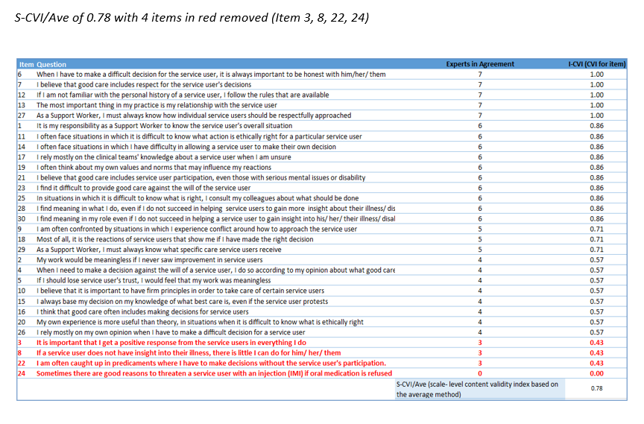

Slide 18
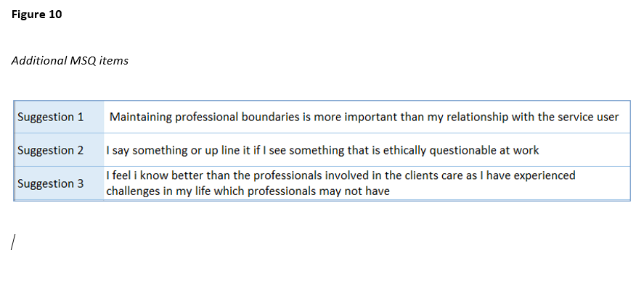
Results

Slide 19
Discussion
The focus of this study has been to assess whether the Moral Sensitivity Questionnaire developed by Lutzen and Nordin (1993) could be used to measure the moral sensitivity of care and support workers working in New Zealand’s healthcare industry.
Content Validity was determined using the CVI method, and following best practice suggestions

Slide 20
Results suggested a reasonable level of validation at 0.73, given the shift in industry focus from health care to support service workers.
However, 0.73 remains short of the minimum recommended CVI of 0.80.
Deleting four items lifted the CVI to 0.78 and three replacement items, suggested by panelists would likely lift it further still.

Slide 21
Conclusions & Future Research
An initial review of the MSQ suggests this instrument could, with small modifications, be appropriately used by managers working with New Zealand based Support Services workers.
Further research is required before this can happen.
  A secondary CVI should be obtained using a panel of support workers, rather than managers
  A Confirmatory Factor Analysis should be run, based on a significant sample of target participants to assess item factor loading and scale structure.

Slide 22

Any Questions?

