Slide 1

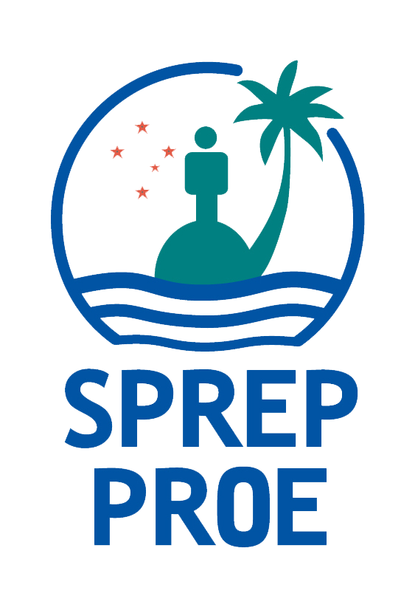

Plastic Pollution Prevention in Pacific Large Ocean Small Island Developing States (LOSIDS)
Dr Trisia Farrelly, Massey University Political Ecology Research Centre [PERC], New Zealand.
Dr Stephanie Borrelle, University of Toronto, Canada, Birdlife Pacific.
Dr Sascha Fuller, Research and Innovation Division, University of Newcastle, Australia.
Funded by the Environmental Investigation Agency and Massey University
Notes:
Talofa lava i lenei taeao manuia. Good afternoon.
Thank you to SPREP, for organising this conference, to my fellow panellists and to all our Pacific island neighbours attending today’s session.
Today I’m presenting research findings on behalf of our research team, Dr Trisia Farrelly from Massey University, NZ and Dr Stephanie Borrelle from University of Toronto, Canada and Birdlife Pacific.
The research team gratefully acknowledges the Environmental Investigation Agency, the Centre for International Environmental Law, WorldWildlife Fund Pacific, Environmental Law Oceania, Island Sustainability Alliance and participating countries.

Slide 2
Regional context
Large Ocean Small Island Developing States (LOSIDS).
Increasingly Import Dependent
Threatened by the transboundary movement of plastics
Threatened by the environmental, health, sociocultural, economic impacts of plastics:
Food sovereignty
Soil sovereignty
Culture/ Way of Life
Livelihoods
Marine and terrestrial ecosystems
Human health
At risk of climate change impacts, exacerbated by plastic production and pollution .
Notes:
Pacific Island countries and territories are some of the most severely affected by plastic pollution and are among the world’s peoples with the closest cultural, economic and social ties to the ocean.
They are nation states whose territory is comprised mostly of oceans and it is for this reason I will refer to them throughout this presentation as Large Ocean Small Island Developing States (LOSIDS).
Increasingly Import Dependent
Threatened by the transboundary movement of plastics
Threatened by the Environmental, Health, Sociocultural, Economic Impacts of Plastics:
At risk of climate change impacts, a threat which is exacerbated by plastic production and pollution
It’s easy to see why one participant in our study referred to plastics as a “WMD, a Weapon of Mass Destruction”.

Slide 3
Research Aims
Identify both the limitations and the strengths of countries to be able to prevent the inflow of plastics under current frameworks; and
Understand the challenges facing Pacific LOSIDS that may limit their potential to be able to implement a multilateral plastic pollution convention, but which a global treaty may help overcome.

Slide 4
Research Methods
Phase 1: A Policy Gap Analysis in which we analysed 52 national level, publicly available documents – legislation, policies, plans and strategies – relevant to plastic pollution in ten participating countries.
Melanesia: The Republic of Fiji, Papua New Guinea, Solomon Islands, Vanuatu
Polynesia: The Independent State of Samoa, the Kingdom of Tonga, Tuvalu
Micronesia: The Republic of Kiribati, the Republic of the Marshall Islands, the Republic of Palau
Based on an adaptation of Pillar 2 of the EIAs proposed multilateral plastic pollution convention.
Completed August 2020. Final report and recommendations available: https://reports.eia-international.org/wp-content/uploads/sites/6/2020/09/Plastic-Prevention-Gap-Analysis-2020.pdf
Phase 2: Narrative Analysis (ongoing)
Preliminary findings of ten semi-structured in-depth interviews with heads of environment departments, heads of waste divisions, heads of customs departments and directors and program managers of regional non-governmental organisations.

Slide 5
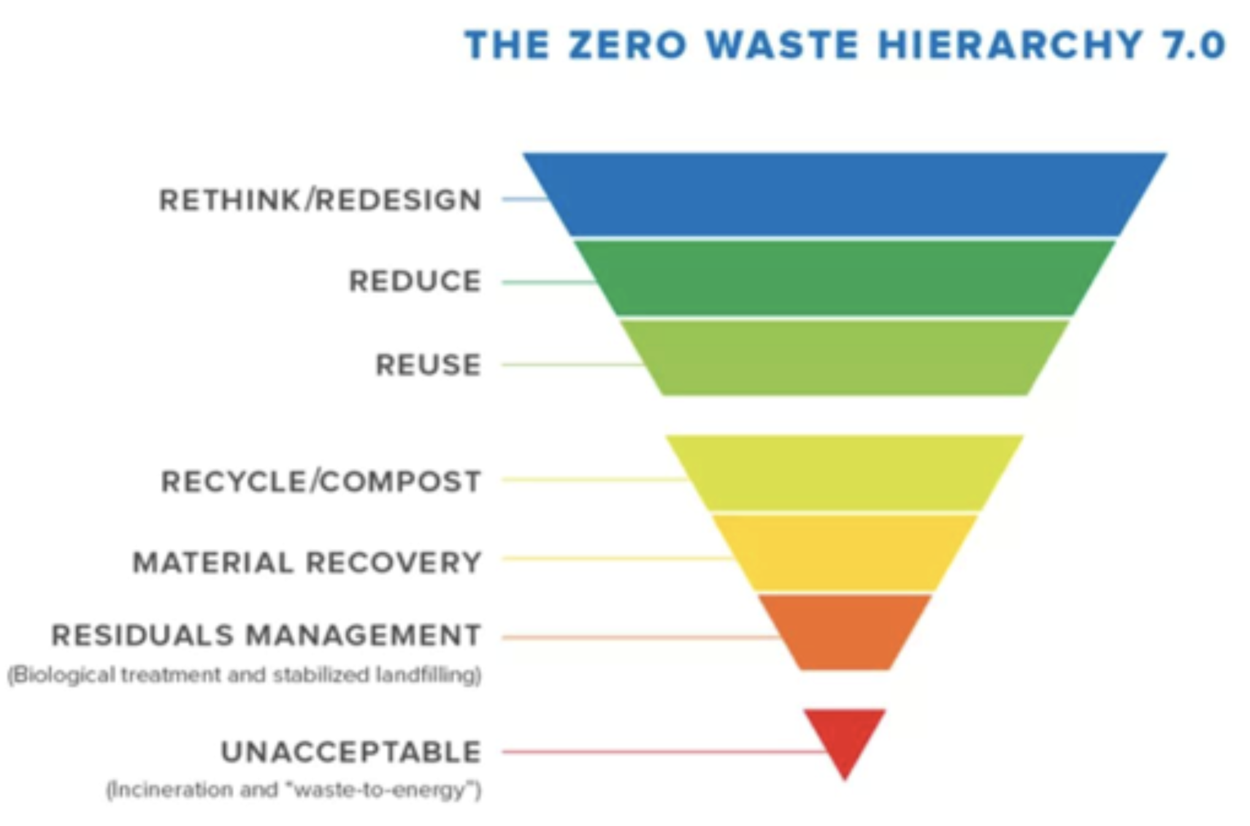
Focus on Prevention
Notes:
The study was focused on policy and legislation that sat at the top of the waste hierarchy: at reduction, reuse, and repair.

Slide 6
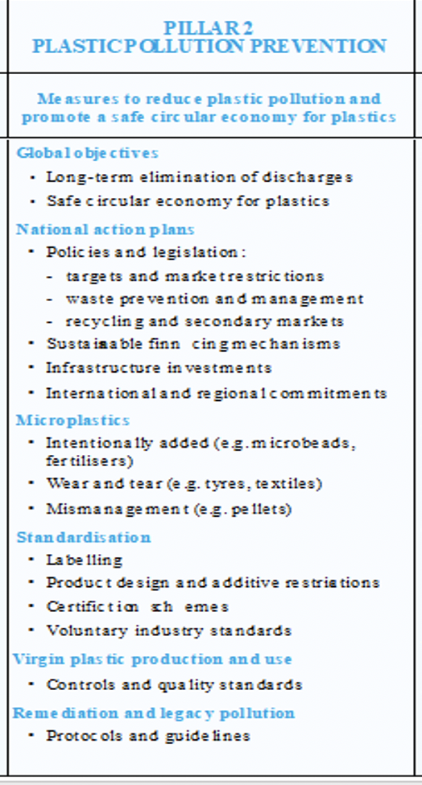
Major Themes
Global objectives
Prevention
Management
Standardisation
Microplastics
Notes:
The gap analysis study results and analysis were structured under five major themes (adapted from the EIAs Pilar 2).

Slide 7
Global objectives
Long-term elimination of discharges | Safe circular economy for plastics | Intergenerational equity & justice | SDGs | Protection of human health | Vertical integration | Horizontal Integration | Precautionary approach | Waste hierarchy | Climate Change
Long-term elimination
Safe circular economy
Intergenerational equity and justice
SDGs
Protection of human health
Vertical integration
Horizontal integration
Precautionary approach
Waste hierarchy
Climate change
Notes:
Each of the documents went through a granular analysis according to the sub-themes listed on the left which are listed on the horizontal axis. The vertical axis lists the 52 key documents we analysed in participating countries. They have been removed here to make viewing easier, but all of these tables can be found and seen easily in the report. The green colour notes that the sub themes listed (or their synonymic phrases) are explicitly addressed in the document. Yellow indicates that the document either partially includes the sub theme or that the sub-theme is inferred. Red indicates that that sub-theme is absent in the document.
For the purposes of this presentation, I will let the tables speak for themselves and focus briefly on the themes of ‘Prevention, Management and Microplastics’.

Slide 8
Prevention
Trade in non-hazardous, recyclable and reusable plastics | National reduction targets | Virgin plastic use | Market Restrictions | Promotion of traditional solutions
Trade in non-hazardous, recyclable, and reusable plastics
National reduction targets
Virgin plastic use
Market restrictions
Notes:
So there is a significant amount if red in this prevention table compared to global objectives. A common theme across the documents was that policies and plans that claimed plastic pollution prevention as the key objective failed to provide a coherent suite of actions and targets to support that claims effective. However, some countries are relatively progressive in terms of legally supported market and trade restrictions. For example, a growing number of countries are banning single-use plastic products such as bags and straws. In most countries, however, there is very little legislation that protects them or the region from the influx of non-recyclable or hard to recycle toxic and unnecessary plastic.
Because Pacific island countries do not produce plastics, virgin plastics in this list here refers to standards, protocols and caps on usage, and the domestic manufacture of plastic products.
Plastic pollution reduction targets were virtually non-existent across the documents and there were no plastic pollution reduction plans. In one regional plan a plastic pollution target was set but the 2025 target remained unchanged from baseline volumes. It’s unlikely that set targets will be realistic unless they are coupled with a focused and coordinated approach to preventing problematic plastic in the region.

Slide 9
Management
Closed loop recycling (primary market) or secondary markets | Infrastructure investments | Legal basis for sustainable financing mechanisms | Economic development/Legal basis for loss or damage | Remediation and legacy pollution | Transport
Closed loop recycling
Infrastructure investments
Legal basis for sustainable financing mechanisms
Economic development
Remediation and legacy pollution
Transport
Notes:
Moving on to ‘Management’. Generally the focus on all the documents analysed remained low down on the waste hierarchy, often stopping at waste management, including landfill management or recycling. Now there is nothing wrong necessarily with recycling but what we’re focused on pushing interventions further up the waste hierarchy than that. Recycling does have the potential to move things further up the waste hierarchy.

Slide 10
Standardisation
Product design | Polymer restrictions | Additive restrictions | Voluntary certification & industry standards | Mandatory product stewardship | National monitoring, reporting, & inventories | Transparency & Freedom of information | Enforcement | Definitions
Product design
Polymer restrictions
Additive restrictions
Certification schemes
National monitoring and reporting
Transparency and freedom of information
Enforcement
Definitions
Notes:
The mostly green sub-theme under ‘Standardisation’ is enforcement. Demonstrating that Pacific countries do have a framework that supports the enforcement of prohibitions relating to plastic pollution. Unfortunately, however, our phase 2 findings demonstrate that enforcement is not happening in practice.

Slide 11
Microplastics
Intentionally added (e.g., microbeads) | Wear and tear (e.g., tyres, textiles) | Agriplastics | Management (e.g., pellets)
Intentionally added (e.g. microbeads)
Wear and tear (e.g. tyres and textiles)
Agriplastics
Management (e.g. pellets)
Notes:
And finally the major theme of microplastics. As you can see there is a lot of red! The only document that reference microplastics was Palau which plans to control virgin pellets, also known as pre-production pellets or noodles, as outlined in Palau’s National Solid Waste Management Strategy 2017-2026.

Slide 12
Key Findings
1. Missed opportunities
2. Lack of access to the latest science-based evidence on plastic pollution.
3. Almost no reference to microplastics.
4. Almost no references to plastics additives, monomers, or persistent organic pollutants (e.g. PFAS).
5. No references to invasive species and pathogens.
Few references to health implications.
Few connections made between plastic pollution and climate change.
Notes:
The study identified missed opportunities to implement legislation and strategies to prevent plastic pollution and strengthen existing plastic pollution legislation and policies by shifting the focus further up the waste hierarchy.
There appeared to by a lack of access to and interpretation of the latest science-based evidence on plastic pollution and as a result, few examples of ‘best practice’.
This is likely the reason for the lack of references across all of the documents to microplastics, to plastic additives and monomers, to persistent organic pollutants (POPS),
and invasive species and pathogens which are rafted on plastics, particularly in marine ecosystems,
to health relationships with plastics that are associated with the toxic chemical components of plastics,
and to climate change relationships with plastic production and pollution.

Slide 13
Key Findings
8. Almost no protections against the toxic impacts of plastic pollution.
9. Lack of traditional/local alternatives.
10. Emphasis on investing in consumer responsibility instead of producer/importer responsibility.
11. Lack of inter-ministerial coordination specific to plastics (beyond ‘waste management’).
12. Limits of Pacific Islands policy:
product design and production volumes
transboundary inbound flows of plastic pollution.
Notes:
There were few traditional or local alternatives to plastics and packaging offered.
There is a much greater emphasis on changing existing consumer behaviour and individual responsibility, for example, a great focus on awareness raising campaigns at the community level, rather than a focus on producer and importer responsibility and behaviour change education, that is, on extended producer responsibility.
We also identified a lack of inter-ministerial coordination, some of that around waste management but quite often those sorts of inter-ministerial coordinate arrangements missed references to plastics and plastic pollution.
The reality is that the current actions legislation, plans and policies cannot effectively prevent the inflow of plastics into the region; they are not robust.

Slide 14
Phase 2: The Politics of Plastics
Findings from our interviews demonstrate the tremendous and unrelenting pressure Pacific nations are under to continue to import plastics and, at the same time, prevent the inflow of plastics to the region.
“It’s got a political context in it now, whereas waste was not political. You know it didn’t have any inter, inter-jurisdiction issues. No one took notice of it. It was a national issue. You deal with waste at the national level. But now it’s becoming a global issue. It’s trans-boundary and I think, you know,… we’re going to see more of a politicisation of plastics.”
Notes:
Preliminary findings from phase two reinforce the findings of the gap analysis. But what is not reflected is in the abovementioned legislation, plans and policy frameworks that the narrative analysis has been able to draw out is the intersection of plastic pollution with
Fisheries
Climate Change
Nutrition, Health and Sanitation
And, the global political economy, for example.
The findings from phase 2 on those which I will focus on now, demonstrate that plastic prevention is a highly contentious political issue. It has changed the waste space in Pacific LOSIDS. Waste has always been a political issue, but a national issue. The emerging global politics of plastics, or the political ecologies of plastics has seen a transformation in this space: transforming what is required of waste and pollution control personal, once national decision-makers, into global negotiations.
Findings from our interviews demonstrate the tremendous and unrelenting pressure Pacific nations are under to continue to: import plastics and, at the same time, prevent the inflow of plastics to the region.

Slide 15
Transnational Corporations
“J-PRISM and SPREP…were working towards a container deposit legislation, a CDL in Fiji…[T]hat was, immediately, that was put on hold and that was put aside, and we found out later that it was because of Coca-Cola. Coca-Cola didn’t want to be told what to do... they didn’t want to be told that [they] had to put in this container deposit fee into [their] product. They wanted to do their own thing….[T]his is just a company, this is not a government, so this is an industry that has, that is a producer of waste that has put a hold on a national policy.”
Notes:
Pacific LOSIDS are under external pressure from transnational companies such as Coca-cola. Coca-cola are opposing national container deposit legislation so they can control the scheme design and self-regulate. They are an example of a major corporation holding nation states to ransom over waste and plastic pollution policies.
In addition to thwarting Fiji’s CDL plans, it looks like Coca-Cola may be trying to influence the direction and scope of CDL in Samoa.

Slide 16
Plastics Manufacturers/ Importers/ Suppliers
“It is out of our control how to influence big suppliers.”
Notes:
While Pacific islands do not produce plastics. they do manufacture plastic products. For example, a number of Samoan-owned water companies bottle water in Samoa. To do so they buy resins from Chinese importers who have imported pellets for distribution in Samoa, and they blow them into water bottles. Banning plastic imports is not necessarily in these manufacturers, importers and suppliers’ interests, with representatives from national environment departments describing the influence importers have over minimizing efforts to implement national single-use plastic bans.

Slide 17
Donor Countries
“Cheque book diplomacy”
“[T]he donors give aid money to countries ultimately to meet their own development and foreign policy needs. So that’s the drive.”
Notes:
The increased politicisation of waste because of plastics has seen more interest, recognition of the issues, and donor funding in this space. It is not lost on Pacific leaders that this is at times a type of “cheque book diplomacy”, that can result in duplication and overlap at the national level, and is cause for some frustration for countries.

Slide 18
Trade Agreements
“[it’s] caused an inability of governments to control their own economy. They have to abide by a law that they’ve signed, and they can’t unsign…they to be able to trade and meet this international trade agreement where…you can’t restrict [it], so it’s actually left to the power of the people to choose what they , [want] and …if you don’t have any money you’ll be buying the most cheapest food and normally it comes in, in you know, normally it probably comes as a result of excess somewhere that is being dumped into the Pacific.”
Notes:
Linked to this is trade agreements, which highlight the powerlessness of national governments to prevent food and waste ‘dumping’ under their World Trade Organisation (WTO) obligations. For example NZ lamb flaps which are illegal to sell in NZ are exported to the Pacific. This highlights too, the link between food dumping and related disease in the Pacific. One participant stated, “[D]isease is a big, is a huge problem…we’re feeding the masses the cheap food and you know we’re hoping that they don’t complain and that they die early.”

Slide 19
Fisheries
“these fishing vessels are not just raping the Islands and the ocean of its resources at a very cheap rate, but they’re getting away with, you know, …they’re polluting as well as raping. It’s almost like the mining industry you know you’re, you’re mining, you’re discharging, you’re not accountable for this, you know you’re getting away with, with illegal unregulated [activities].”
Notes:
Between 2003 and 2017 there were over 20,000 MARPOL violations recorded, demonstrating as one participant notes, “fishing vessels are the bad boys.” There is no enforcement despite the Western and Central Pacific Fisheries Commission (WCPFC) agreement and national . One of our participants suggested the reason for this is that, “powerful distant fishing nation such as China and Japan are responsible for 77% of the incidents.

Slide 20
Pacific LOSIDS are currently ill-equipped to deal with the politics and pressures of plastics
“[We] just want to just do the work instead of dealing with the politics, but I think [plastic pollution] brings in a different dimension and it’s going to require a different set of skill that the technical folks don’t have and, yeah I think we’re going to have to collaborate and form different coalitions that, and get friends that are, that are, can do this part of the work which is not in the current skill of the folks that we have”.
Notes:
The above external pressures have transformed waste management and pollution control in Pacific LOSIDS. Technical staff in regional NGOs and national governments have not previously had to deal with the politics of negotiating global power relations and do not have the skills in influencing international policy. But it’s not just an issue of technical capacity, human resources are stretched. The focus on plastics has added to the workloads of environment and customs officers across Pacific island nations, who in addition to their full-time jobs are expected to represent their countries in global fora.

Slide 21
Support for a Global Convention on Plastics
Support a shared, regional position
Address global transboundary challenges
Promote extended producer responsibility/ safe economies
Put pressure back on big suppliers
Draft international standards
Support local/ traditional solutions
“This global treaty is going to share the load, yeah. It, I think it’s going to mean that the countries are not just by themselves. We all are in this together.”
“Well because it’s a trans-boundary [issue], you know…so this international trans-boundary legally binding agreement is and has to be the key. It’s not just a national waste problem. It is a global waste problem.”
Notes:
It’s for all of the above reasons that the participants we have spoken to, to date, have given overwhelming support for global treaty. For Pacific islander leaders a global convention will:
Support a shared, regional position
help address global transboundary challenges
Promote extended producer responsibility/ safe economies and in so doing
Help put pressure back on big suppliers
Draft international standards so more powerful countries can no longer waste dump products in the Pacific.
Support Local/ Traditional solutions

Slide 22
What can Pacific island leaders do?
National and regional declarations of support for a global agreement.
Ratify existing regional instruments (Noumea Convention, Noumea Emergencies Protocol and Dumping Protocol, Waigani Convention).
Ratify existing global instruments: London Convention and its Protocol under the International Maritime Organisation, MARPOL, and the Basel Convention
Engage at AHEG-4, AHEG-5, and UNEA-5 to secure a negotiating mandate at UNEA-5.
Notes:
The key to preventing plastic pollution in the Pacific region and around the world is to regulate the most powerful plastics producers at port and so conclude by making the recommendation for Pacific island countries continue to support the development of an international plastic pollution agreement that addresses the full life cycle of plastics, prevention at source and the transboundary flows of plastic pollution.

Slide 23
Recommendations
Prioritise a coordinated, collaborative, transparent approach between sectors to restrict categories of plastics.
Mandatory product stewardship schemes for difficult to ban products
Shift responses from waste management to waste prevention
Sustainable financing mechanisms. For example, extended producer responsibility (EPR) or product stewardship schemes.
Consider a centrally located and regionally coordinated container deposit scheme
Legislate backloading/ reverse logistics
Consider support for the establishment of WCPFC compliance measure and strengthen national MARPOL legislation.
Seek training and support to develop capacity to be able to negotiate with powerful interests in the region.
Notes:
Those countries that have enforced bans may wish to consider working with customs, law enforcement, and importers to restrict categories of plastics. Prioritise a coordinated, collaborative, transparent approach between sectors, particularly between Environment and Customs Departments.
Wrapping mandatory product stewardship schemes around difficult to ban products, those products that Pacific island countries are dependent on that don’t have alternatives yet may also be considered.
Current management strategies can be developed to shift responses to the inflow of increasing volumes and increasingly problematic forms of plastics from waste management to waste prevention using sustainable financing mechanisms. For example, extended producer responsibility (EPR) or product stewardship schemes. These schemes can be built to ensure off-shore plastic producers are responsible for the full life cycle of the products they profit from and including what happens to those products once they are imported into the Pacific region.
Consider a centrally located and regionally coordinated container deposit scheme, particularly for the most recyclable of plastics, PET, to provide the economy of scale required to support struggling national container deposit schemes.
Legislate backloading/ reverse logistics to ensure plastics and other problematic materials are removed entirely from the region at end of life and that producers responsibly manage these at point of origin. These kind of arrangements as well as trade restrictions could replace the need for expensive domestic container deposit schemes that rely on dwindling and volatile foreign recycling markets.
Consider support for the establishment of WCPFC compliance measure and strengthen national MARPOL legislation.
Seek training and support for technical waste staff in regional NGOs and national governments to develop capacity to negotiate with powerful interests in the region.

Slide 24
National Plastic Pollution Elimination Action Plans
Address the full life cycle of plastics, not just the end of pipe management
Prioritise prevention over false solutions
Include labour laws to support informal waste workers
Prevent problematic plastics passing into countries through customs
Supported by regional and global efforts
Extend current public-private partnerships
Notes:
National plastic elimination plans would address the full life cycle of plastics, not just the end of pipe management, they should prioritise prevention over end-of-pipe in general, for example, prioritising prevention over landfill expansion.
Prioritise prevention over false solutions (e.g, bioplastics, waste to energy incineration and downcycling), due to the pervious outcomes that we’ve been alerted to in the science-based evidence.
Include labour laws to support informal waste workers and legislation would be flexible enough to incorporate new materials as they are released onto the global market.
Prevent problematic plastics passing into countries through customs.
Supported by regional efforts and would extend current public-private partnerships.

Slide 25

Thank you
For more information please contact:
T.Farrelly@massey.ac.nz
Stephanie.borrelle@birdlife.org
Sascha.Fuller@Newcastle.edu.au

