Slide 1


The sixth vowel in Vatlongos
(Southeast Ambrym)
Eleanor Ridge
Vanuatu Languages Conference
12/07/2023

Slide 2
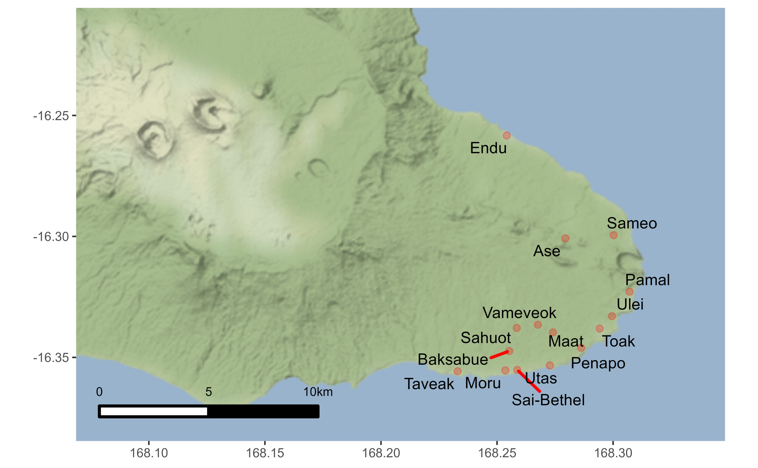
Vatlongos – Southeast Ambrym

Slide 3
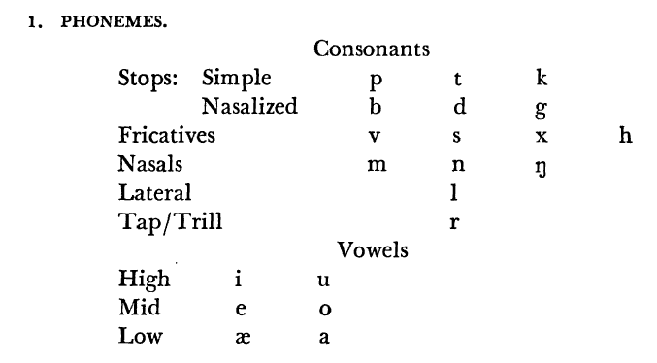
Vatlongos phonemes
Parker 1968 ‘Southeast Ambrym Phonology’

Slide 4
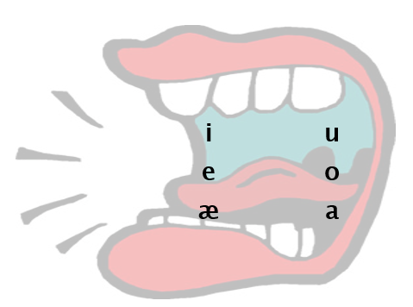
Vatlongos vowels

Slide 5
Vowel 6: Minimal pairs
e | æ | a
mei ‘kam’ | mæi ‘hangga, hemi letem’ | mai ‘rif, sotleg’
lehi ‘lego’ | læhi ‘karem!’ | lahi ‘singsing!’
mel ‘hemi glad (Endu-Vatlongos) | mæl ‘dragon plum’ | mal ‘hemi wid lo garen’
mbe ‘hemi go lo, hemi... (olsem English is)’ | mbæ ‘hemi go’ | mba ‘hemi sakem frut’ (ating Endu-Vatlongos nomo?)

Slide 6
Vowel 6: Minimal pairs
e | æ | a
 | hæl ‘mekem shap’ | hal ‘husk blo kokonas’
 | mæh ‘oltaem’ | mah ‘carry’
 | mæhis ‘ases’ | mahis ‘aftanun’
mele ‘sore throat’ | mæle ‘nogat salt, bland’
mæmei ‘yawn’ | mæmæi ‘pispis’
 | mæt ‘hemi ded’ | mat ‘mat’ (Bislama loanword)
pe ‘andanit’ | pæ ‘karem (wan man)’
 | pæpæn ‘sut wetem boanaro’ | papan ‘wisel’
 | pæs ‘bonem’ | pas ‘brekem’
 | væh ‘pandanus’ | vah ‘shed’

Slide 7
Vowel 6: Restrictions
Occurs in just 107 words of >3000 in database
  (excluding Bislama loanwords and proper nouns)
  but there might be more transcribed as /a/ or /e/

Slide 8
Vowel 6: Restricted distribution
After labial consonants (/p/, /ᵐb/, /m/, /v/)
pæsi ‘bonem’ mbæ ‘hemi go’
mætu ‘kokonas’ væhakut ‘oltaem’
Before /h/
milæhi ‘hemi karem’ puitæh ‘door’
viliæh ‘wataem’ kettæh ‘lukluk’
Exceptions
hælis ‘padel’ hæsi ‘glad’
hiræe ‘neck’ kæau ‘fatfat’

Slide 9
Vowel 6: Role in morphology
Distribution in verb paradigm of ha ‘go’ suggests at some point an allophone of /a/ conditioned by labial consonant
  ha – basic form (imperative, distant future, immediate future 3sg…)
  mbæ – non-future affirmative
  væ – negative polarity, immediate future 2sg and pl
  mæ – immediate future first person singular
(This verb very frequent in corpus)

Slide 10
Lexical variation
In many lexemes, there seems to be free variation between /a/ and /æ/ or /e/ and /æ/
e.g. with /e/:
himetu or himætu for ‘bigwan’
heilep or heilæp for ‘middle’
e.g. with /a/:
sakras or sakræs for ‘no save’
vari or væri for ‘wantaem’
Possibly subject to regional patterns, but not as salient as other patterns, e.g. /a/ and /o/
This project found lots of intraspeaker variation, within same recording event

Slide 11
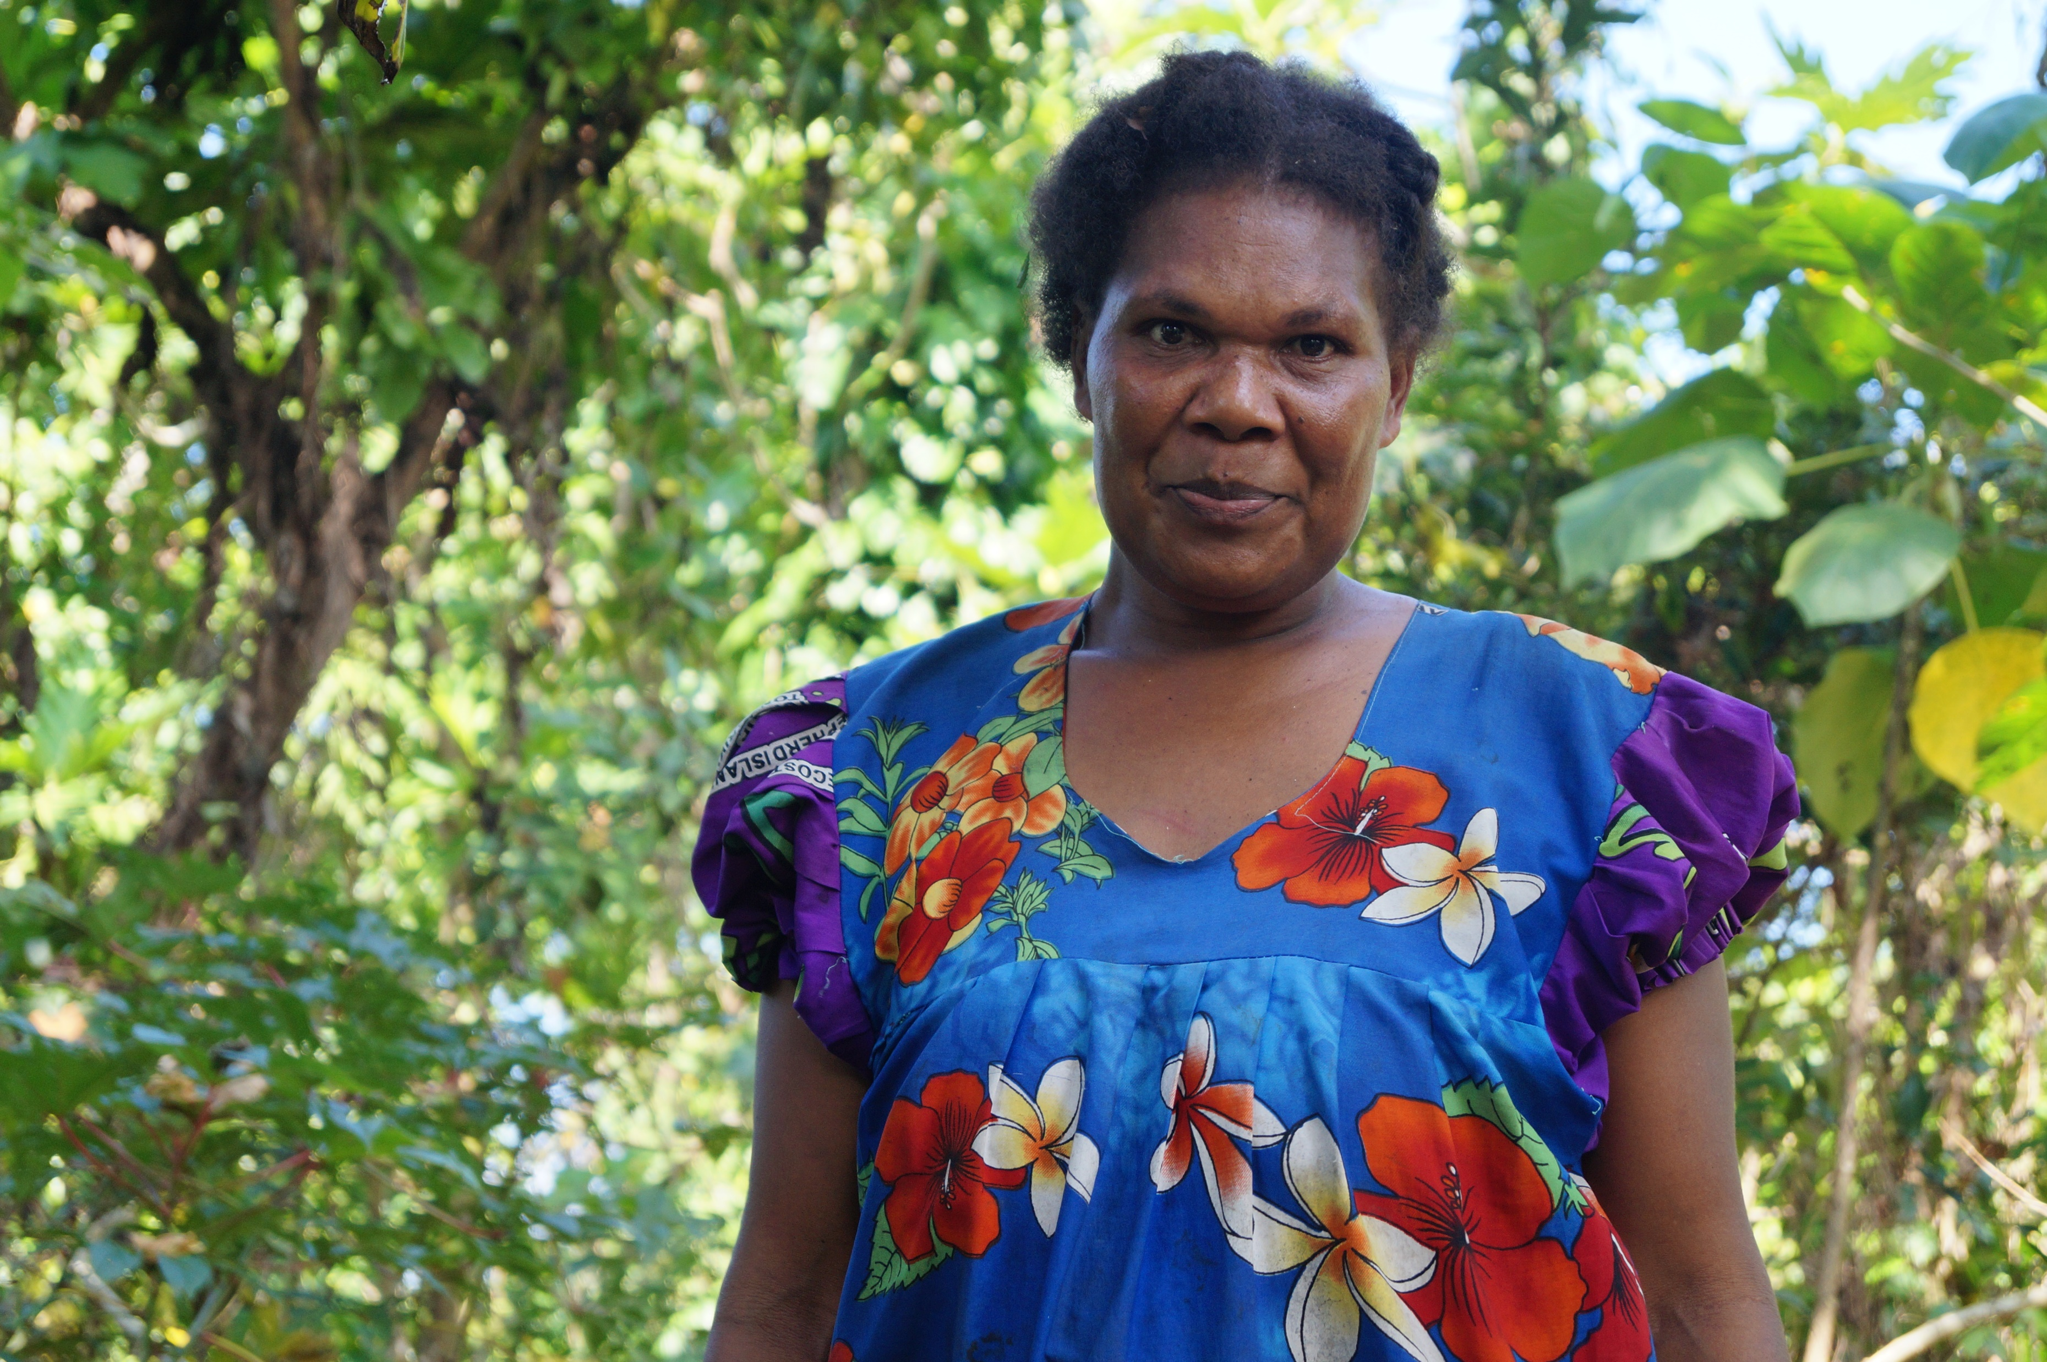
Acoustic investigation
Examined vowels in three narrative texts from the same speaker – Madleen Ben
Collected in normal Ambrym conditions - noisy
already had time-aligned transcriptions and interlinearisation in FLEx
Research assistant Abrie Brits extracted clips from ELAN into Praat and annotated segments in timegrids, keeping track of vowels in spreadsheet
Used the RPraat package (Albin 2014) and followed Stanley 2022 tutorial on vowel plots with ggplot2

Slide 12
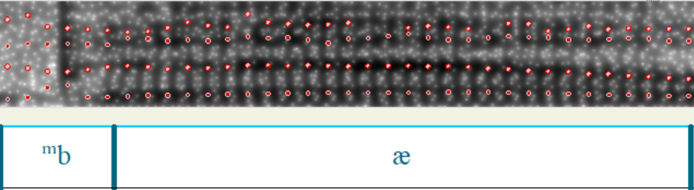
Spectrograms

Slide 13
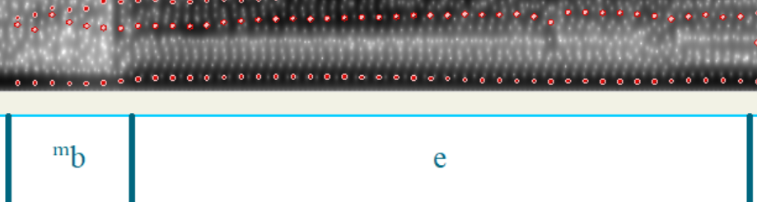
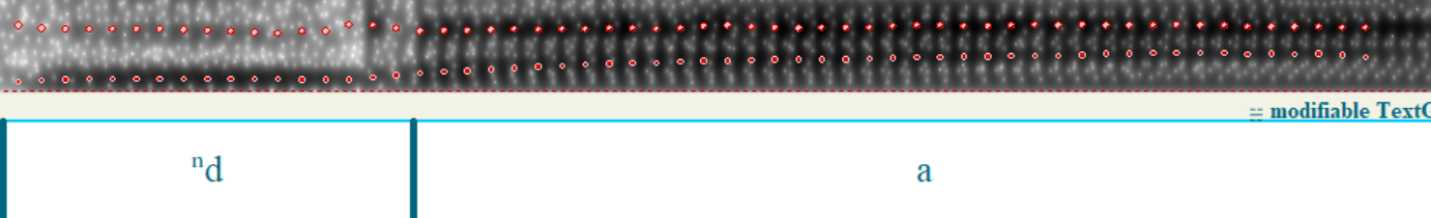

Slide 14
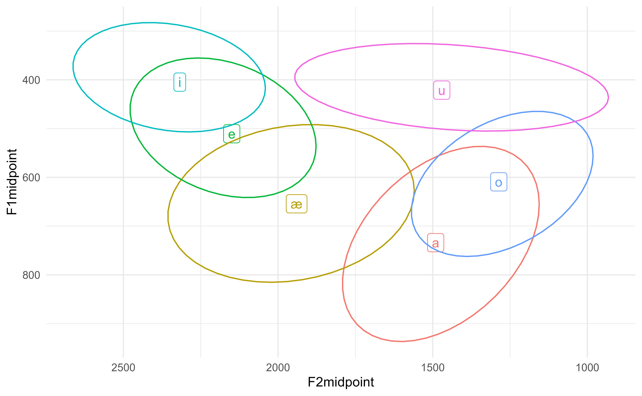
Vowel space

Slide 15
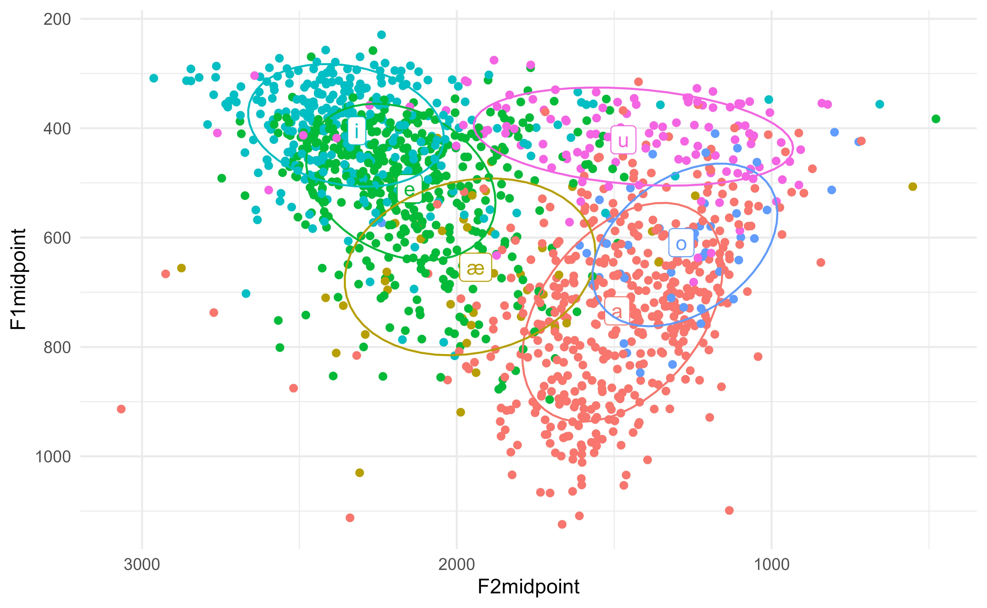
Vowel space

Slide 16
Variants of æ
Nasalisation
  Tbc – nasality data collected last week using earbud method (Stewart and Kohlberger 2017)
  Nasalisation adjacent to nasal consonants
  Nasalisation after prenasalised consonants?
  Stylistic nasalisation?
Devoicing
Creaky

Slide 17
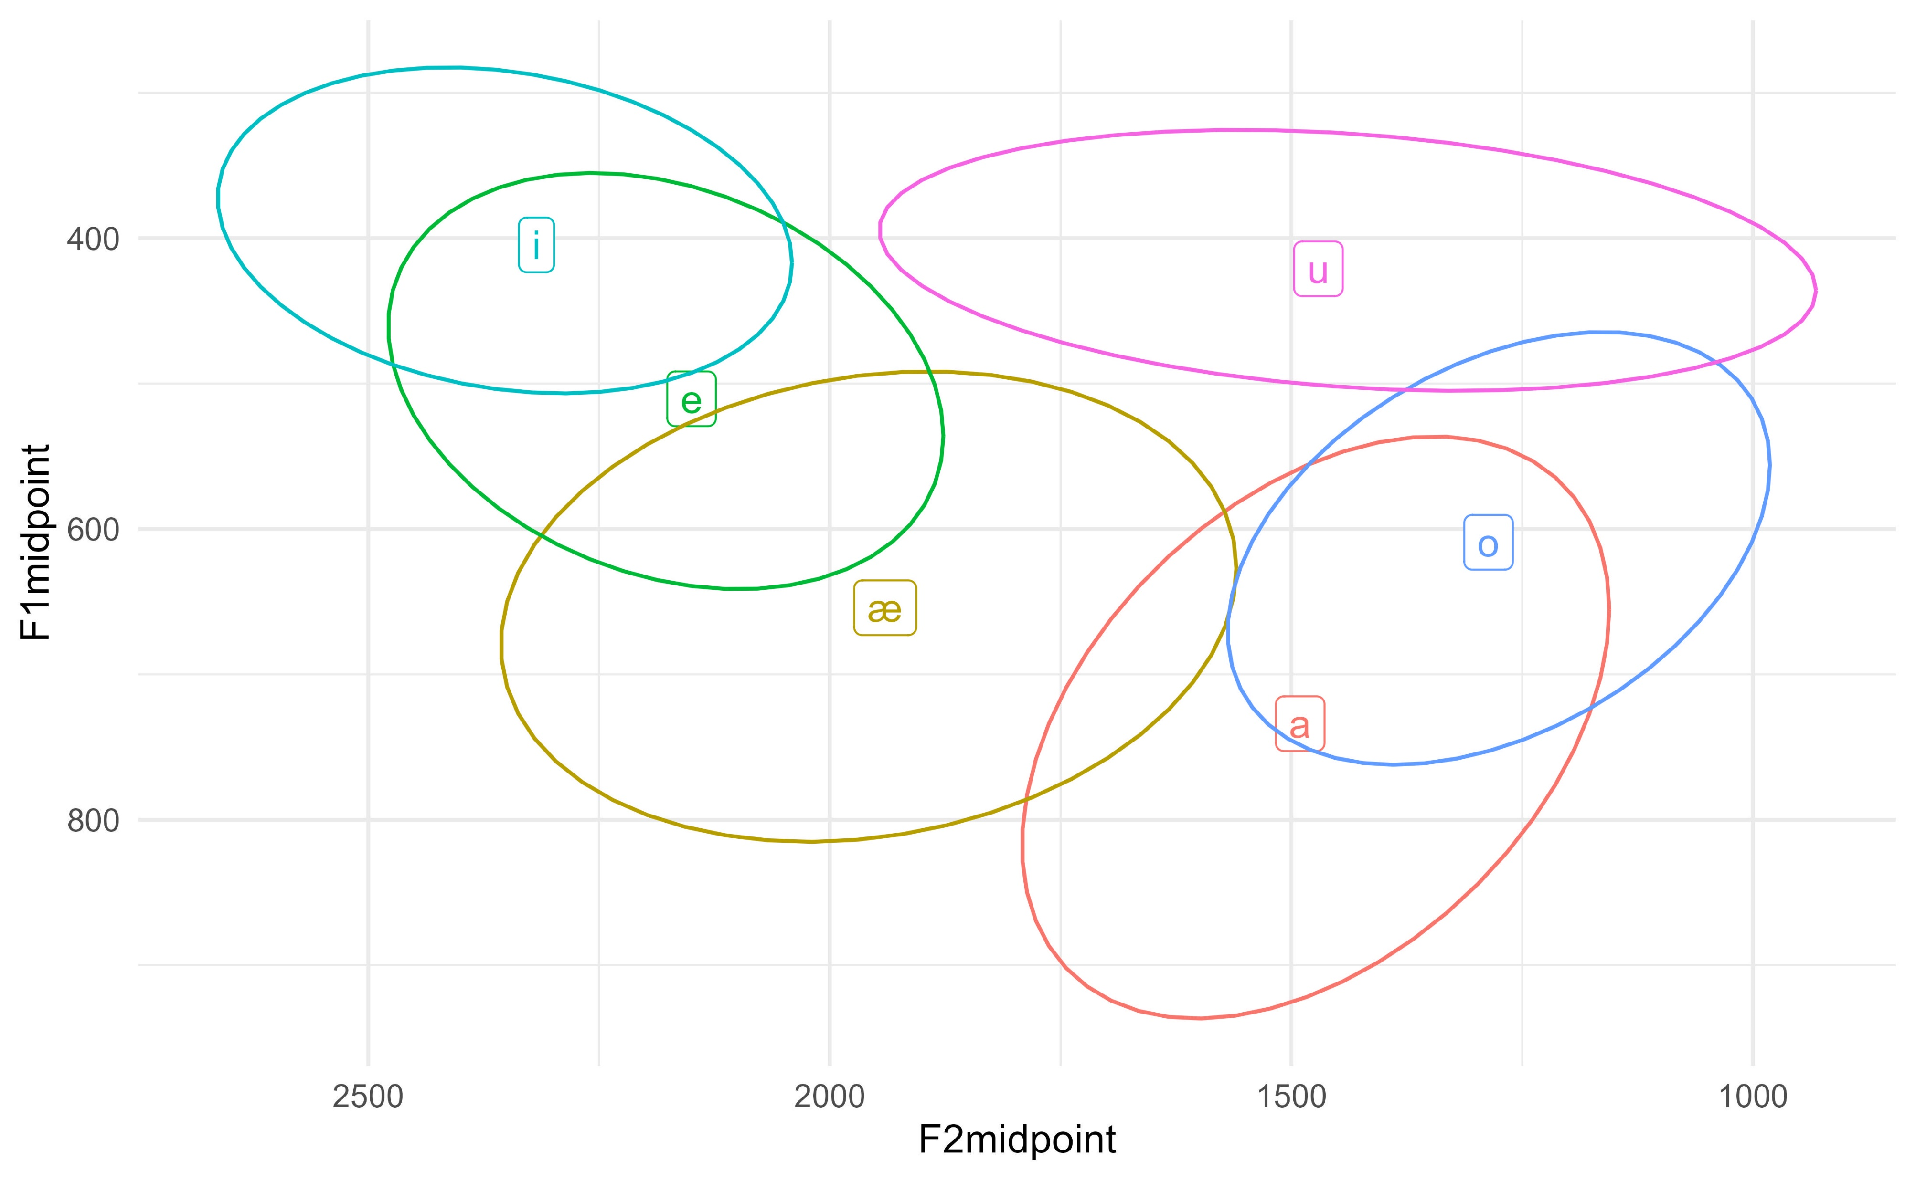
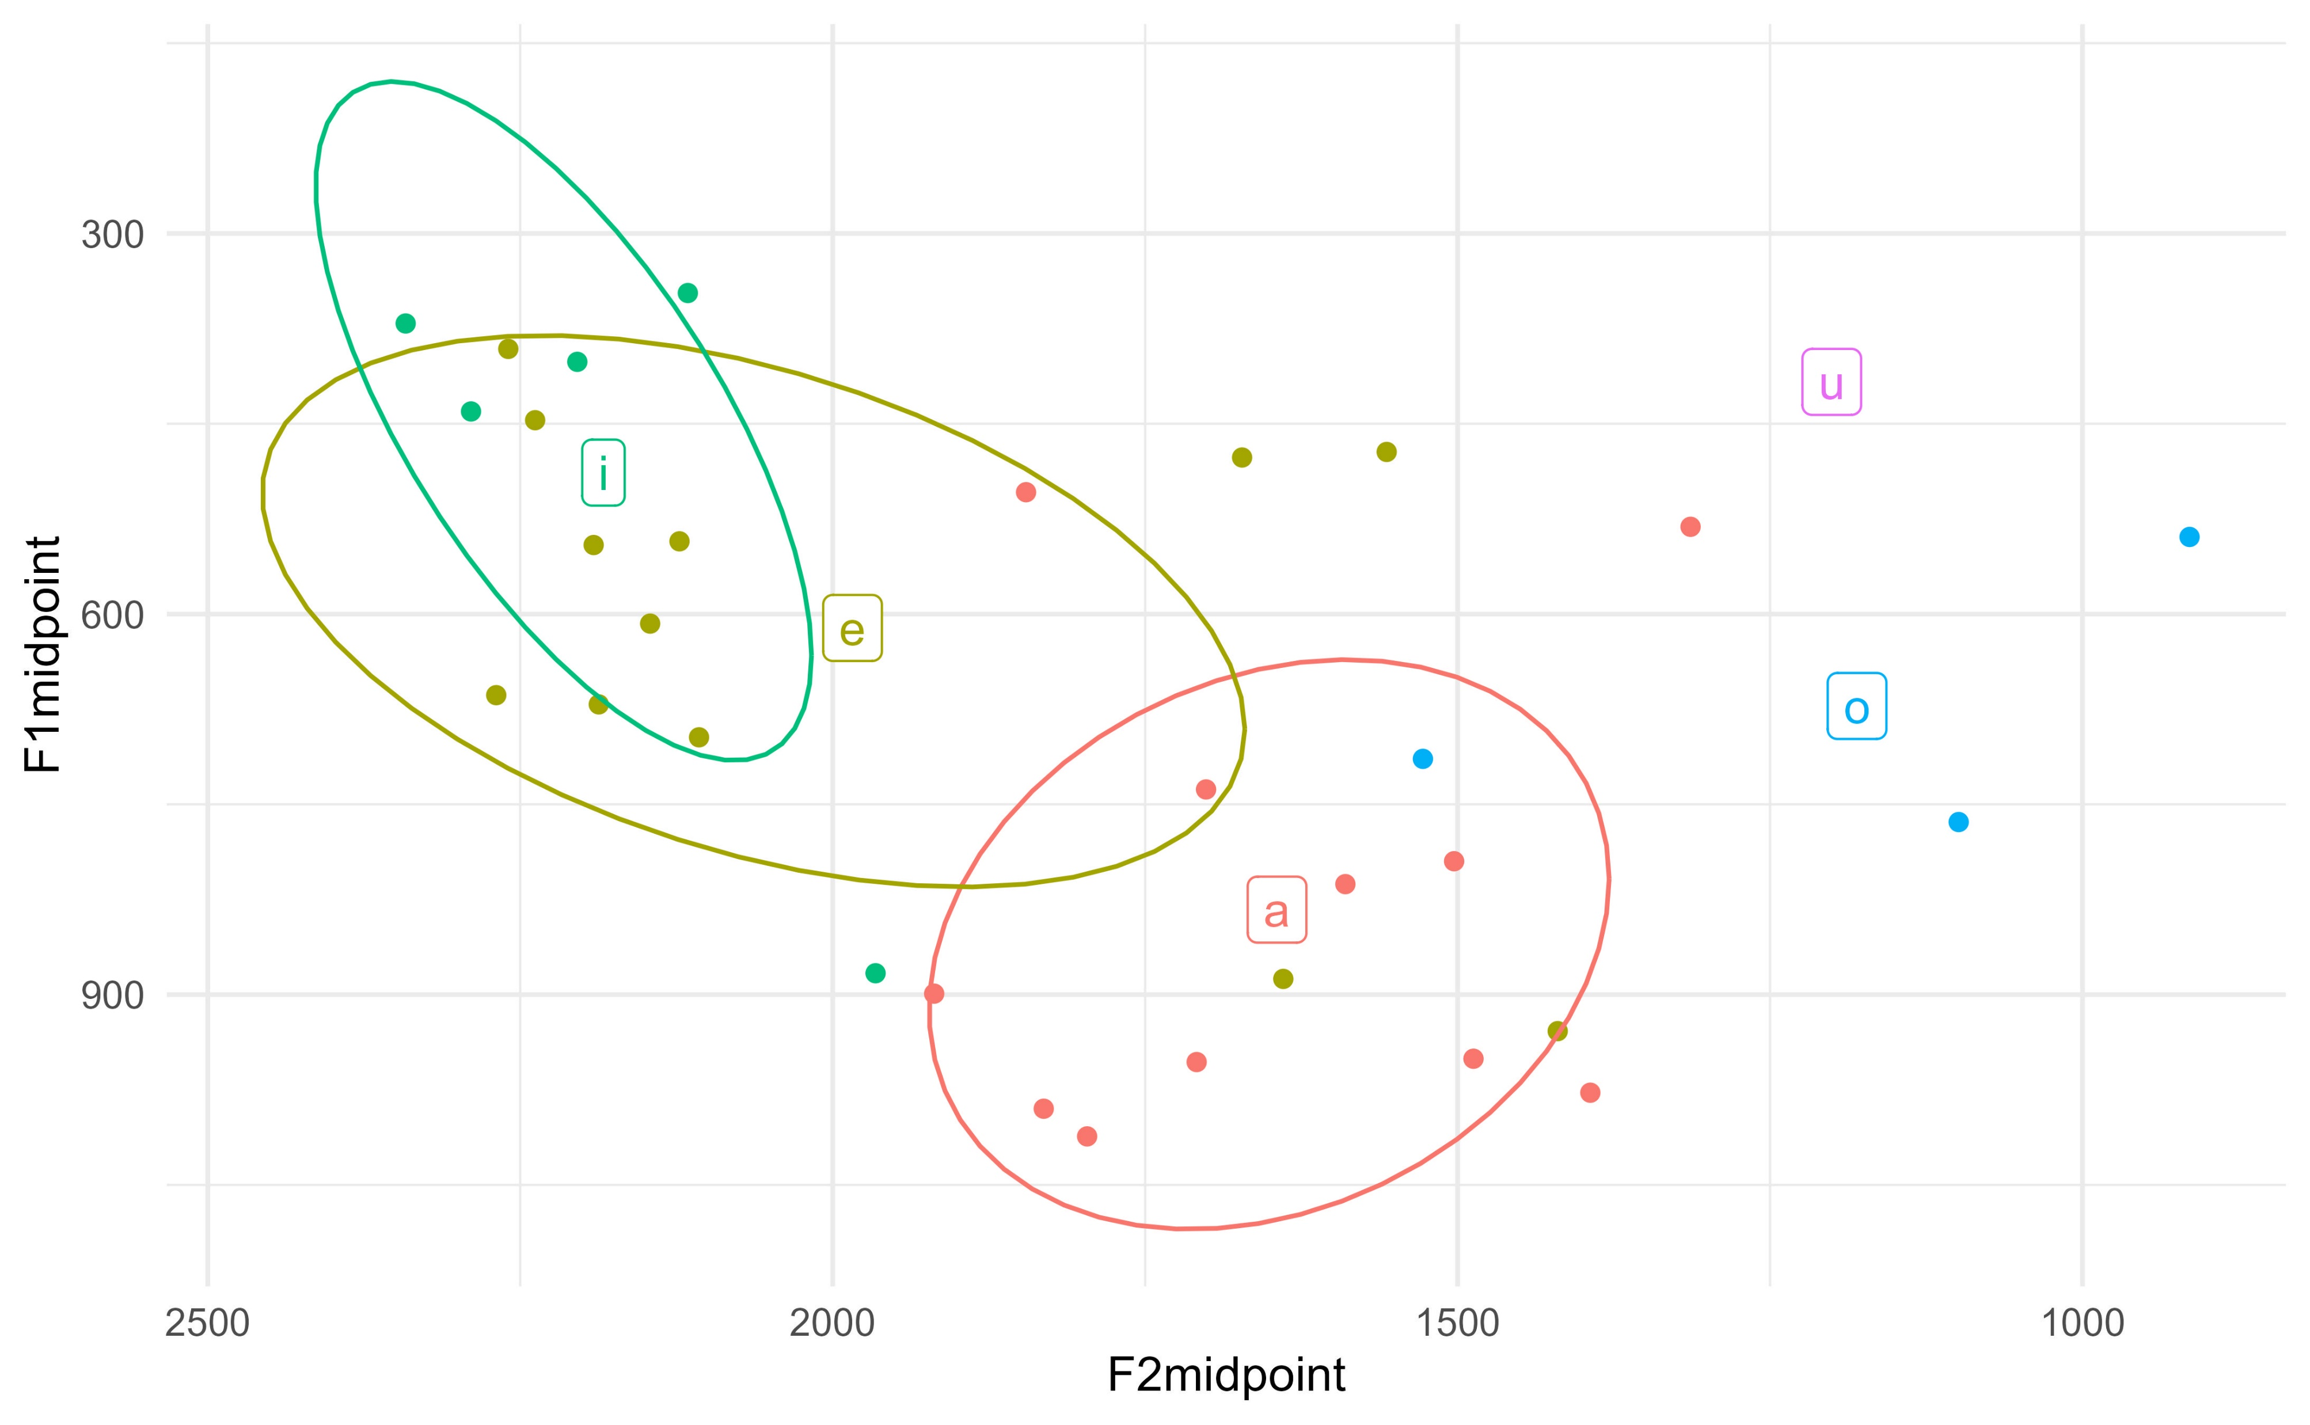
Bislama /a/?
Based on very limited data, Bislama /a/ seems to be intermediate between Vatlongos a and æ
Lack of integration of Bislama /a/ into Vatlongos sound system

Slide 18
Writing /æ/
Tends not to be marked in writing, including in Vatlongos Bible translation
General preference to write with <e> rather than <a>
  especially before <h>
and use <a> consistent with basic verb form in mba
Exceptions: e.g. <mat> for mæt in Vatlongos Bible
Do exceptions reflect alternate pronunciations? Underlying phoneme?

Slide 19
Writing /æ/
Current suggestion for transcription: <à> or <è>
Pros:
Symbols used in French
Allows for flexibility in preferences in <a> or <e>, which may reflect sound system
Cons:
Two symbols, one sound
Diacritics less likely to be used, especially by majority Anglophone educated population

Slide 20
Questions
Is /æ/ in some cases a variant of /a/ and /e/?
Looking at different phonological environments
What happens in vowel sequences?
  (especially as best minimal pair is in sequence _i)
Inter and intra speaker variation
Relation to lexicalisation
/a/ in Bislama loanwords versus Vatlongos /a/
How/if to mark /æ/ in the writing system?

Slide 21

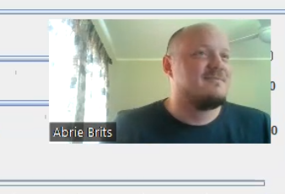
Nammes xatel
Language consultant Madleen Ben for sharing and transcribing these stories
Research assistant Abrie Brits
This project was funded by a Massey University Research Fund grant

Slide 22
References
Albin, A. 2014. PraatR: An architecture for controlling the phonetics software "Praat" with the R programming language. Journal of the Acoustical Society of America, 135(4), 2198.
Baquero, Oswaldo Santos. 2019. ggsn. (https://github.com/oswaldosantos/ggsn)
Kahle, David & Wickham, Hadley. 2013. ggmap: Spatial visualization with ggplot2. The R Journal 5(1). 144–161.
Parker, Gary J. 1968. Southeast Ambrym Phonology. Oceanic Linguistics, 7(2): 81-91.
Stanley, Joseph A. 2022. Vowel plots with ggplot2. https://doi.org/10.5281/zenodo.7222149
Stewart, Jesse & Martin Kohlberger. 2017. Earbuds: A Method for Analyzing Nasality in the Field. Language Documentation and Conservation, 11: 48-80.
Wycliffe Bible Translators. 2015. The New Testament in the Southeast Ambrym Language of Vanuatu: Vanuvei Eo e sepinien Vatlongos na mol-Vatimol xil. Wycliffe.

Slide 23

Sipa mun!

