Slide 1

The path to a legally binding plastics treaty
Associate Professor Trisia Farrelly
Massey University, Aotearoa New Zealand
for BFFP India National Meeting , Chennai, Tamil Nadu, 18 December 2021
Notes:
With plastics production set to double by 2040, plastics are presenting novel and complex challenges to life on our planet. Our current narrow and siloed business-as-usual approaches to the crisis has failed. If we have any hope of resolving the plastic pollution crisis, we need to see the adoption of an international legally binding plastics pollution treaty.

Slide 2
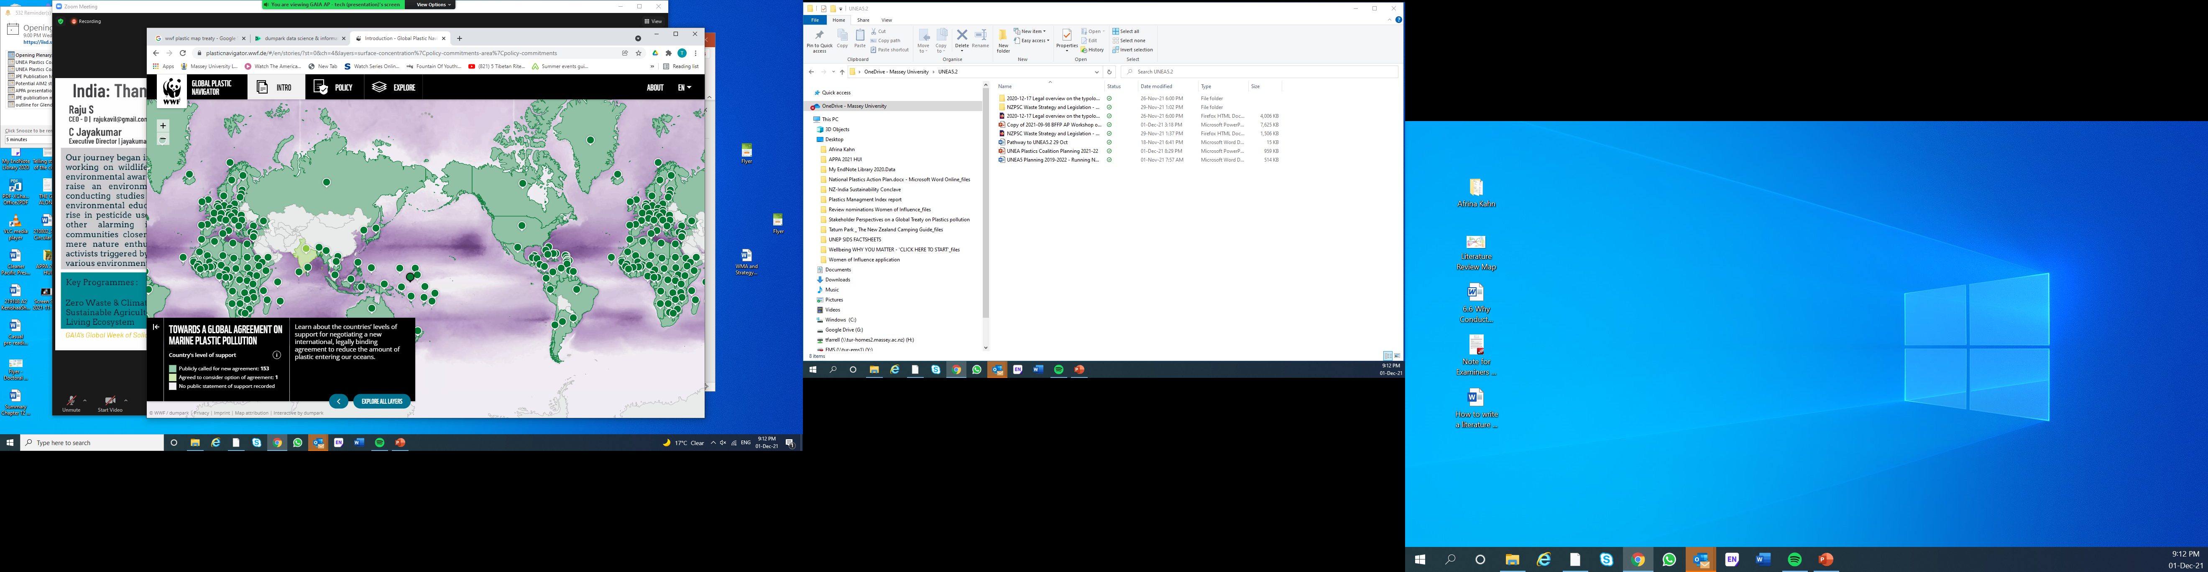
Notes:
Following years of discussions, the global community is finally seeing widespread support to convene an intergovernmental negotiating committee (INC) at the 5th Session of the United Nations Environment Assembly (UNEA-5.2) in February 2022, with a mandate to prepare a new international treaty to address the accelerating plastics crisis. Over 150 countries are now in support of such an agreement.

Slide 3
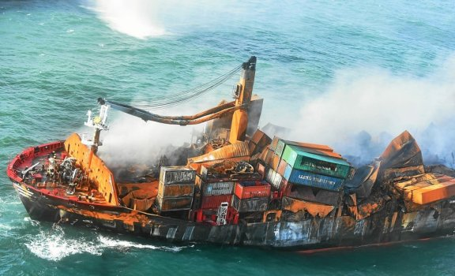
Gaps in current global governance
Notes:
Why a new standalone global agreement on plastics? Why not just improve on the multilateral environmental agreements we already have?

Slide 4

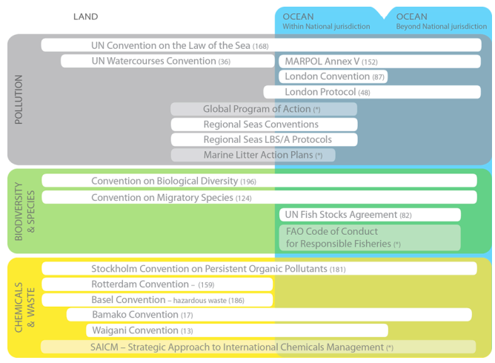
“Current governance strategies provide a fragmented approach that does not adequately address marine litter and microplastics.”
Source: UNEP (2017) Assessment
Notes:
In 2016, the second UN Environment Assembly called for an assessment of the effectiveness of the relevant governance strategies to combat marine plastic litter and microplastics. The report revealed significant gaps, weaknesses, and lack of integration between current governance strategies, and that the status quo was not an option - we need to work towards a new global framework.
No current international agreement or convention aimed at addressing plastic pollution individually nor collectively deals with the full life cycle of plastics. Most agreements are restricted to marine litter, especially sea-based sources, and virtually all of them focus on waste management but are weak on design, production, prevention, reduction, and trade. The mainly voluntary current approaches have proven insufficient in terms of their ability to respond to the scale of the plastics crisis. What is needed is ambitious, legally binding and globally collaborative action.

Slide 5
THE PROCESS HAS BEEN A SPRINT because of the urgency of the situation
UNEA 1
UNEA 2
UNEA 3
UNEA 4
Resolution 1/6 (2014):
Stresses the importance of the precautionary approach.
Requested UNEP to undertake a study focusing on key sources of marine plastic debris and microplastics.
Resolution 2/11 (2016):
Recognizes the issue as “rapidly increasing serious issue of global concern that needs an urgent global response taking into account a product life-cycle approach.”
Requested UNEP to undertake an assessment of the effectiveness of relevant governance strategies to combat marine plastic litter and microplastics.
Resolution 3/7 (2017)
Stresses the importance of long-term elimination of discharge of litter and microplastics to the oceans.
Encouraged innovative approaches such as extended producer responsibility and container deposit schemes.
Decided to convene an Open Ended Ad-Hoc Expert Group on Marine Litter and Microplastics (AHEG).
Resolution 4/6 (2019)
Stresses the importance of more sustainable management of plastics throughout their life cycle, including but not limited to the circular economy.
Required UNEP to compile data to prepare an assessment on sources, pathways and hazards of litter, including plastic litter and microplastics pollution, and its presence in rivers and oceans.
Decided to extend the AHEG mandate unti UNEA 5.
Notes:
Significant work has been done to get to the point where over 150 countries have declared support for a plastics treaty:
This is reflected in successive UNEA resolutions as shown here:
An analysis and subsequent report requested at UNEA 2 in 2016 demonstrated the gaps in current international law to preventing plastic pollution and marine litter.
- UNEA Expert Group was called for in UNEA3 in 2017. The group discussed options to address plastic pollution at a global level, on the basis that maintaining the status quo was not an option.
There was a dedicated Ministerial Conference on Marine Litter and Plastic Pollution in September this year and the Ministerial declaration calling for for a global agreement.
A number of groups have proposed treaty elements for a the architecture and elements of a treaty
And two resolutions have been submitted for discussion at UNEA5.2.

Slide 6
TIMELINE
Sept-Dec:
UNGA Resolution calling to UNEA to take ambitious action?
UN Ocean Conference
(tbc)
June 2-3:
Stockholm+50
Oct:
Japan announced a
Draft Working document
UN Official meetings
Sept 2nd: Peru/Rwanda +40 presented a
Draft UNEA Resolution
Feb:
OECPR &
UNEA-5.2
June:
High Level Dialogue
on SDG 14
UNEA-6
Nov:
AHEG-3
Nov:
AHEG-4
Feb:
UNEA-5.1
2020
2021
Sept 1-2:
Ministerial Conference
2022
2024?
May 27-28:
Pre-meeting
June 28-29:
Pre-meeting
Ministerial Conference on Marine Litter and Plastic Pollution
Ocean Day Declaration on Plastic Pollution
A non-negotiated Ministerial Statement with key elements for global action
Resolution requesting UNEP’s ED to convene an INC under UNEA to prepare an international legally binding instrument to address plastic pollution
OUTCOMES
AHEG Chair's summary
- Message from
UNEA-5.1
-Decision 5/3.
Notes:
The 150+ countries that have declared support for treaty negotiations have done so through the following mechanisms:
UN Oceans Day Declaration → which calls for a legally binding treaty
The Ministerial Statement → which lays out the “aim of achieving a new Global Agreement with ambitious goals, wide participation and means of implementation”
And a range of regional and topical declarations including OSPAR; the Pacific Regional Declaration; 5th France-Oceania Summit Declaration; IUCN; AMCEN; Bamako signatories; CARICOM; Nordic Council; G7; and G20;

Slide 7
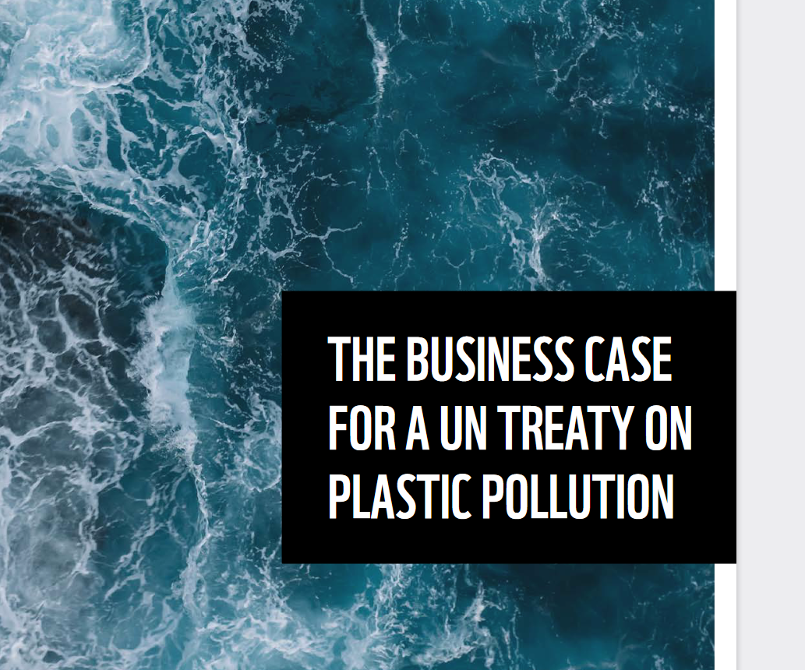
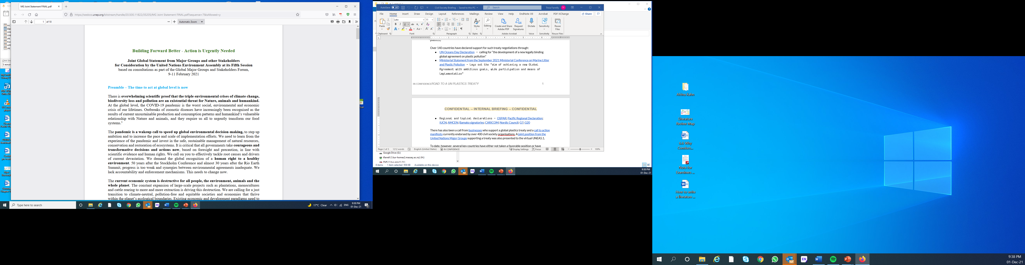
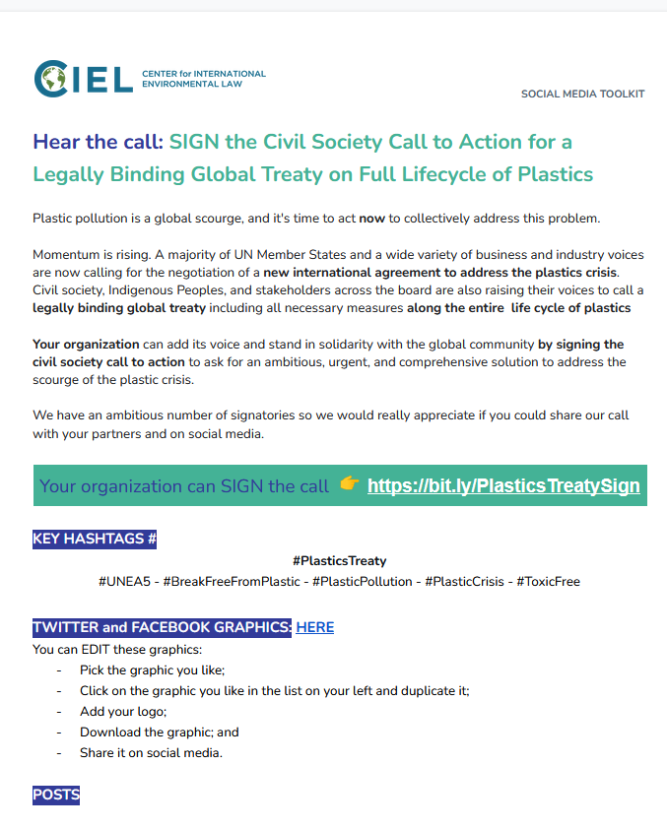
Notes:
Additional support for a global treaty on plastic pollution comes from a joint position from the United Nations Major Groups which was presented to the virtual UNEA5.1.
There has also been a call from businesses who support a global plastics treaty. This was sponsored by WWF, Ellen MacArthur Foundation and Boston Consulting Group.
A call to action for a legally binding plastics treaty has currently been endorsed by over 750 groups including civil society, women, Indigenous Peoples, workers and trade unions, children and youth. Signatories are from more than 120 countries on six continents, representing several million members, volunteers, and community members globally.
And the Ellen McArthur Foundation supports a global treaty with legally binding targets.

Slide 8
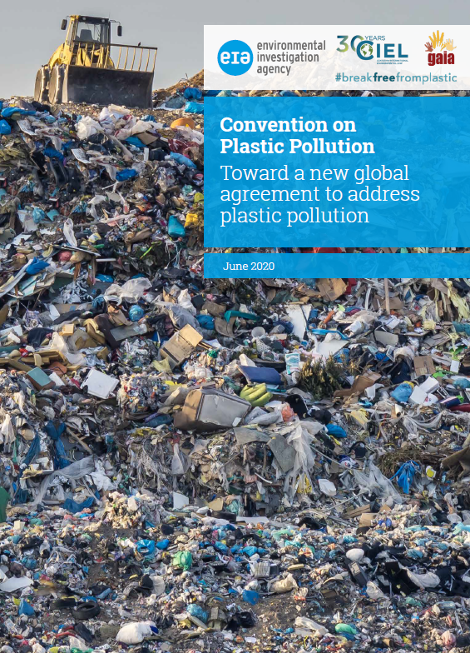

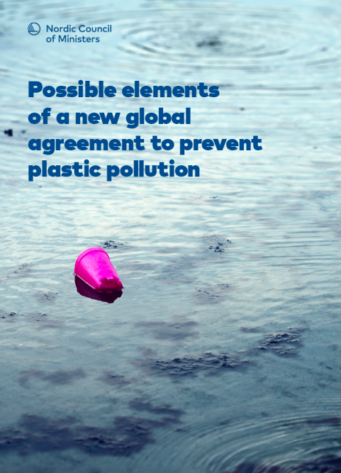
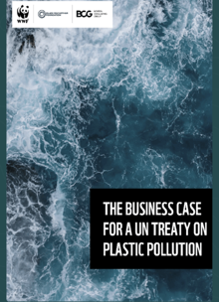
WHAT SUCH A TREATY MIGHT LOOK LIKE
EIA, CIEL, GAIA
#BreakFreeFromPlastic
A binding global agreement to address the life cycle of plastics
CIEL and alt.
Nordic Council of Ministers
WWF, Ellen MacArthur Foundation and Boston Consulting Group

Slide 9
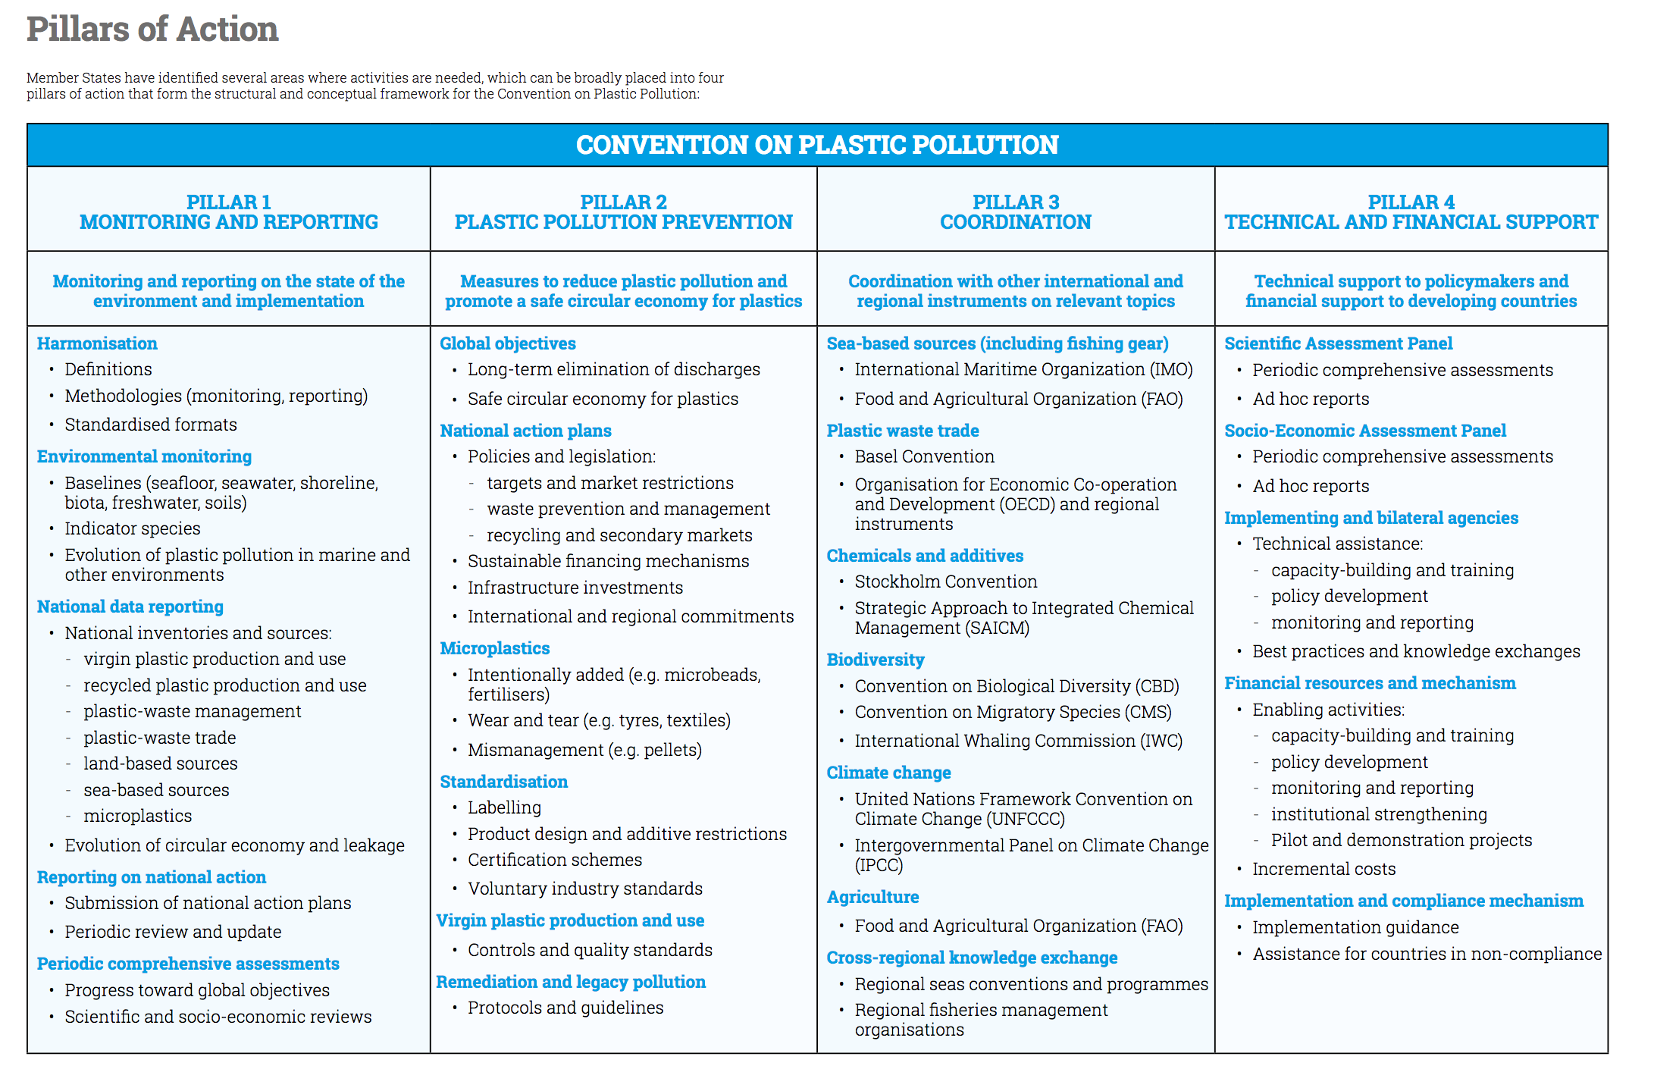

Notes:
The Science article, and the architecture proposed by CIEL and EIA agree that a start and strengthen approach is needed. This would start with well-designed national plastics pollution prevention plans or N4Ps with time bound and measurable targets. Some of the key elements needed in N4Ps and reflected in this table include standardized testing protocols, monitoring and reporting as well harmonized definitions.

Slide 10
Indirectly related to trade related measures
Need of trade related measures/policies
Notes:
Acknowledgement here goes to Andres Del Castillo (CIEL) for this slide which emphasises the direct and indirect need for trade controls as core to an ambitious and effective plastics treaty.

Slide 11
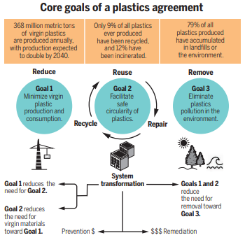
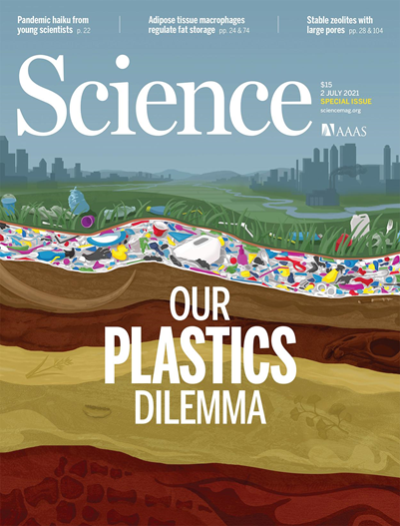
Notes:
The Science article presents three core goals for a plastics agreement. If we prioritise the first goal of minimizing virgin plastic production and consumption, we will reduce the need for Goal 2 safe reuse of plastics and Goal 2 removal and remediation and thus avoid the higher financial burden of Goals 2 and 3.

Slide 12
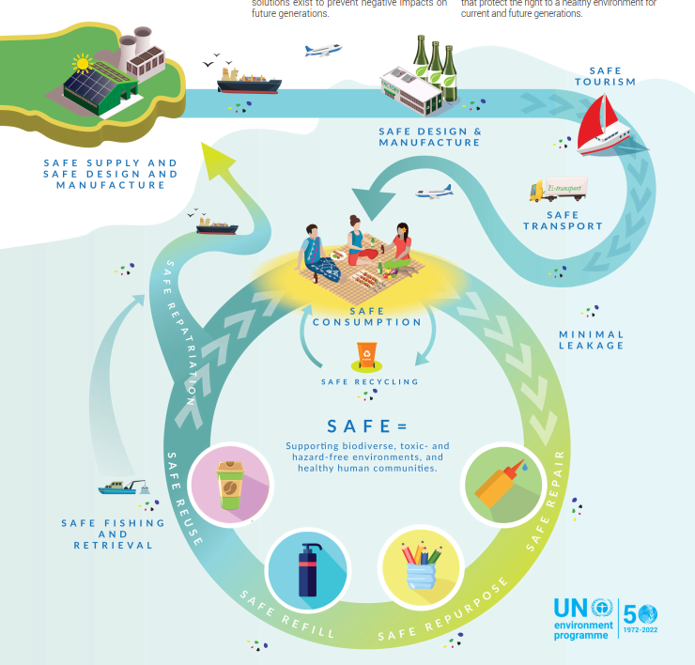
Notes:
We designed a safer circular economy for the Pacific Islands region in which plastics are minimized. This may serve as a useful reference for other, particularly small island developing states, that are revising their policy frameworks toward a rights-based and safe circular economy and one that may contribute to a start and strengthen approach to a plastics treaty.

Slide 13
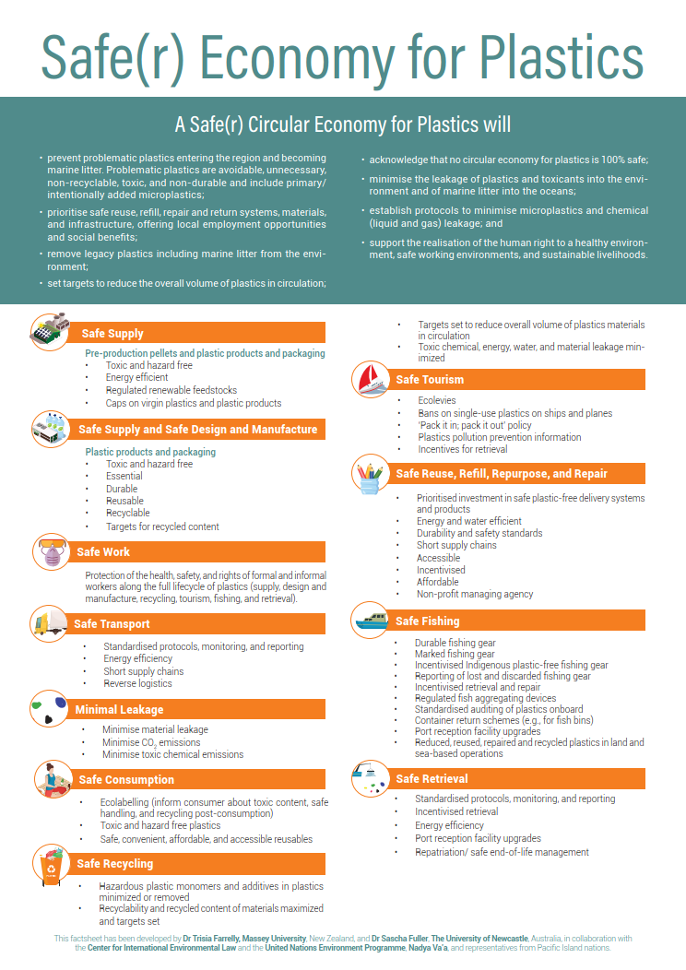
Notes:
The key elements include safe supply, design, manufacture, work, transport, minimization of leakage, consumption, safe reuse, refill, repurpose, and right to repair systems, fishing and retrieval and remediation. Perhaps one of the key and unique elements of this design is the recommendation for the repatriation of plastics that cannot be safely and responsibly management in the region – back to the point of production through extended producer responsibility schemes. As plastics are not produced in the Pacific Islands, these would all be removed from the region at end of useful life.

Slide 14
Key differences
Rwanda-Peru
Mandate
Open mandate
Scope
Plastic pollution
Life cycle approach
Structure
Strong institutional framework
Japan
Mandate
Closed mandate
Scope
Marine plastic pollution
Downstream focus
Structure
Weak instructional framework
Notes:
There are now two concrete proposals to start negotiations in the form of resolutions for UNEA5.2. Both resolutions propose to convene an INC but with stark differences in the mandate and overall vision:
Peru and Rwanda have jointly submitted a draft resolution that is commensurate with the gravity of the plastic pollution crisis, which resulted from a consultative process engaging many countries. The resolution proposes a comprehensive vision for addressing the problem, taking a full lifecycle approach. As of November 2021, it had 42 co-sponsors. The resolution sets out an open mandate for the INC to negotiate a complete international framework and supportive institutional structures, including financial and scientific mechanisms and coordination with existing instruments. ← this resolution has widespread support among civil society organizations.
In contrast, the Japan Resolution represents a step in the wrong direction. The parameters it proposes for the INC are inadequate, in that it proposes a closed mandate. This would mean the INC would not be able to consider relevant aspects that are not already explicitly named in the mandate. The contemplated interventions further lack ambition and effectiveness, as they focus exclusively on reducing marine plastic pollution, relying only on downstream measures of waste management to achieve its limited objective. This resolution also conspicuously deletes references to achieving sustainable production and consumption of plastics as well as to addressing product design and use. Ultimately, this resolution risks watering down the Rwanda-Peru resolution.
We are asking countries to endorse the ambitious resolution proposed by Rwanda and Peru because this is the only proposal that includes parameters for discussing the comprehensive and complex elements that will need to be decided by our governments to reduce toxic harms, reduce plastic pollution in our environment, and save lives.
Unlike the Japan Resolution, the Rwanda-Peru Resolution go beyond marine and sea-based plastic pollution to address plastic pollution in all environments.
The Rwanda-Peru Resolution takes a full lifecycle approach rather than continuing to focus on downstream solution – an approach all-to-well-proven to be dismally globally ineffective.
The Rwanda-Peru Resolution also sets out an open mandate for the INC to negotiate a complete international framework and supportive institutional structures, including financial and scientific mechanisms and coordination with existing instruments. This resolution has widespread support among civil society organizations.
Key differences:
Open Mandate vs Closed Mandate (mandate). The Rwanda-Peru resolution contains more specific guidance on the elements and design of an effective treaty while also containing an open mandate whereby the INC may “consider any other aspects that the intergovernmental negotiating committee may consider relevant.” The Japan resolution deletes important aspects on elements and design while also containing a closed mandate whereby the INC is not allowed to consider other relevant aspects, thus significantly undermining the ability of the INC to prepare an effective treaty.
Plastic Pollution vs Marine Plastic Pollution (scope). The Rwanda-Peru resolution seek to address plastic pollution in all environments, in recognition of the need to address all sources of plastic pollution. The Japan resolution focuses only on “marine plastic pollution.”
Lifecycle Approach vs Downstream Focus (scope). The Rwanda-Peru resolution promotes a full lifecycle approach with interventions envisioned on production (upstream), product design (midstream) and waste management (downstream). The Japan resolution, despite using the word “lifecycle” several times, envisions the focus being on downstream interventions, e.g. monitoring discharge in the marine environment, goal of reducing additional marine plastic pollution by 2050, national action plans that by their nature will predominantly contain measures on waste management. The Japan resolution even explicitly deletes OP2(b) on sustainable production and OP2(c) on product design from the Rwanda-Peru resolution, which is at complete odds with AHEG discussions and the ministerial statement.
Strong Institutional Framework vs Weak Institutional Framework (structure). The Rwanda-Peru resolution requests consideration of key aspects related to the institutional framework, including a financial mechanism and scientific and socio-economic body to support implementation of the treaty. The Japan resolution deletes this consideration for no apparent reason

Slide 15
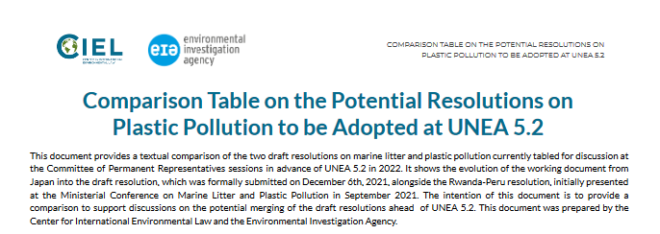
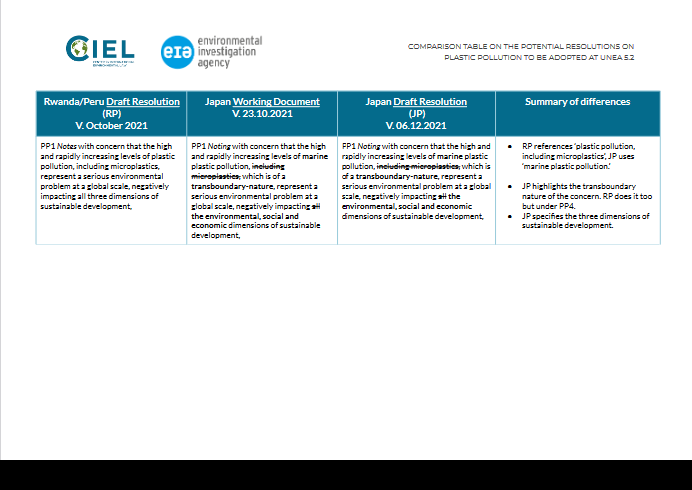
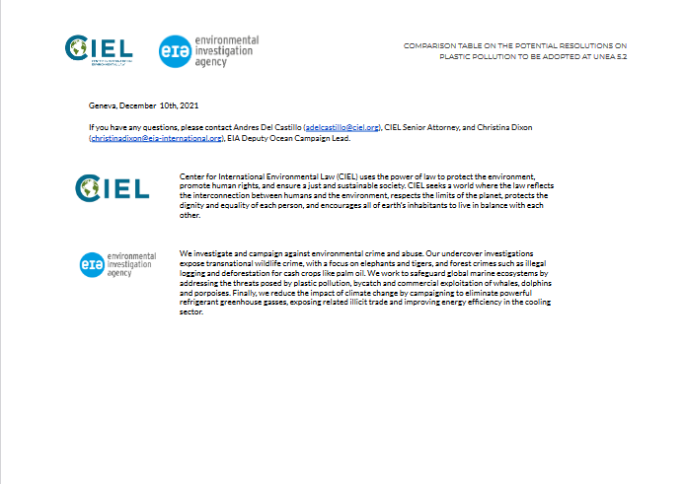
Notes:
Please contact Andres Del Castillo at CIEL or Christina Dixon at EIA for the Comparison Table.

Slide 16

Prevention is better* than cure
* safer, cheaper, responsible, ethical
Notes:
A global agreement with a clear vision and ambitious objectives and measures is urgently needed to achieve the reduction and progressive elimination discharges of plastics and their associate toxic chemicals into the environment. Such an agreement would complement and enhance existing international instruments would avoid duplication of efforts.

