Slide 1
A cross country analysis of social justice in assessment
Dr Jenny Poskitt, Massey University, NZ
Dr Lenore Adie, Australian Catholic University
Prof Louise Hayward, Glasgow University, Scotland

Slide 2
Overview
Social justice expects equitable voice and participation of all
Assessment policies imply spaces for student voice and participation
But tensions arise when compared to reporting policy and procedures in each country
Suggestion of potential ways forward (bridging the gap between intent and enactment of social justice in assessment)

Slide 3
Questions
What do assessment policies in Australia, New Zealand and Scotland say about student voice and participation?
What happens in policy enactment of assessment reporting?
What do Robinson and Taylor’s (2007) core values of student voice contribute to understanding student participation in assessment reporting, particularly student led conferences?

Slide 4
Theoretical framework
Robinson & Taylor (2007, p.8) four core values of student voice
A conception of communication as dialogue
Dialogue enables development of shared understanding
The requirement for participation and democratic inclusivity
Participation and democratic inclusivity require all voices to be listened to; and acceptance of diversity
The recognition that power relations are unequal and problematic
Equal power means equitable opportunities to actively express ideas and to shape consequences
The possibility for change and transformation
Transformation actively seeks (student) voice, takes it seriously and uses it to creatively solve problems

Slide 5
Comparison of national ‘aspirational’ documents
Robinson & Taylor (2007 ) | Australia (Melbourne Declaration, 2008; ACARA, 2012) | New Zealand (MOE, 2011) | Scotland (Scottish Govt, 2011)
Communication as dialogue | “Share with parents & communities to …ensure common understanding” (ACARA, 2012,p.3) | “Reciprocal learning conversations between school & whānau” (p.14) | “Discuss with learners (p.18)…& parents as partners about learning & assessment” (p.34)
Participation and democratic inclusivity | “Need to engage indigenous students, their families & communities” (MD, 2008, p.15) | “Inclusive approach that responds to diversity” (p.18) | “Learners should be engaged in all aspects of assessment processes …[with] choice & personalisation…”(p.18)
Equitable power & opportunities to express views | “Increase indigenous participation… & support students… and their families…” (ibid, p.15) | “Student-centred” Encourage partnerships with whānau” (p.18) | “Parents are fully involved where children and young people need additional support” (p.50)
Possibility for change and transformation | “targeted support… and more equitable outcomes” (ibid, p.15) | “All participants to use assessment for benefit of every student” (p.17) | Assessment is used to support learning & promote learner engagement (p. 7)

Slide 6
Comparison of reporting policies/guidelines
Robinson & Taylor (2007 ) | Australia | New Zealand (MOE, 2011) | Scotland (Scottish Govt, 2011)
Communication as dialogue | “… accurate and objective assessment of the student’s progress and achievement: against any available national standards” (AER 2013, ss 59.4) | “Parents/whānau receive meaningful information to support their child’s learning…” (p.29) | Parents are informed about any gaps in their children’s progress & ways that they can help.” (p.50)
Participation and democratic inclusivity | “… relative to the performance of the student’s peer group” (AER 2013, ss 59.4) “reports developed in consultation with parents” (NSW DEd, 2016) “parents as participating in the reporting process (Tas. DEd., 2013, 4) | “Together with teacher & child, they can identify aspects to celebrate and aspects needing attention” (p.29) | “Ensure… assessment information is used to support learning & involve learners in target setting” (p.50)
Equitable power & opportunities to express views | Learners “contribute to discussions about assessment and monitoring processes” (Tas. DEd 2013, 4) “…include self-assessment by students as part of the process of reporting to parents” (Vic. CAA, 2015) | “… as part of dialogue … parents/whānau share their own knowledge that … is [also] valued” (p.29) | “Receive regular information about their children’s strengths, progress & achievements” (p.50)
Possibility for change and transformation | Through states | “To encourage dialogue, schools should provide information that is clear & contextualised.” (p.29) | Reports inform … and create agendas for follow up discussions (p.42)
Notes:
Country assessment policies are mindful of involving teachers, parents and students in conversations in learning and assessments
· But the reporting documents largely focus on school generated information to give to parents/learners (one-way, teacher/expert voice dominating)
· Learners/parents passively receive the written information from schools (no voice)
However, in the NZ and Scottish contexts, and some Australian states, the written reports are often used as vehicles for generating discussions with parents/learners afterwards at formal or informal SCLs.

Slide 7
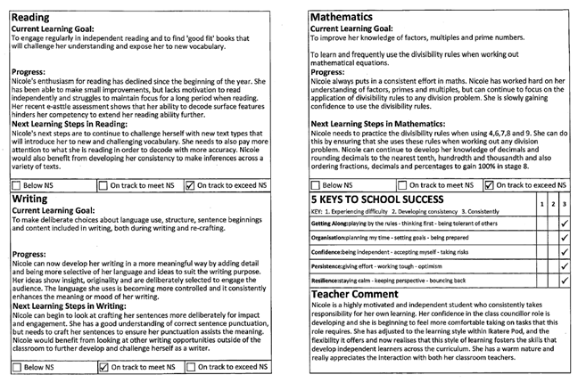
Example of written report

Slide 8
Deeper understanding and application of assessment principles
  Letter and spirit of formative assessment
  Feedback as a dialogic process
  Moving from summative to formative uses of reporting

Slide 9
Theoretical ways forward - Student Voice Lundy (2007)
    Space to express a view
    Coaching to communicate their learning
    Audience to hear views
    Action on views expressed
Notes:
Who owns the data? Is it private?

Slide 10
Potential pathways to enacting social justice in assessment reporting
  Increased parental and student participation
  Increased accountability of students for learning
  Improved student-teacher partnerships
Student led conferences
–enabling socially just assessment reporting
Notes:
In SLCs, and other supplementary reporting mechanisms (like sharing blogs, access to student portfolios, school websites etc parents can view more information).

Slide 11
Realities of student-led conferencing
cultural and language barriers
privilege dominant culture and educated families
unequal and problematic power relations
Notes:
Teachers lack awareness of their positions of power, social & cultural assumptions; especially limits opportunities for ethnic minorities (Bishop & Berryman, 2006)
NZ case study (McFee, 2012). Built on respecting cultural identity of students/families. Led to increased family involvement
Real responsibility for learning occurs only when there are equitable relationships and talking opportunities Tholander (2011)
More open, conversational communication generated when students lead the conference (Tholander, 2011).
Partnerships develop when SLC is co-constructed between teacher and student: from planning, to facilitating discussion, and selecting evidence of learning (Cleland,1999; Hackmann et al.,1998; Kinney, 2005)

Slide 12
Conclusions for social justice
Reconceptualise
reporting
communicating
assessment
progressing learning
teacher ownership of data
participation and inclusiveness
mutual partnership
expertise of teacher, student, and family
reinterpretation through dialogue

Slide 13
References
ACARA (2012). Assessment and reporting: Improving student performance. Sydney, Australian Curriculum, Assessment and Reporting Authority.
Australian Education Regulation 2013 (Cth). Compilation No. 3, August 25, 2015. <https://www.legislation.gov.au/Details/F2015C00747> (21 July 2017)
Lundy, L. (2007). ‘Voice’ is not enough: conceptualising Article 12 of the United Nations Convention on the Rights of the Child. British Educational Research Journal, 33(6), 927–942. https://doi.org/10.1080/01411920701657033
Ministerial Council on Education, Employment, Training and Youth Affairs (2008). Melbourne Declaration on Educational Goals for Young Australians
MOE, (2011). Ministry of Education Position Paper: Assessment [Schooling Sector]. Wellington, NZ: Learning Media Ltd.
New South Wales Department of Education. 2016. Curriculum planning and programming, assessing and reporting to parents K-12. https://education.nsw.gov.au/policy-library/policies/curriculum-planning-and-programming,-assessing-and-reporting-to-parents-k-12
Robinson, C., & Taylor, C. (2007). Theorizing student voice: values and perspectives. Improving Schools, 10(1), 5–17. https://doi.org/10.1177/1365480207073702
Scottish Government. (2011). Curriculum for Excellence Building the Curriculum 5 a framework for assessment. Edinburgh, Scottish Government.
Tasmania Department of Education. (2013). Curriculum, Moderation, Assessment and Reporting Policy K-12.” https://documentcentre.education.tas.gov.au/Documents/Curriculum-Moderation-Assessment-Reporting-Policy.pdf
Victorian Curriculum and Assessment Authority. 2015. Victorian Curriculum F–10 Revised curriculum planning and reporting guidelines. http://www.vcaa.vic.edu.au/Documents/viccurric/RevisedF-10CurriculumPlanningReportingGuidelines.pdf

