Slide 1
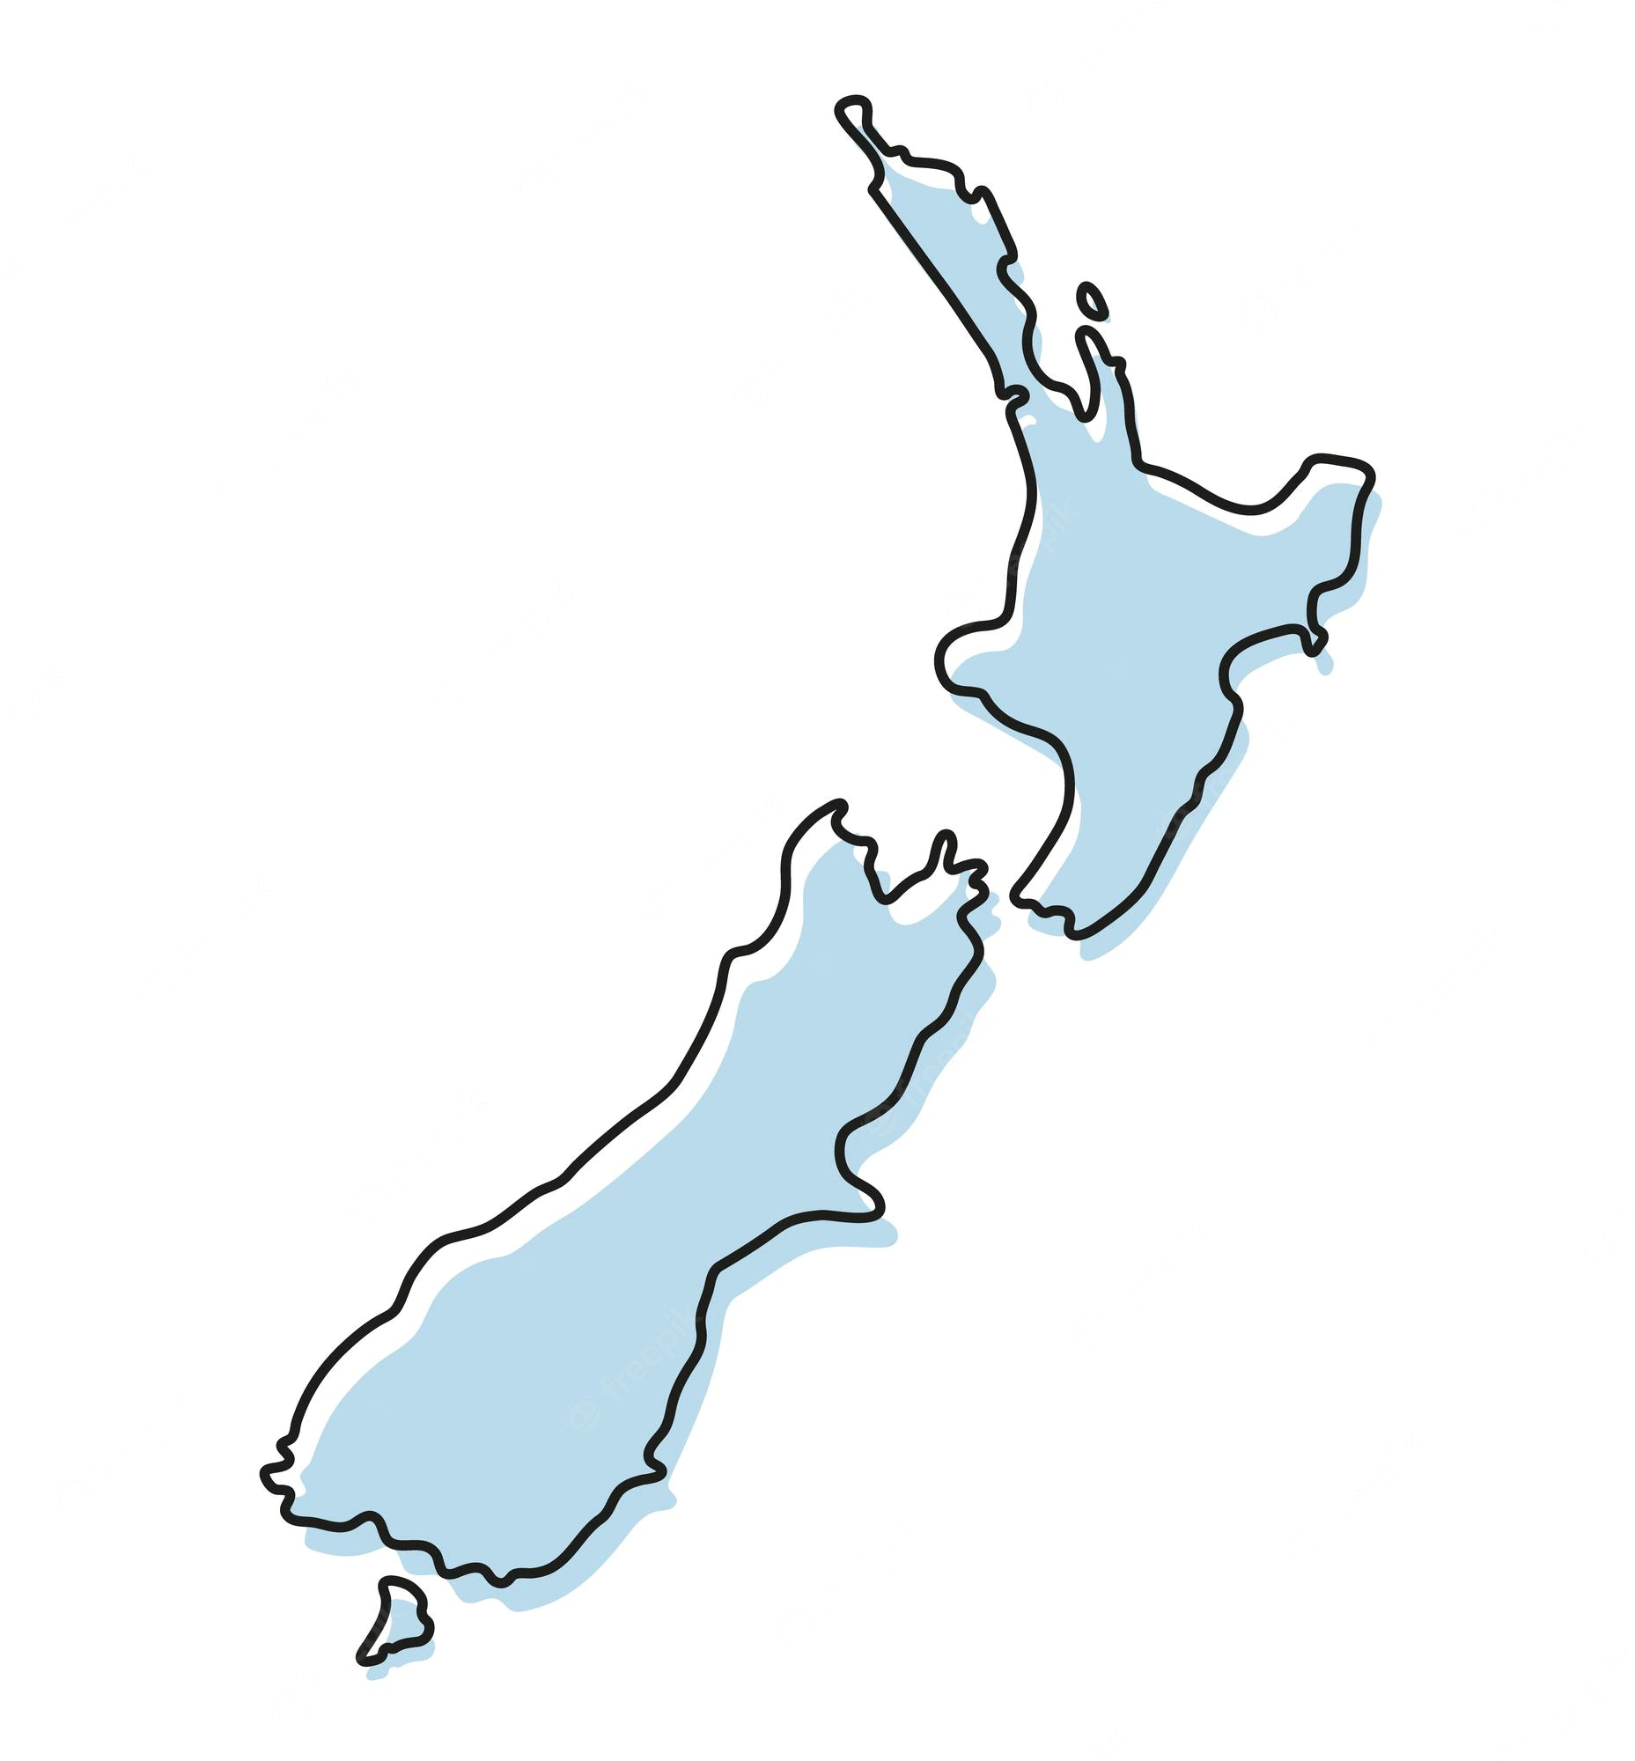

Live Music Recovery
Reflections on the Aotearoa experience

Slide 2

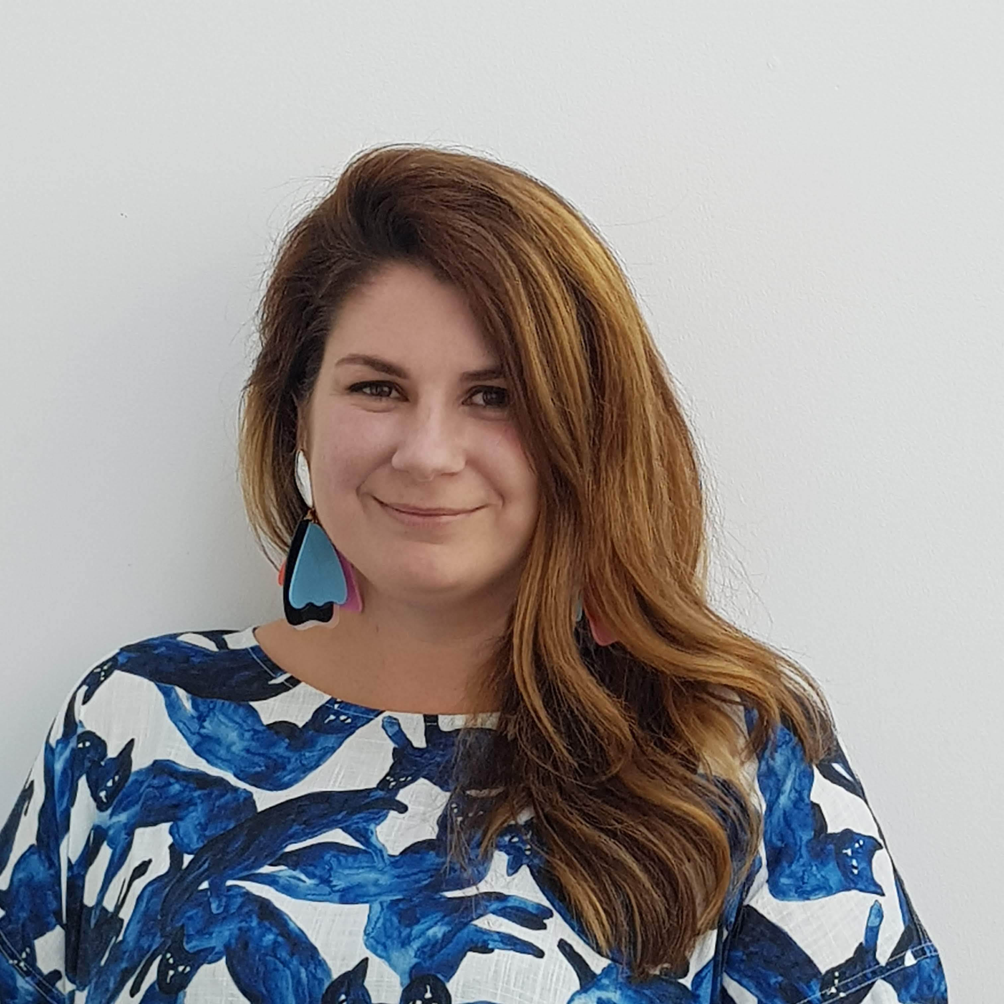
Associate Professor Dave Carter
Music Industry, Te Rewa o Puanga School of Music and Creative Media Production
Dr Catherine Hoad
Critical Studies, Te Rewa o Puanga School of Music and Creative Media Production

Slide 3
What we’ll try cover today
The music industry landscape in Aotearoa
Music careers and experiences
Challenges of the NZ context
Amplify Aotearoa
Aotearoa Live Music Recovery
What we’ve learned along the way

Slide 4




Aotearoa’s music industry
In 2022, the New Zealand music industry directly contributed NZ$350m to the national GDP, and $720m in total (after accounting for multiplier effects) (PWC, 2023).
The industry contributes around 2,250 direct full-time equivalent (FTE) jobs, and around 4,900 FTEs in total (once indirect and induced jobs are included). (PWC, 2023).
Locally-generated content accounts for just over 30% of the economic contribution of the New Zealand music industry.
There is no consolidated point of contact or representative voice – rather a fragmented cross-section of bodies that do (and don’t) engage with one another in complex ways….

Slide 5




















Government
Royalty Collection/
Copyright Management
Collectives/Guilds
Advocacy/Support

Slide 6




Slide 7
What do music industry careers look like in Aotearoa?

Slide 8



The Basic Landscape…
The estimated average annual income for performing artists was around NZ$34000 in 2019 (MBIE), slightly below the national average.
The music industry in Aotearoa directly employs around 2250 full-time equivalent roles, and about 4900 FTEs in total, including indirect/induced roles. (RMNZ/PWC, 2023).
The biggest employers are live performance and radio broadcasting - these account for about 3600 FTEs (RMNZ/PWC, 2022).
Musicians in Aotearoa commonly undertake portfolio careers – Amplify Aotearoa respondents worked in four different roles on average (Hoad and Wilson, 2020).
Musical earning is frequently supplemented by income from non-musical activities: only around 16% of Amplify Aotearoa respondents were able to earn all of their income through music-making (Hoad and Wilson, 2020).

Slide 9
The core challenges…
Aotearoa is a relatively small market in global terms, situated at a long geographic distance from the music industry’s ‘traditional’ centres.
There is limited infrastructure in terms of both physical spaces, but also employers, and systemic resourcing/funding.
Music industry bodies often situate Aotearoa as a coincidental market with Australia (e.g. Spotify Aus-NZ)
Aotearoa’s live music industry is very heavily dependent on international touring artists, and the sector suffered greatly during COVID lockdowns.
Notes:
A lot of the struggles aren’t unique to Aotearoa – music industry employees worldwide are often in precarious working situations with limited income.

Slide 10
What role do universities play?
Notes:
Our research backgrounds are concerned with the social, cultural, political, and economic conditions of music-making, and the opportunities and experiences of people who make and support music.

Slide 11


There are eight universities in Aotearoa – music qualifications are offered at six of these.
The tertiary music landscape is generally dominated by conservatorium-style pedagogy.
Music cohorts across the country are largely populated by young, Pākehā men from high decile (i.e. wealthy) areas (TEC).
Notes:
Over a decade of enrolment data from the Tertiary Education Commission showed that women* are consistently underrepresented in tertiary music programmes across Aotearoa, as are Māori, Pacific Peoples, POC, and people from low decile schools.
There is a consistent drop off from high school, into tertiary study, and then into industry careers.

Slide 12


We wanted to know
What kind of industry are we training our students for?
What is the relationship between a lack of diversity in tertiary music cohorts, and industry outcomes?
So we looked for research on the demographics of the music industry in Aotearoa
And found out…. There wasn’t any.

Slide 13
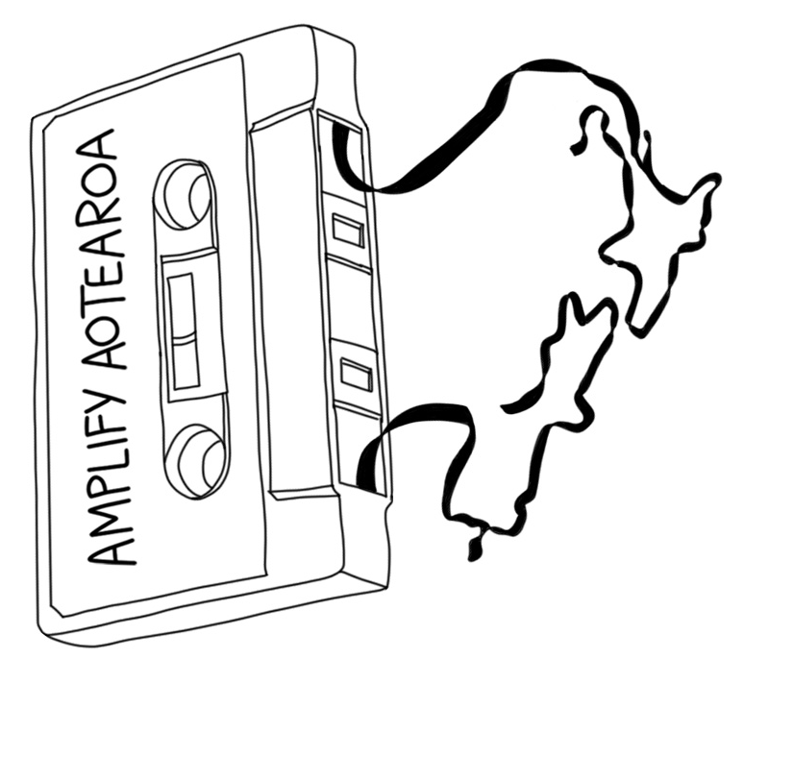
Amplify Aotearoa
Catherine Strong and Fabian Cannizzo’s 2017 report with APRA (Aus) had generated interest in Aotearoa.
AMCOS NZ agreed to partner on this research.
Awarded a small pot of funding from Massey University.
Extensive sector engagement throughout 2019.
Survey distributed online via APRA AMCOS NZ’s membership base of 12,000, and shared by other key industry bodies.

Slide 14
Our goals
Undertake a nationwide survey to gather demographic data on diversity, and experiences within the industry (using APRA AMCOS NZ members as a census population)
Understand how music-makers in Aotearoa rate access and opportunities in the music industries.
Identify key areas where diversity is strong, and others where there may be disparities.
Identify areas requiring actions and/or further research.
Encourage resourcing and support to develop best-practice frameworks for increasing diverse participation in creative industries.

Slide 17
Some suggestions we made
Our findings indicated that interventions into the culture of the music industry in Aotearoa should pursue the following outcomes:
Better representation across all genres and roles
Safer environments where music is made and shared
Fairer access to resources, support networks, and opportunities

Slide 18


Slide 19

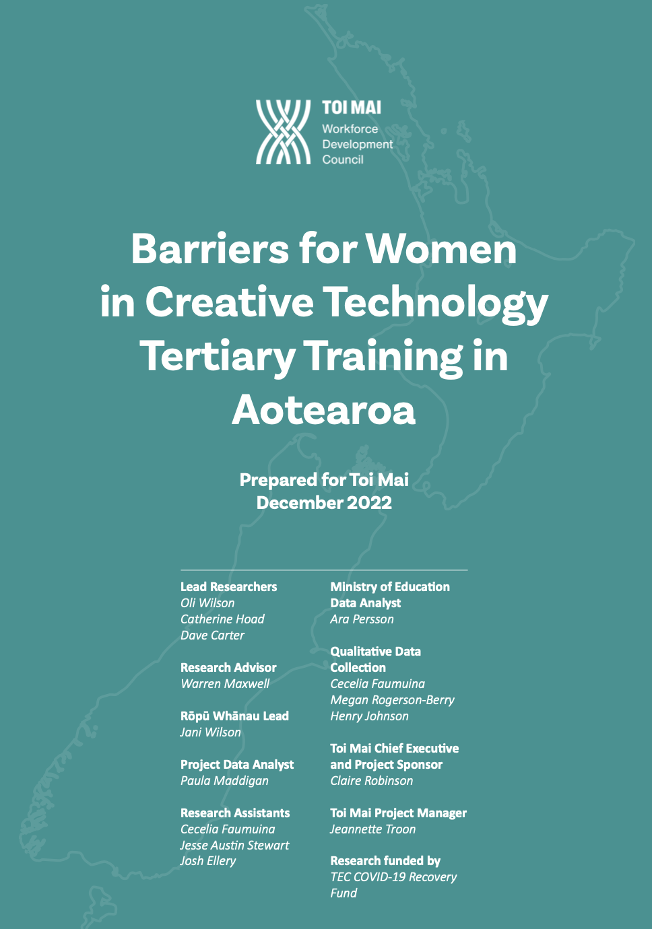



What happened after?
We were closely involved in the formation of SoundCheck Aotearoa, and continue to work with them to develop resources and support their Professional Respect Training
We’re part of advocacy groups such as Safer Spaces in Music Education to work towards better institutional practices
We were contracted by Toi Mai Workforce Development Council to research the school-to-employment ‘pipeline’ for women in creative tech areas
We received a grant from Manatū Taonga Ministry for Culture and Heritage for a project that directly supports venues to create more diverse and inclusive programming...

Slide 20
COVID-19 also happened
Yeah.

Slide 21
COVID-19’s impact on Aotearoa’s music industry
(pretty huge)
(goes without saying)

Slide 22
Te Urungi: Cultural Sector Innovation Fund
‘COVID-19 presented unprecedented challenges for Aotearoa which hit the cultural sector particularly hard. As part of the COVID-19 Recovery Budget, the Government made a landmark investment to help ensure the sector not only survives – it adapts and thrives.
…The Cultural Sector Innovation Fund was designed to support innovative projects that improve the sustainability and resilience of the sector, provide commercial opportunities, and improve access and participation’ (MCH, 2020)

Slide 23

Aotearoa’s live music sector was often an exclusory and unsafe environment for women, gender diverse folk, people with access needs, and people of colour.
Pilot studies we did during lockdowns indicated that the live sector in Aotearoa was at a crisis point – and that lockdowns had revealed longstanding, systemic, infrastructural problems with the sustainability of the sector.

Slide 24
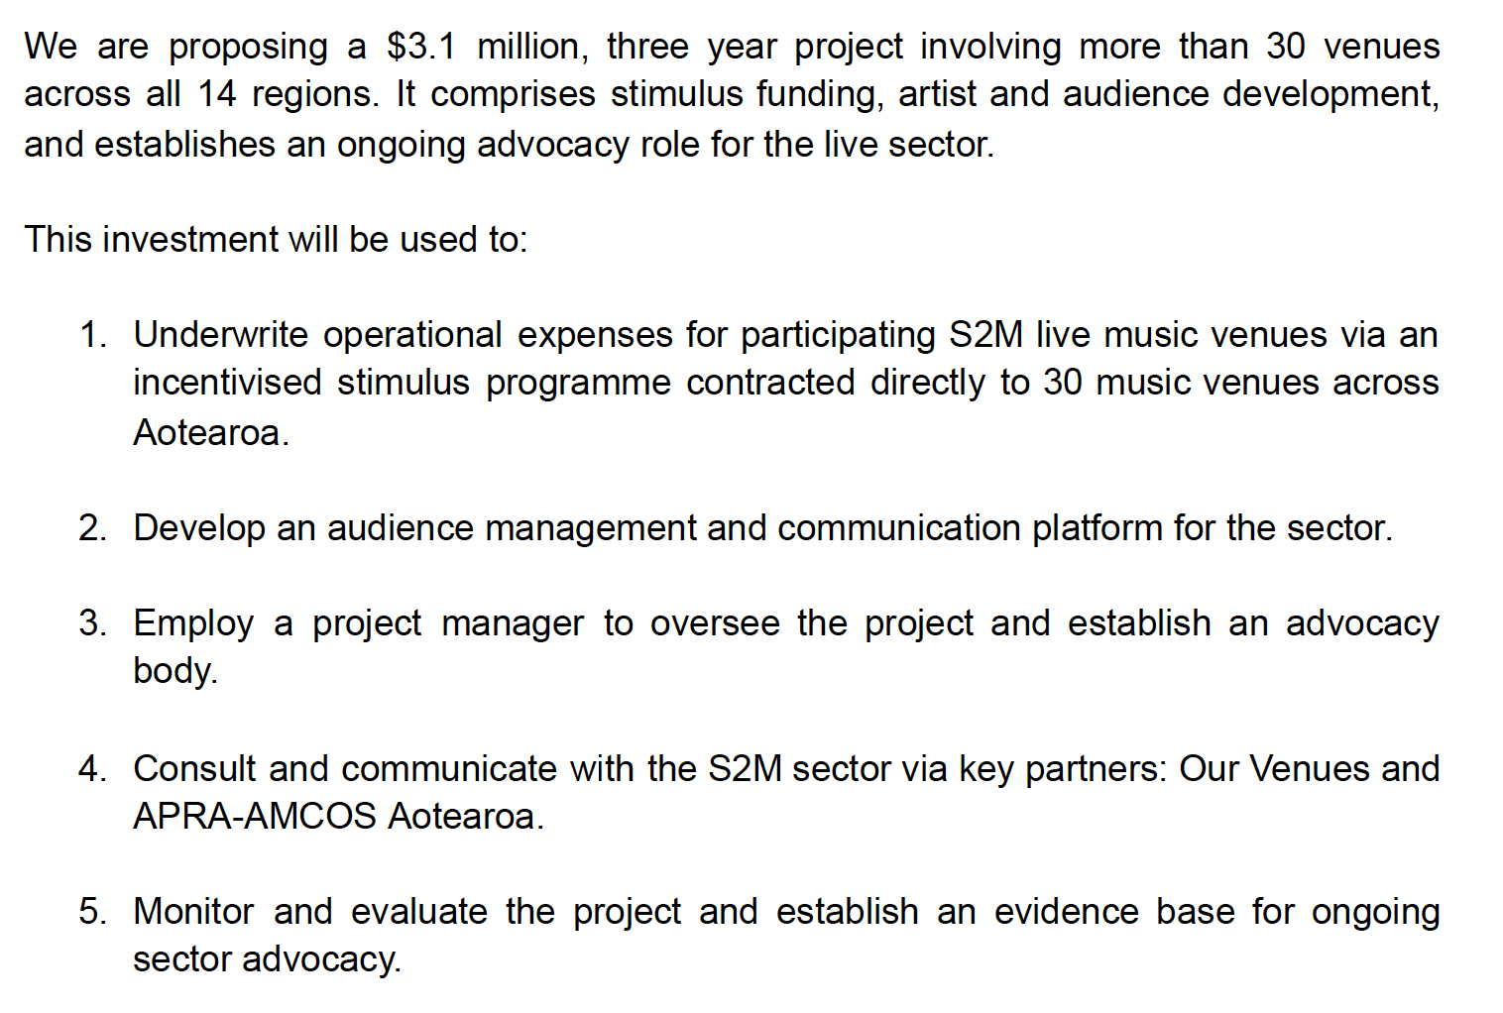
What we pitched –
Aotearoa Live Music Recovery Project
Notes:
Aotearoa Live Music Recovery is a three year project involving small to medium music venues across all 14 regions. It comprises stimulus funding, artist and audience development, and establishes an ongoing advocacy role for the live sector.
This investment will be used to:
1. Underwrite operational expenses for participating S2M l ive music venues via an incentivised stimulus programme contracted directly to music venues across Aotearoa.
2. Develop an audience management and communication platform for the sector.
3. Employ a project manager to oversee the project and establish an advocacy body.
4. Consult and communicate with the S2M sector via key partners: Our Venues and APRA-AMCOS Aotearoa.
5. Monitor and evaluate the project and establish an evidence

Slide 25
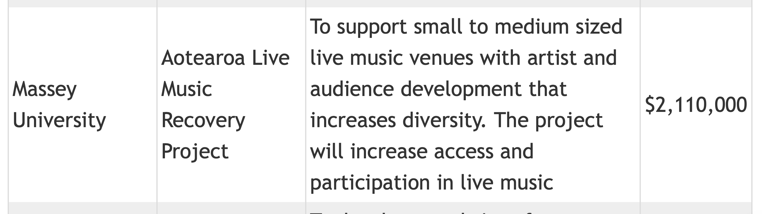
What we got

Slide 26
How it works
Eligibility: Primary purpose, independently owned, small-to-medium (<500 pax) music venues, programming original music at least 3 nights a week.
Scope: 18 small-to-medium music venues across the country receive stimulus funding in 6-monthly rounds, to support at least one night a week of diverse programming.
Personnel: A project manager, subcontracted through Our Venues, has established a central advocacy point for the venues sector.
Reporting: Venues work with the project manager to plan, make connections with communities, and report on their outcomes at the end of every 6 months.
Outcomes: Reporting is reviewed by a group of sector experts representing different industry bodies and communities.

Slide 27
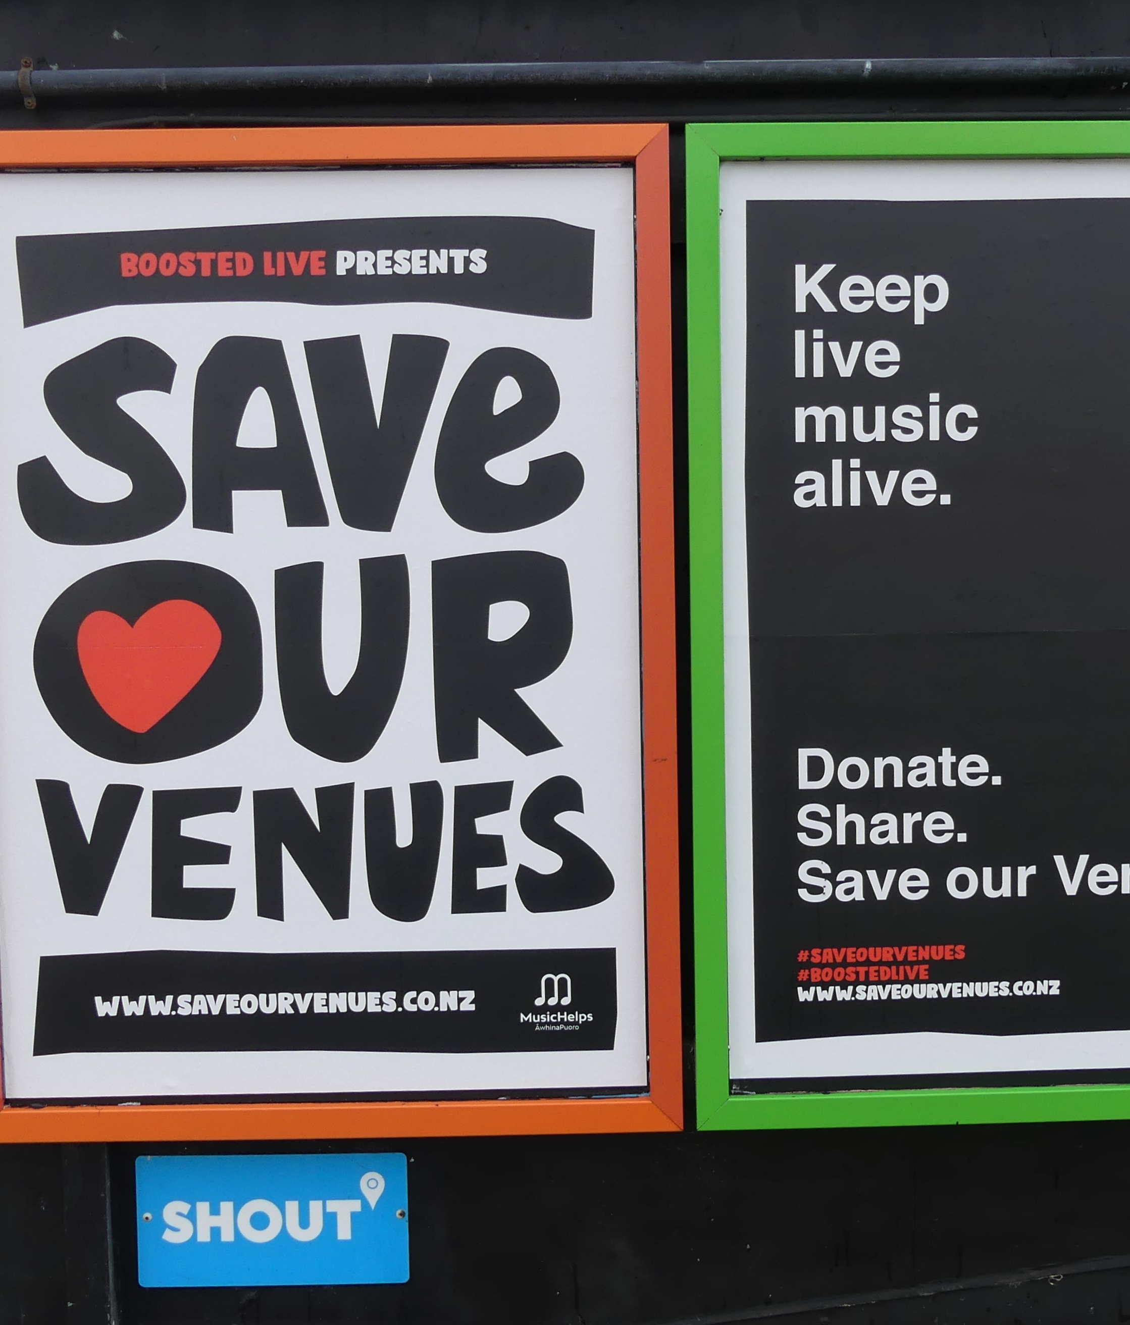
Aotearoa Live Music Recovery
Of the shows funded to June 2023 of the programme -
534 shows (53.8%) featured women and gender diverse artists (up 3.8% from Stage 2, and 6.8% from Stage 1)
363 shows (36.6%) featured Māori and Pacific artists (up 3.8%/20%)
533 shows (53.7%) featured new and emerging artists (up 11.9%/15.9%)
Across each of the 992 lineups reported on, 86.2% of shows had at least one of the above demographics represented.
None of the 18 venues have closed down.

Slide 28
What didn’t go to plan?
It was harder to give venues money than you’d think
It took 6 months to hire a project manager
No-one cared about audience management / profiling
We had to modify scope due to omicron lockdowns
We also had to modify scope due to devastating cyclones and flooding
Live Nation acquiring one of the venues…

Slide 29
What did go to plan?
If you fund venues like core-infrastructure they do good stuff
Advocacy works
Government has actively engaged with protecting live music
Venues are about to incorporate a member-based independent NFP org

Slide 30
Other outcomes
We’re currently working on another project with Manatū Taonga that measures and articulates the value of the live performance sector in Aotearoa
Potential change of government and changes to the tertiary sector
We’re aiming to run the Amplify Aotearoa survey again next year – 5 years on from the first study
Broader engagement from industry with government

Slide 31
Some reflections on this mahi
Universities are well-positioned to deliver big projects
Building good relationships is key
Government departments are intriguing labyrinths of mystery
Everyone has an opinion on how to do research.
Industry groups are generally pretty reciprocal
Notes:
Universities are well-positioned to deliver big projects – and we can probably be more vocal about this as a sector.
Building good relationships is key - we’ve had the most success where we’ve been present, engaged as much as we can, and made ourselves accessible.
Industry groups are generally pretty great about being reciprocal and engaging with students and research opportunities.
Everyone has an opinion on how to do research.
Government departments are intriguing labyrinths of mystery – having an excellent funding advisor within the Ministry has been invaluable.

Slide 32
Nga mihi!
c.hoad@massey.ac.nz
d.carter1@massey.ac.nz

